Slide 1
WEIR
ready!
Notes:
We’re ready! Thank you for your interest in this presentation!

Slide 2
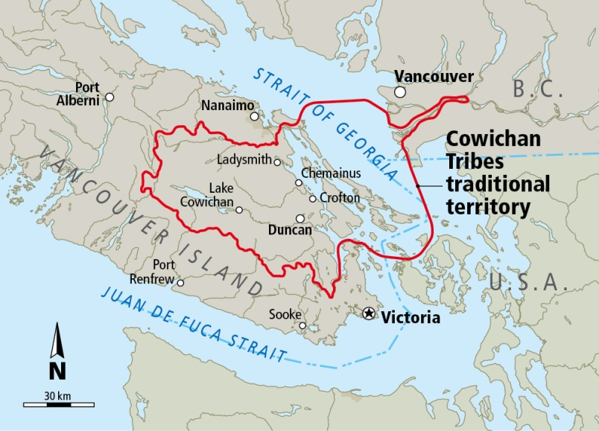
Notes:
We respectfully acknowledge that our activities take place on the lands, and on the rivers, within the Cowichan Tribes’ traditional territory. The recreational canoes and kayaks we paddle strongly reflect design features developed and perfected by Canada’s First Peoples. We are grateful!

Slide 3
Who are WE ??
WEIR Recreational
River Users!
Notes:
We’re the Island’s river-recreation enthusiasts. And, YES, it’s OK to admit you don’t even know who we are! That’s our own fault for tip-toeing quietly around, and flying beneath most people’s radar.

Slide 4
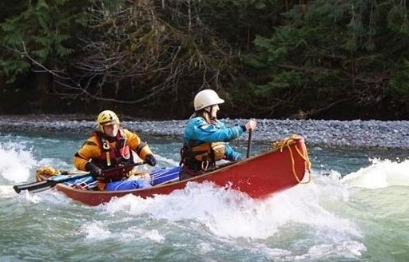
Notes:
We’re whitewater canoeists

Slide 5
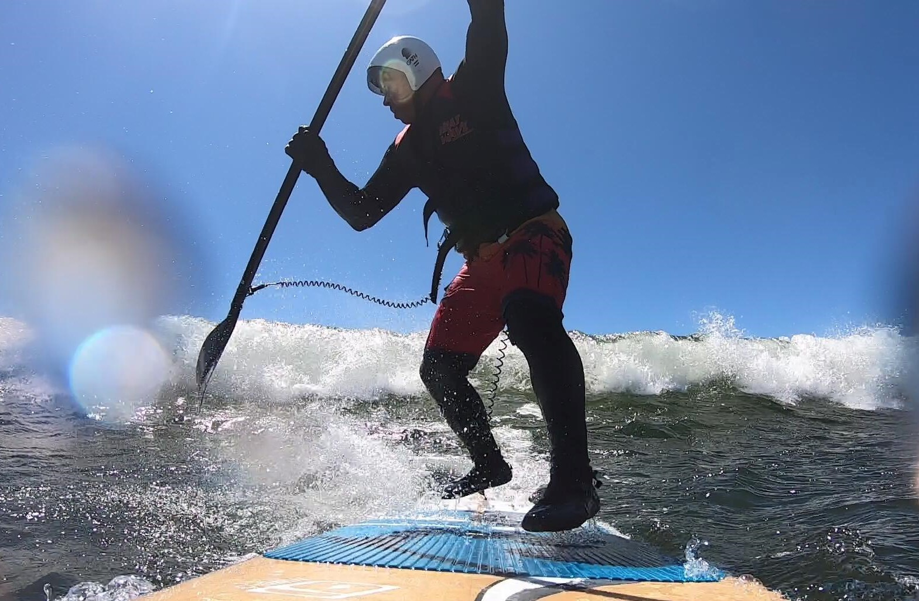
Notes:
We’re stand-up paddleboarders

Slide 6
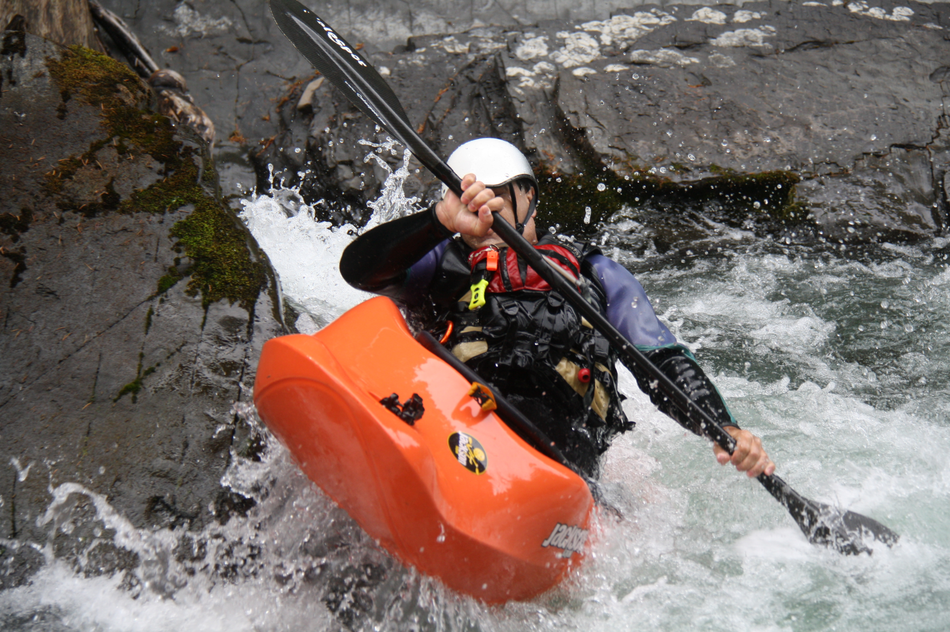
Notes:
We’re whitewater kayakers

Slide 7
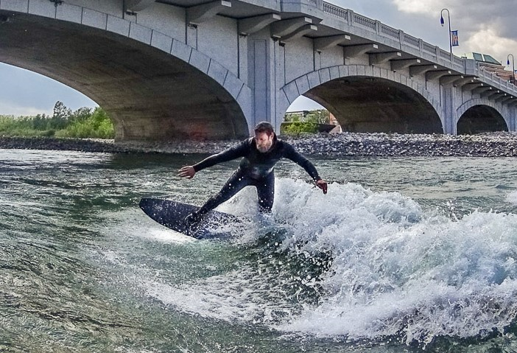
Notes:
We’re board-surfers

Slide 8
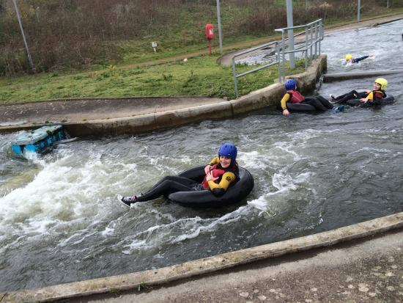
Notes:
We’re tubers.

Slide 9
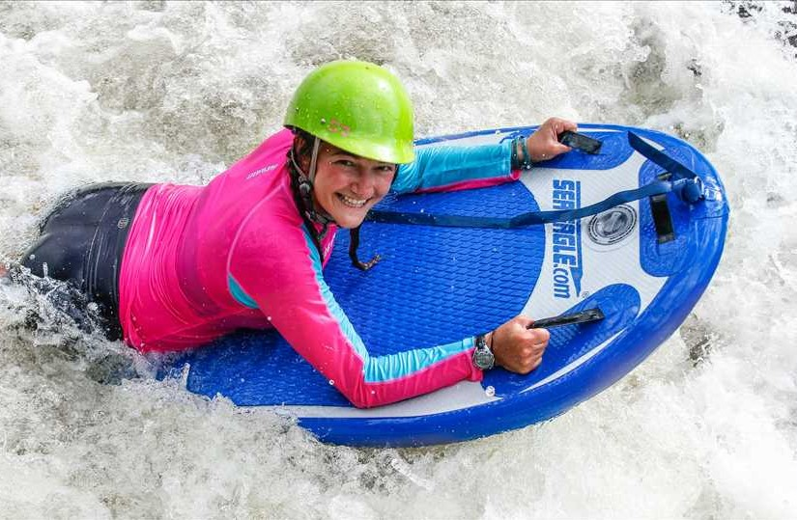
Notes:
We’re boogie-boarders

Slide 10
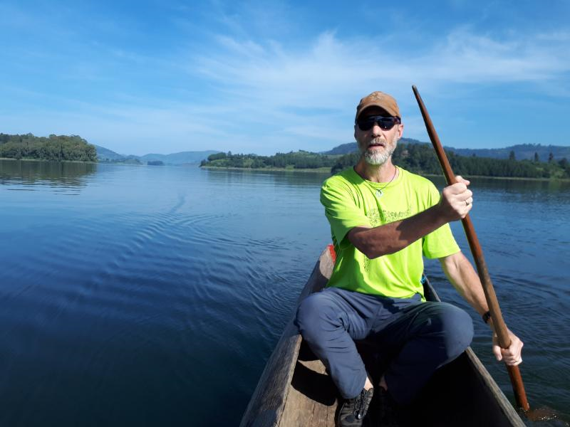
Notes:
And we’re part of the world-wide community of recreational river-users! Here’s Tom Rutherford, recreating in Africa.

Slide 11
“So-o, WHAT does ‘Recreation’
have to do with
the Cowichan Weir project ??”
(GLAD you asked!!)
Notes:
So, let’s start with this –
The COWICHAN is a designated CANADIAN HERITAGE RIVER!

Slide 12
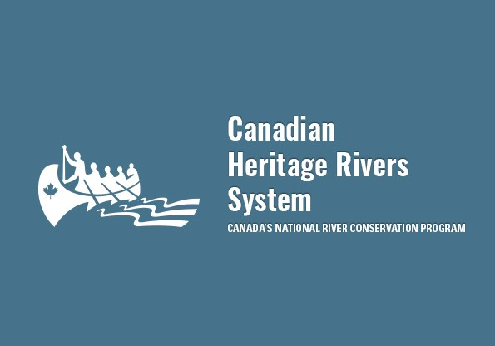
Notes:
NOTE that the CANOE and the RIVER have been chosen as symbols to represent the essence of our Canadian Heritage!
There are three criteria used for selecting a Canadian Heritage River --

Slide 13
CRITERIA FOR HERITAGE RIVER
DESIGNATION
Natural Values
Cultural Values
Recreational Values
Notes:
Sadly (in our opinion), among current Watershed Management practices, RECREATION is often overlooked. Somehow, not worthy? Superficial, perhaps? Too trivial?

Slide 14
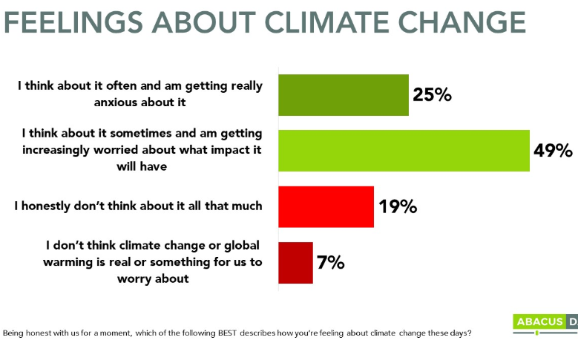
Notes:
So – think about this: Research indicates that approximately ¾ of our population experiences SIGNIFICANT STRESS when faced with climate change issues. And STRESS affects MENTAL HEALTH.

Slide 15
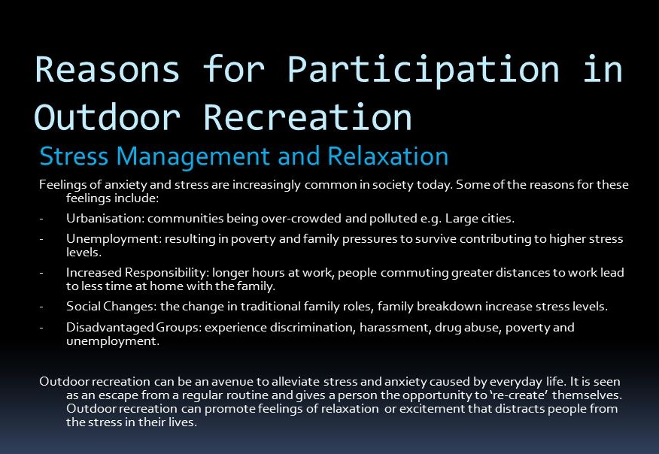
Notes:
And it’s well known that OUTDOOR RECREATION is one key strategy toward mitigating unhealthy stress in our lives.
So, MAYBE recreation isn’t quite as frivolous a topic as we thought!

Slide 16
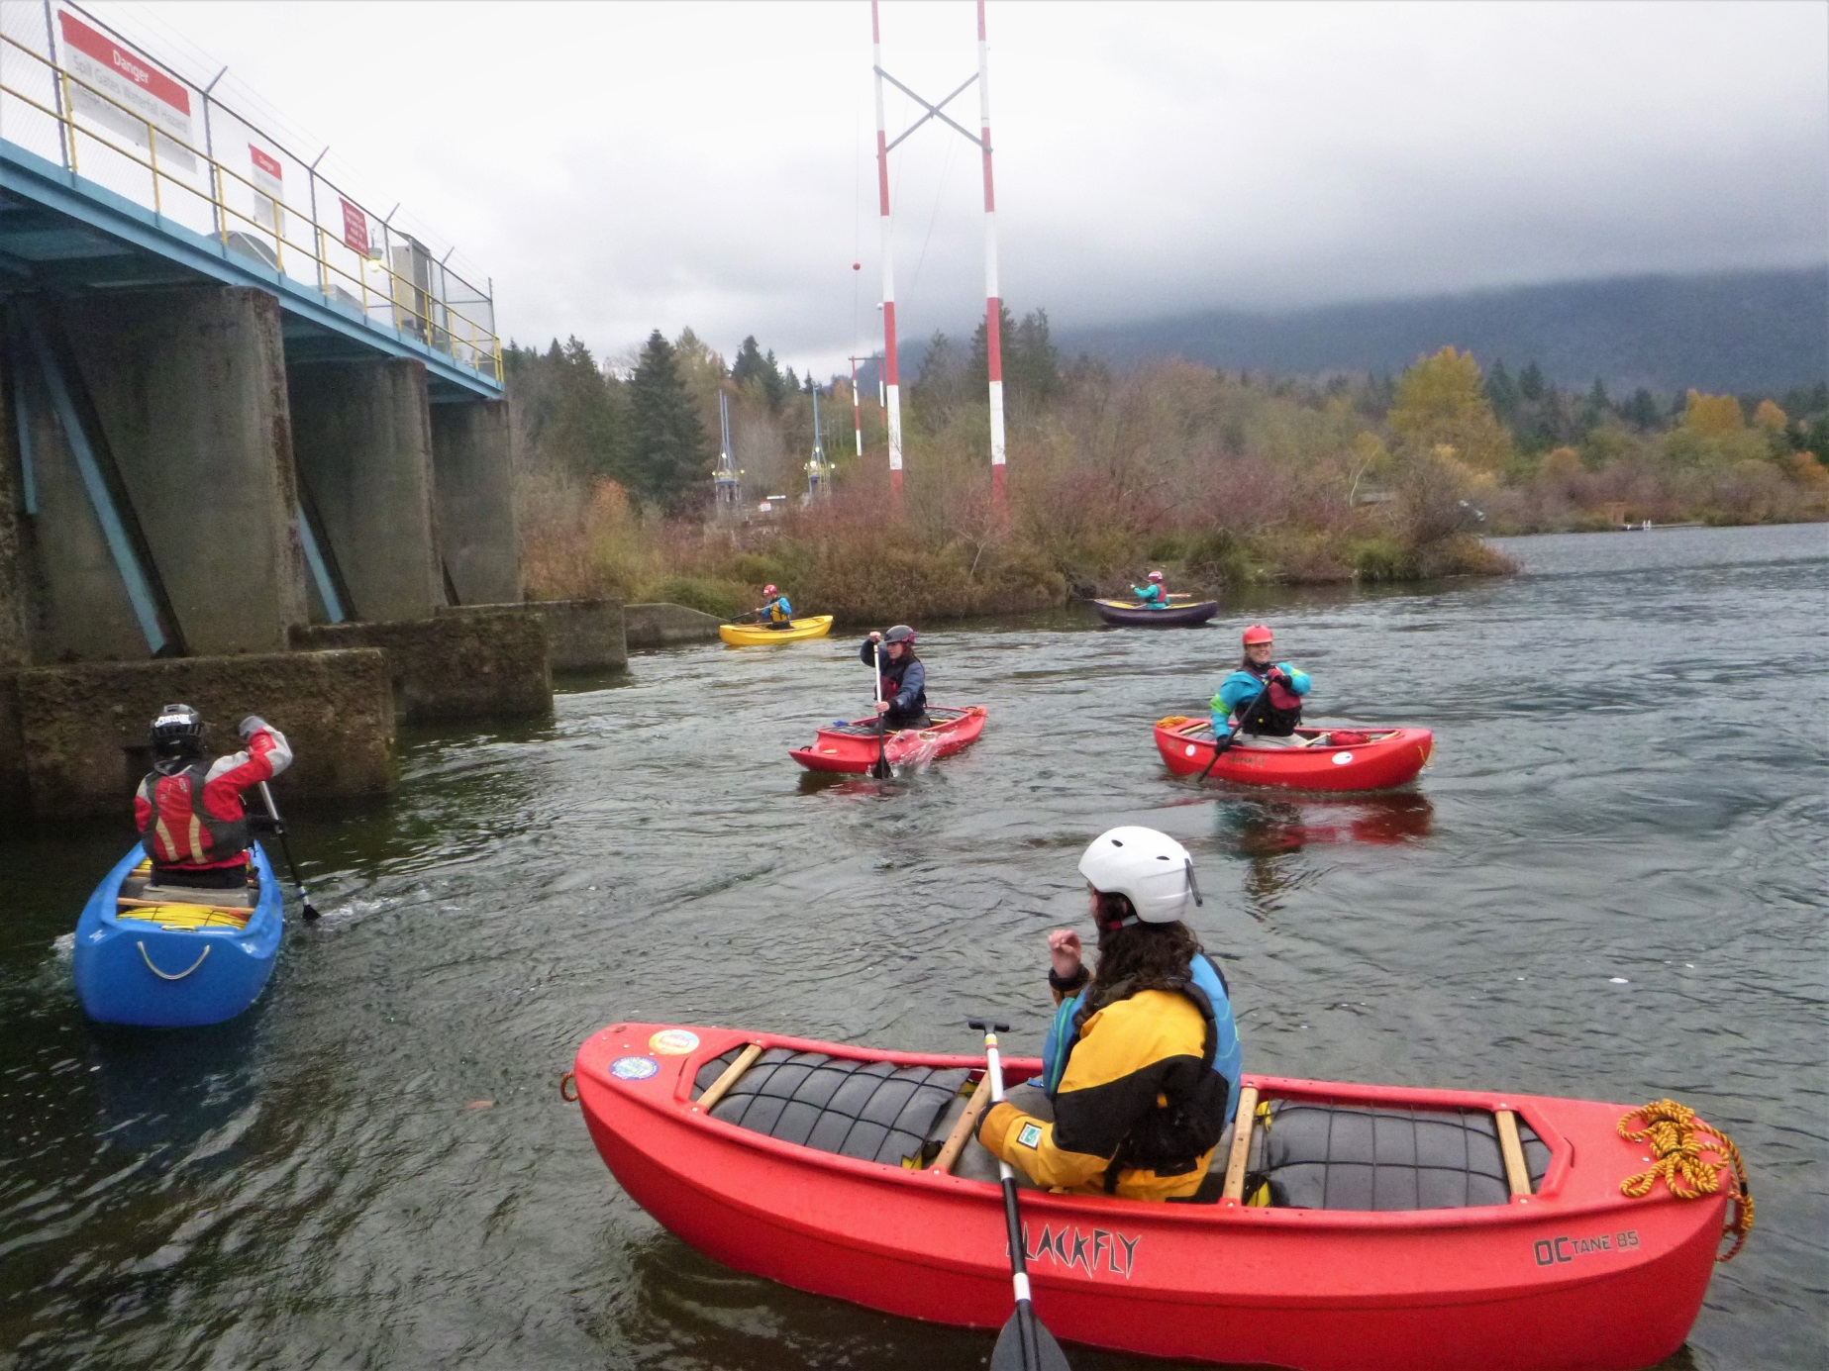
Notes:
The Recreational Paddlesport Community promotes very high SAFETY and ENVIRONMENTAL standards.
We’re well known for involving young people – the next generation of river stewards. It’s all about education!

Slide 17
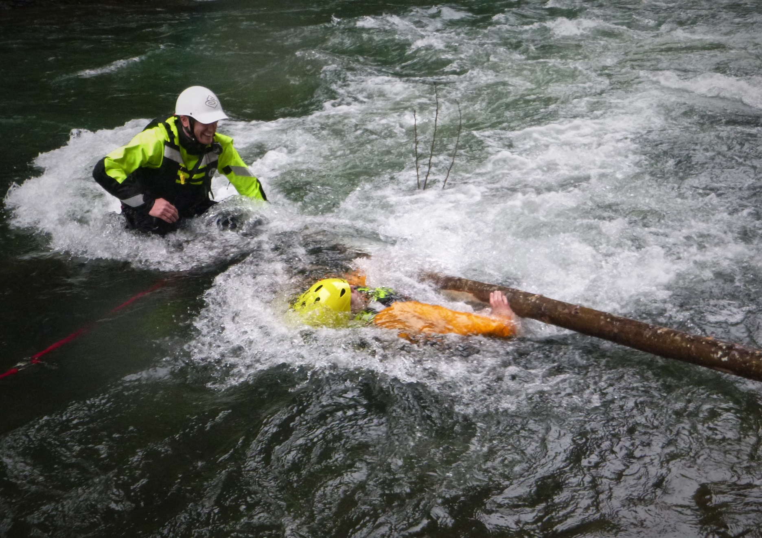
Notes:
We teach not only paddling skills, but also rescue skills.
Here’s a student learning about the importance of defensive swimming when faced with a dangerous log on the river.

Slide 18
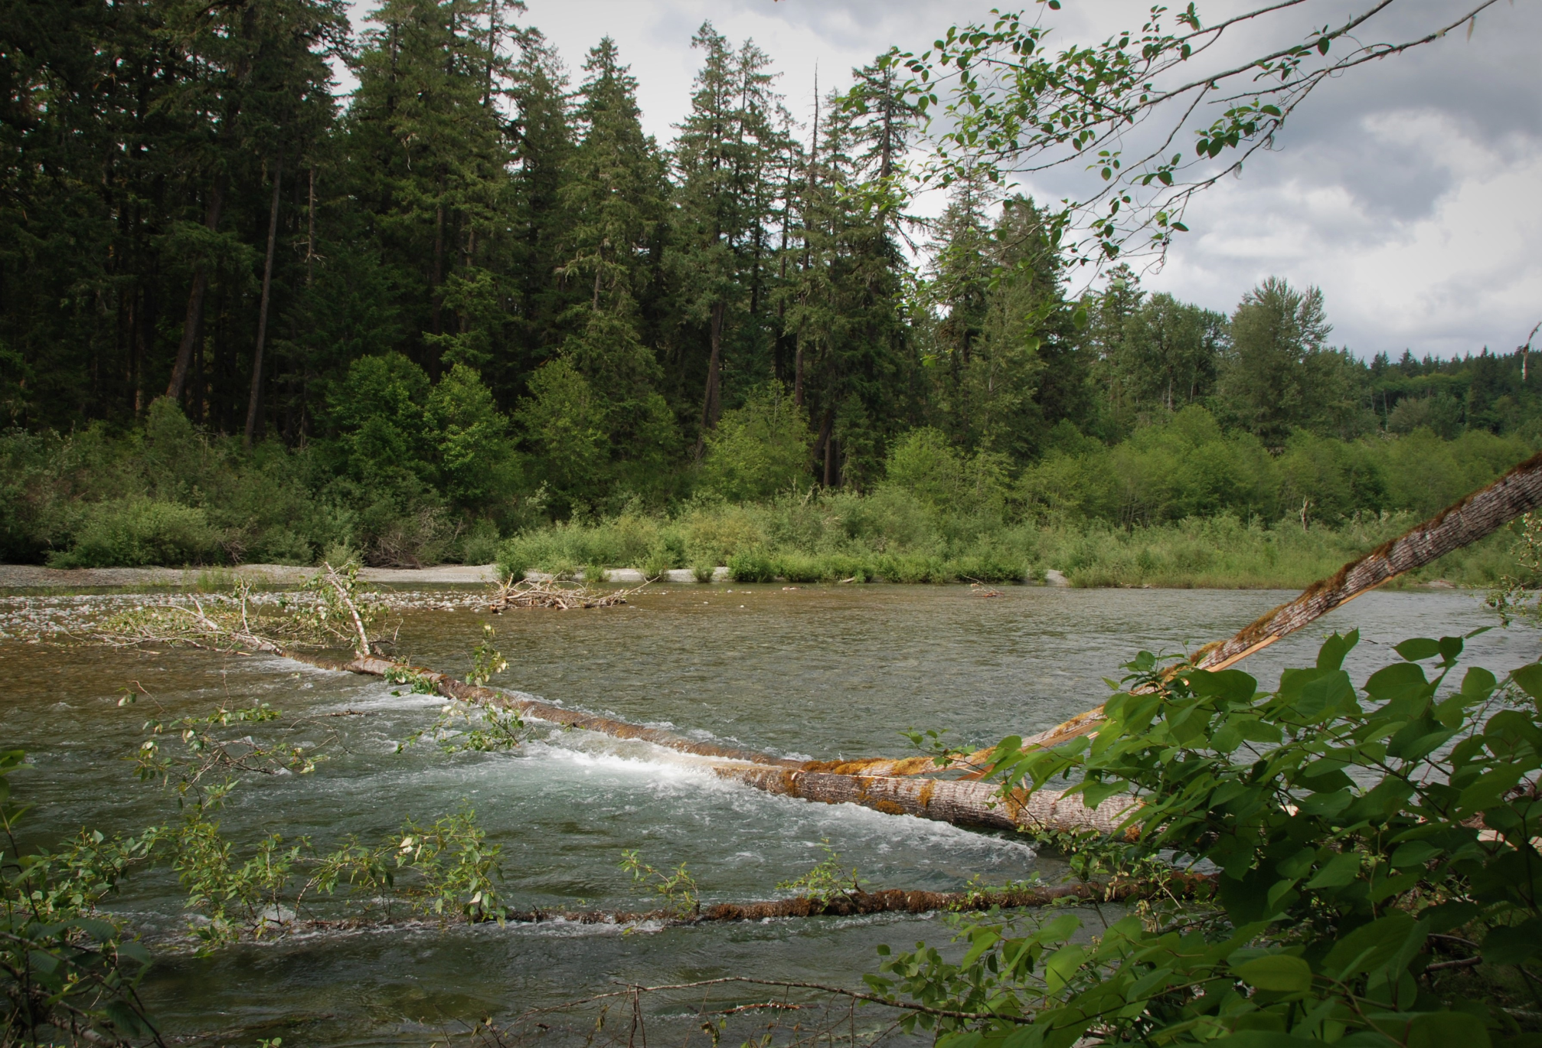
Notes:
We’re vigilant about locating and identifying hazards.
We work closely with Parks staff, and Search and Rescue personnel, to warn river users about the locations of these hazards.

Slide 19
Human-
and
Gravity-
Powered!
Notes:
We take only pictures, and we DON’T leave footprints. We don’t stir up silt. We don’t trample spawning beds. We don’t tear up riparian zones.

Slide 20
No fossil fuels were harmed in the making of this presentation
Notes:
No motors, no fumes, no oil slicks, no emissions!
We don’t drop garbage into the river. In fact…

Slide 21
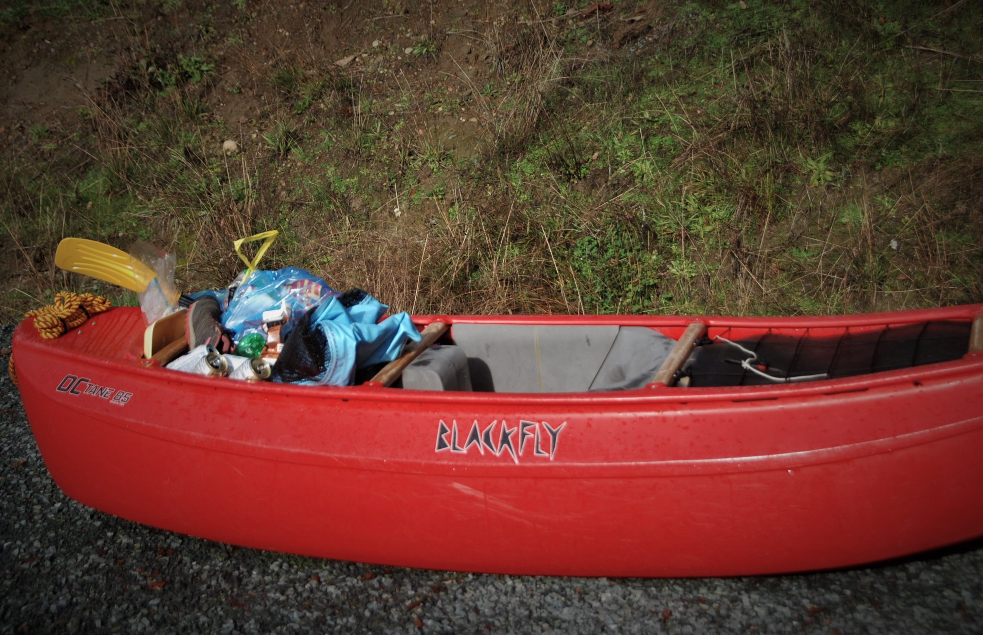
Notes:
… we regularly PICK UP garbage on the river…

Slide 22
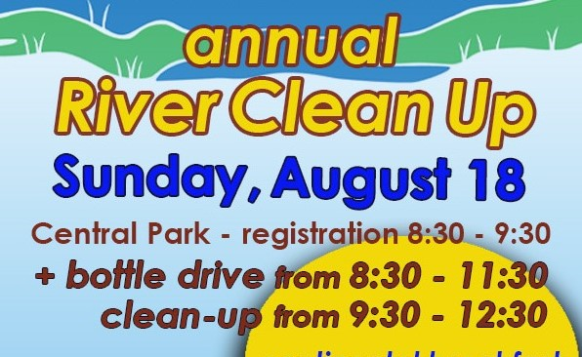
Notes:
…not only during River Cleanup Events, but also on regular trips. We are EYES in inaccessible stretches of the river, and we don’t hesitate to report concerns to appropriate authorities
Those are the kinds of ETHICAL and ENVIRONMENTAL standards which govern our practice.

Slide 23
Cowichan River Stewardship Roundtable
Cowichan Lake & River Stewardship Society
Koksilah Working Group
N. Cowican’s Parks & Trails Master Plan: (Chemainus River Recreational Corridor)
Notes:
In addition, we work with several local Watershed Stewardship groups. We promote PARTNERSHIPS!

Slide 24
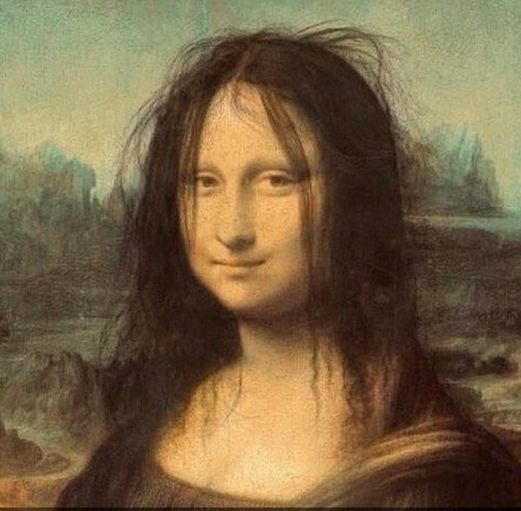
Notes:
We believe the plans for the new weir are ALMOST a masterpiece. They’ve covered Industrial and Agricultural use, Domestic needs, Cultural values, Fish habitat…
But RECREATION has been overlooked – (our own fault for not speaking up sooner!) Now, before we present some suggestions, please let us be clear:

Slide 25
This presentation completely
supports the
weir initiative!

Slide 26
We offer NO suggestions
opposing
the project’s intent
to increase water storage,
safeguard habitat, and
ensure riparian health.

Slide 27
So, um, – HOW could the Weir Project benefit Recreational River Users?
Notes:
Glad you asked!

Slide 28
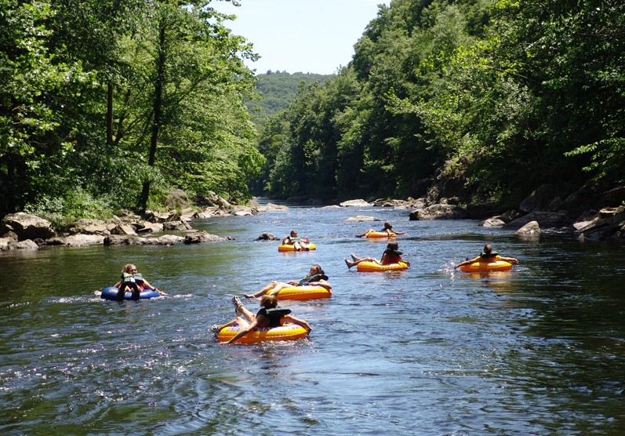
Notes:
The weir’s designed to increase water storage, guaranteeing adequate flows in summer drought conditions. We’re in favour! And recreational tubers will benefit from increased flows in the summer. We’re grateful for that!

Slide 29
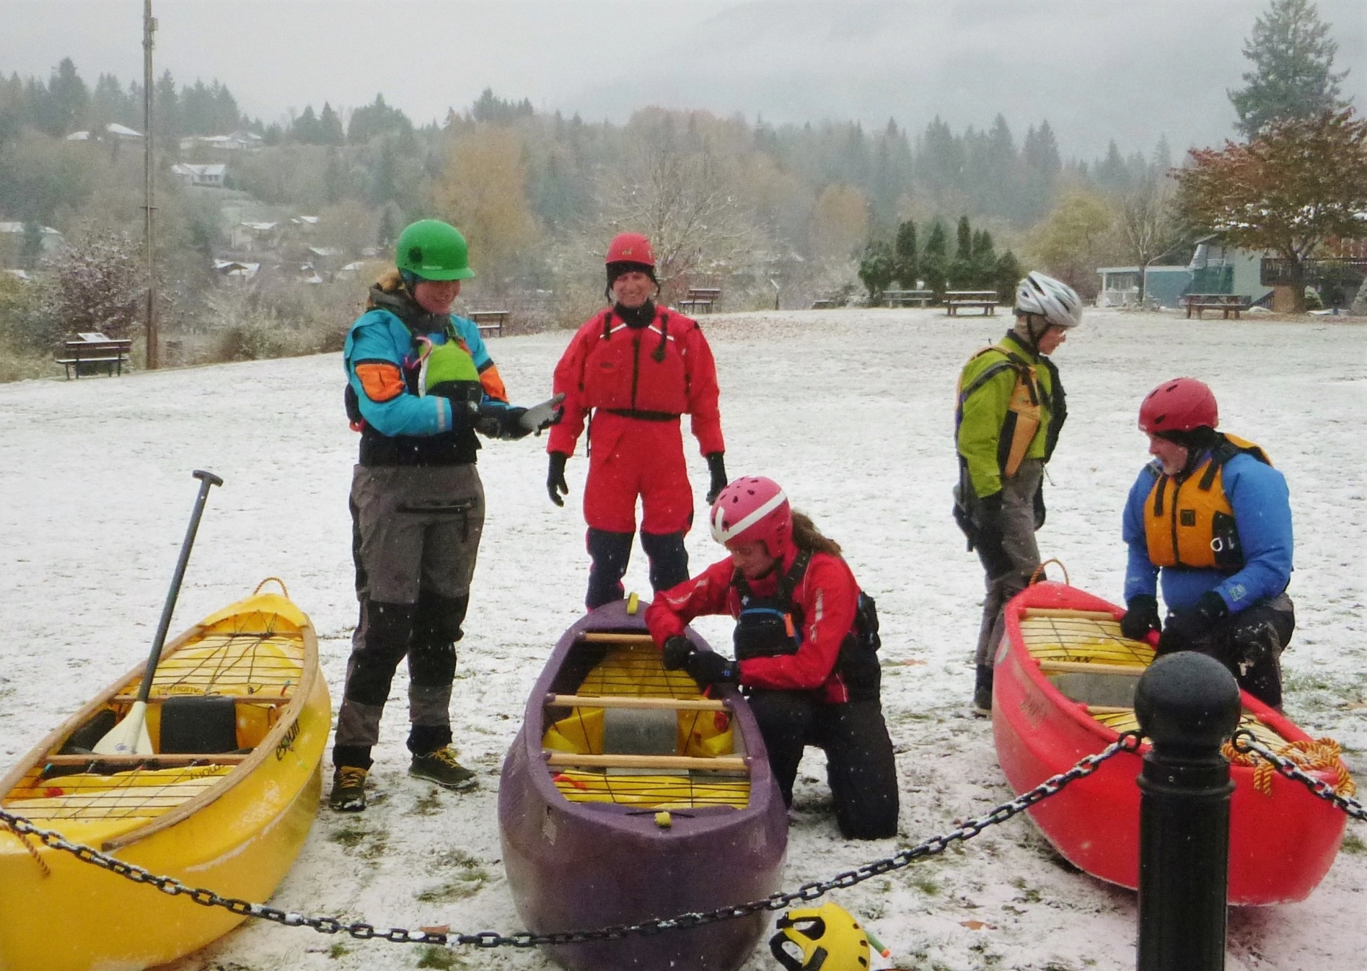
Notes:
But for most river users, our season doesn’t begin until the rains come, usually in October. The season ends in April or May, when rivers dry up. WINTER is paddling season!
We believe that the design of the weir and river bed COULD easily be tweaked to provide recreational value, not just in summer, but also during fall, winter, and spring.
An ALL YEAR WEIR!

Slide 30
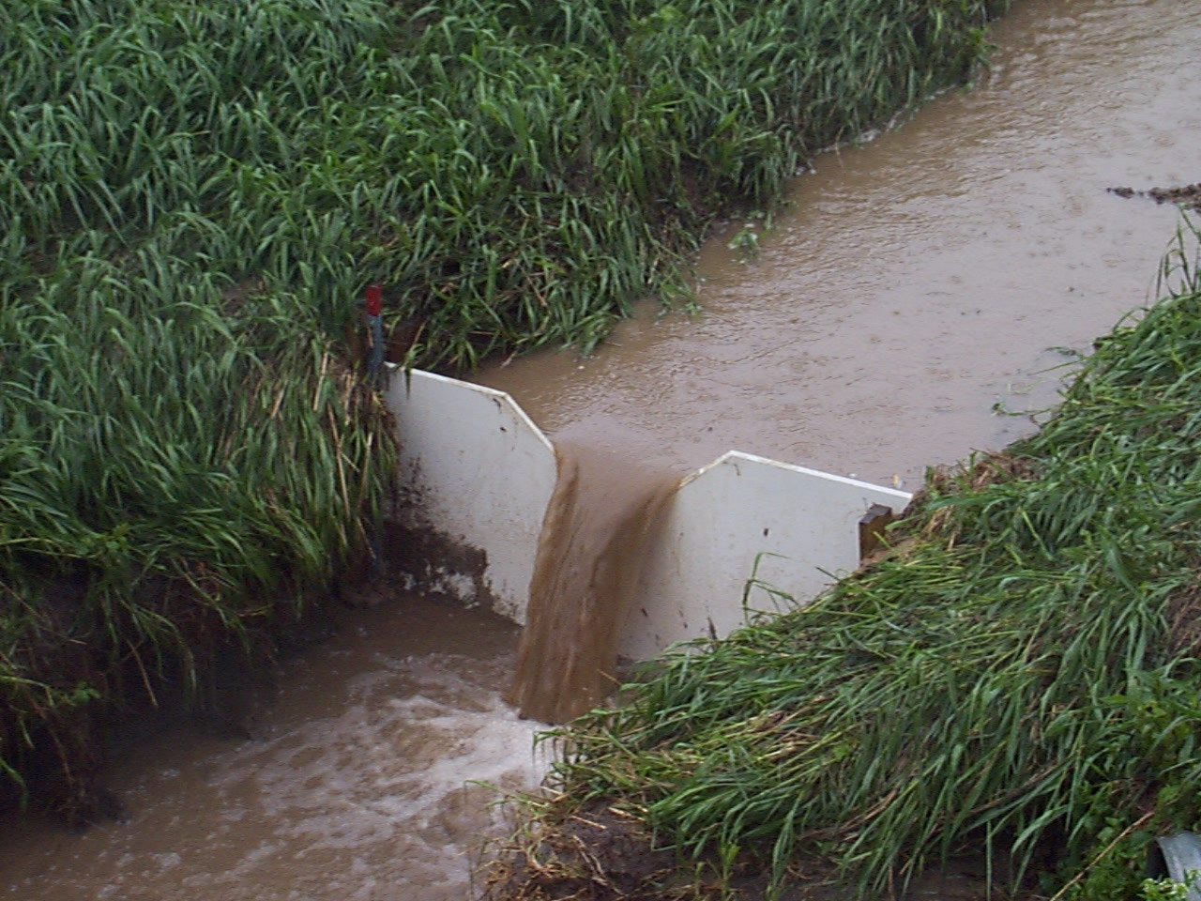
Notes:
So let’s talk weir design. We ALL know that weirs are designed to STORE WATER for a variety of uses.
But they can do more!

Slide 31
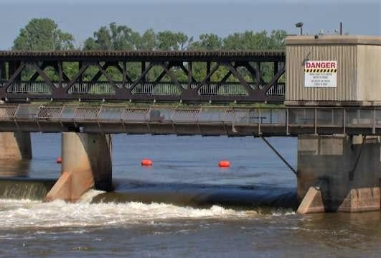
Notes:
For example, this weir is designed to be a DROWNING MACHINE! It forms a dangerous hydraulic -- deadly to anyone caught in it.
And let’s not assume that the sign, or the orange buoys, will prevent people from floating into what LOOKS like an easy drop.

Slide 32
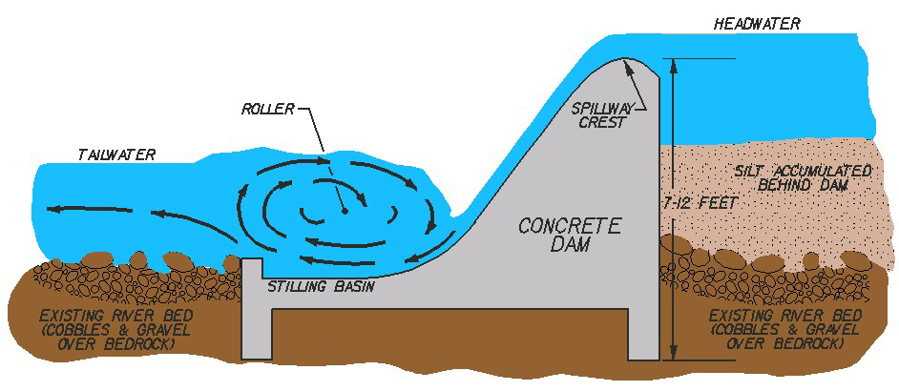
Notes:
Here’s a sketch -- Anyone who floats over the top, or drifts up into the outflow at the bottom, can be caught, trapped, and drowned in the recirculating roller.
We want the engineers to understand that we DON’T want this kind of weir!

Slide 33
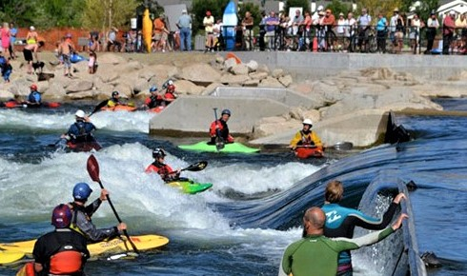
Notes:
However, weirs, and their river-beds, can be designed not only to be safe, but also to provide recreational features in the outflow. OK, so what IS a ‘recreational feature’?

Slide 34
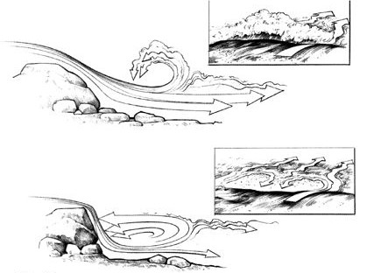
Notes:
Basically, a play feature is a WAVE or HOLE, formed when water flows over an obstacle on the river-bed.

Slide 35
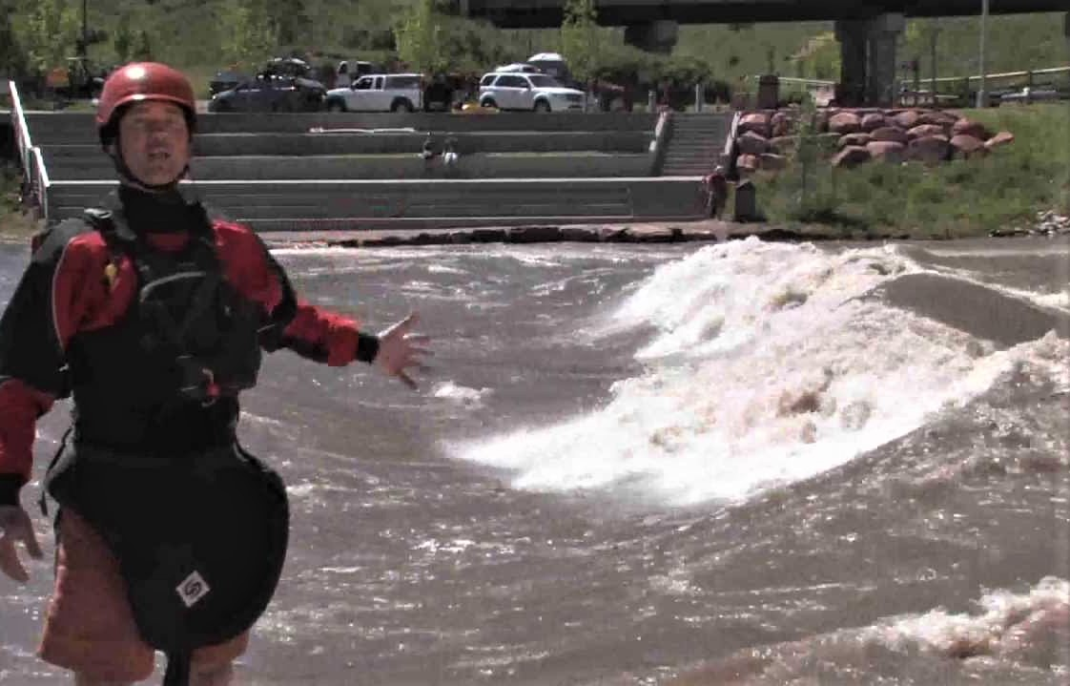
Notes:
And river rats don’t just use rivers for downstream travel, we’re always on the lookout for waves and holes, for some ‘PARK and PLAY’…

Slide 36
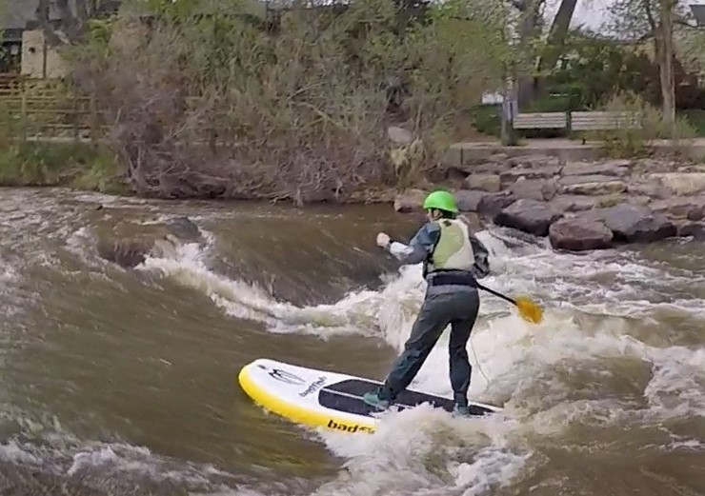
Notes:
…maybe to surf…

Slide 37
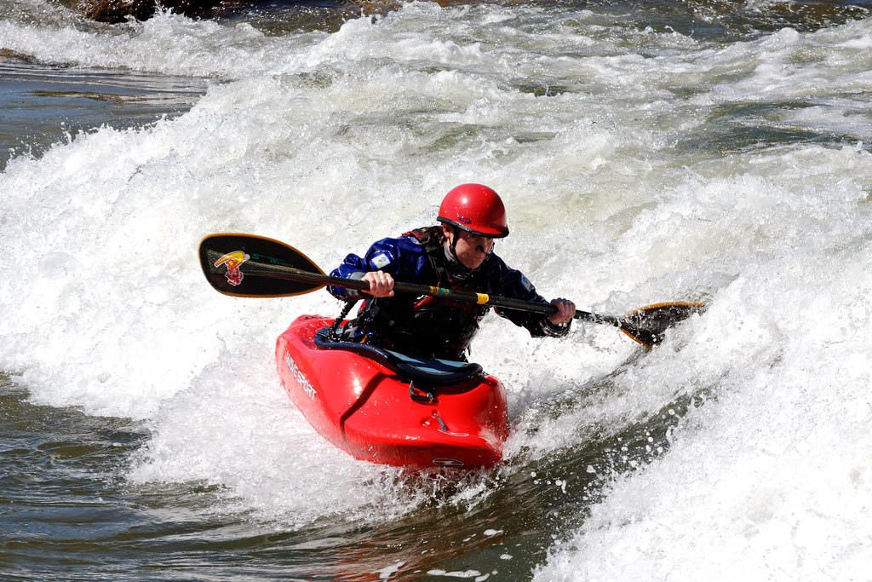
Notes:
…or spin…

Slide 38
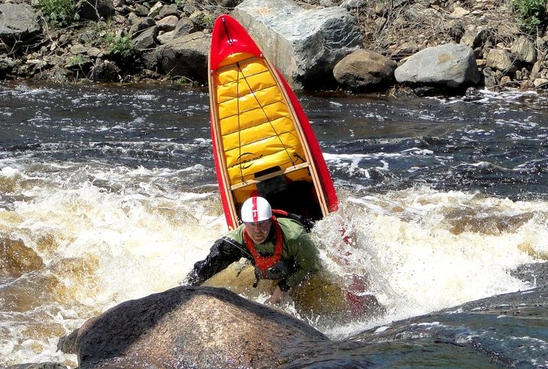
Notes:
…or get vertical

Slide 39
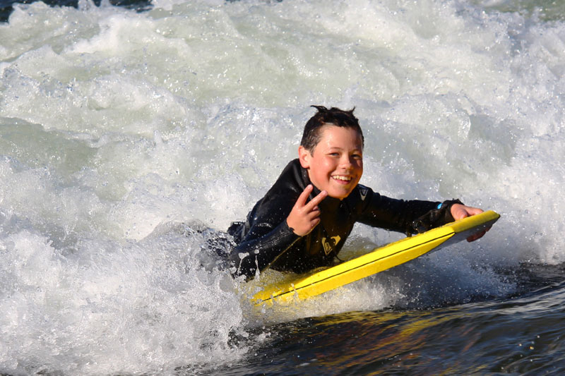
Notes:
…or just simply to enjoy!

Slide 40
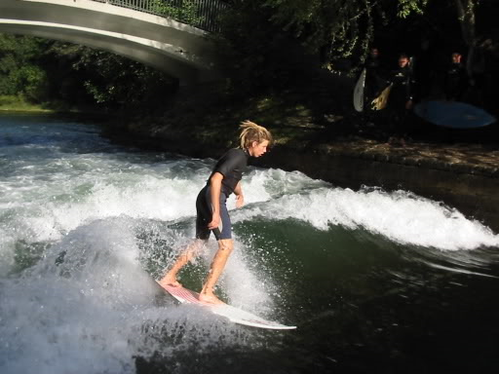
Notes:
It’s true that waves and holes occur randomly on natural rivers. That can be GOOD! Or maybe not!

Slide 41
PROBLEMS WITH NATURAL WAVES:
They appear or disappear depending on daily flows
They may be too big, too small, or too dangerous
They may not be accessible without an eddy nearby
Notes:
So – what’s the solution?

Slide 42
WEIR -
the solution
! ! !
Notes:
During construction of the weir, we can install obstacles on the river bed to create waves , holes, and eddies.
A weir can control the flows over the obstacles.
THEN, play features become dependable, safe, effective, and accessible.

Slide 43
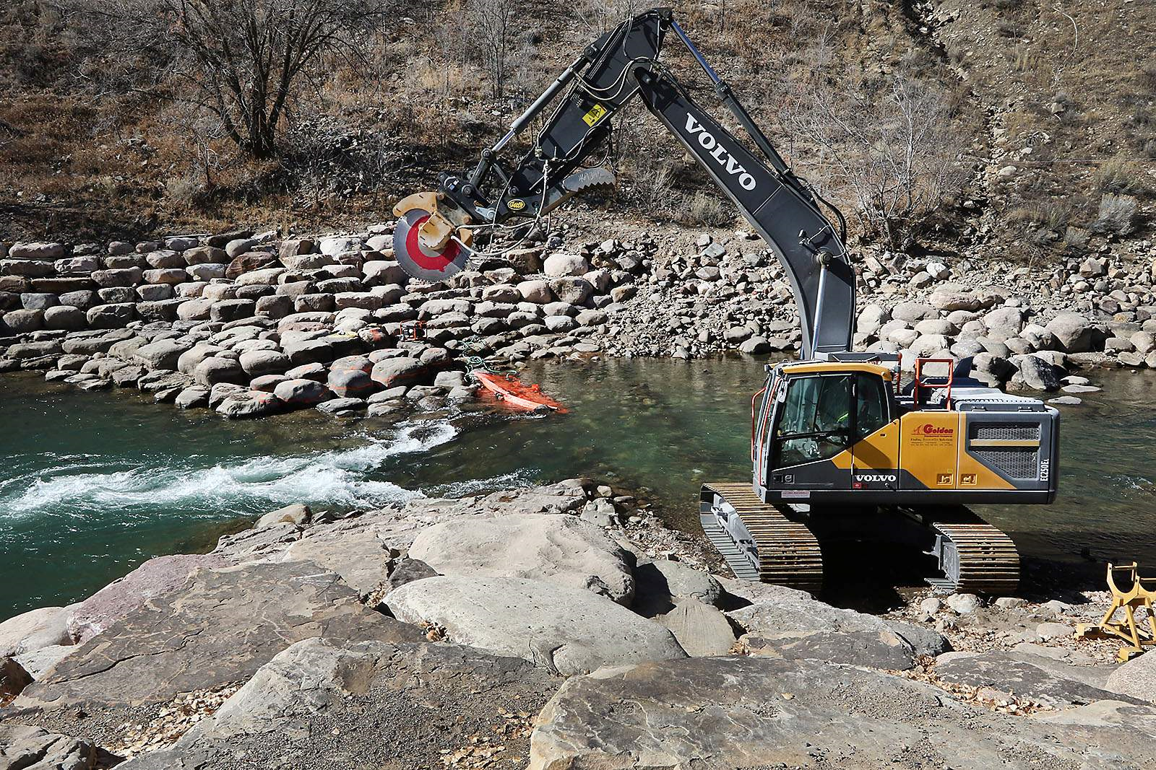
Notes:
This process isn’t a new idea! Developing play features in rivers commonly occurs in the construction of many North American WHITEWATER PLAY PARKS.
(Just not on Vancouver Island!)

Slide 44
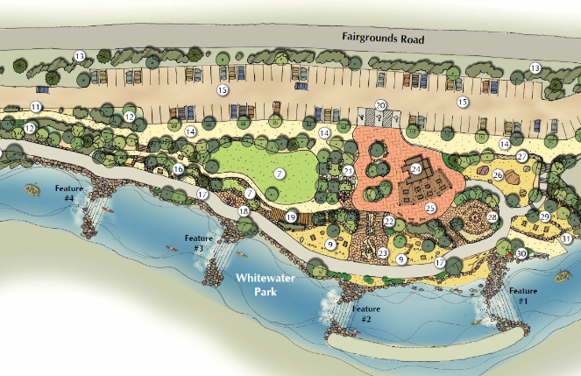
Notes:
We are NOT proposing construction of a complete whitewater play park! But SOME elements of whitewater park design MIGHT be feasible, within our weir design.
Perhaps you are not familiar with whitewater play parks, or what they look like. So -- a quick tour.

Slide 45
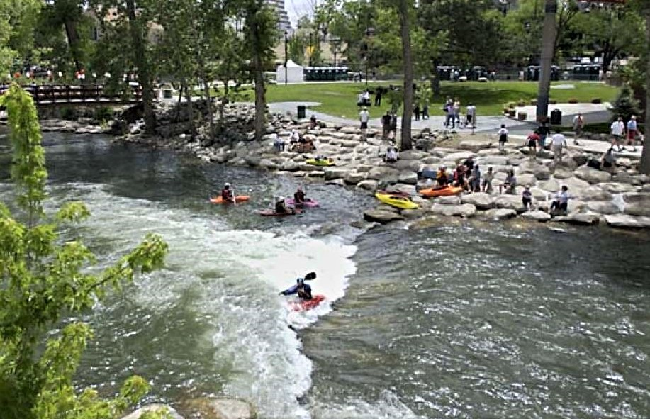
Notes:
Reno, Nevada, has a whitewater playpark right downtown, on the Truckee River. This park is fairly large – possibly 15 – 20 different features.

Slide 46
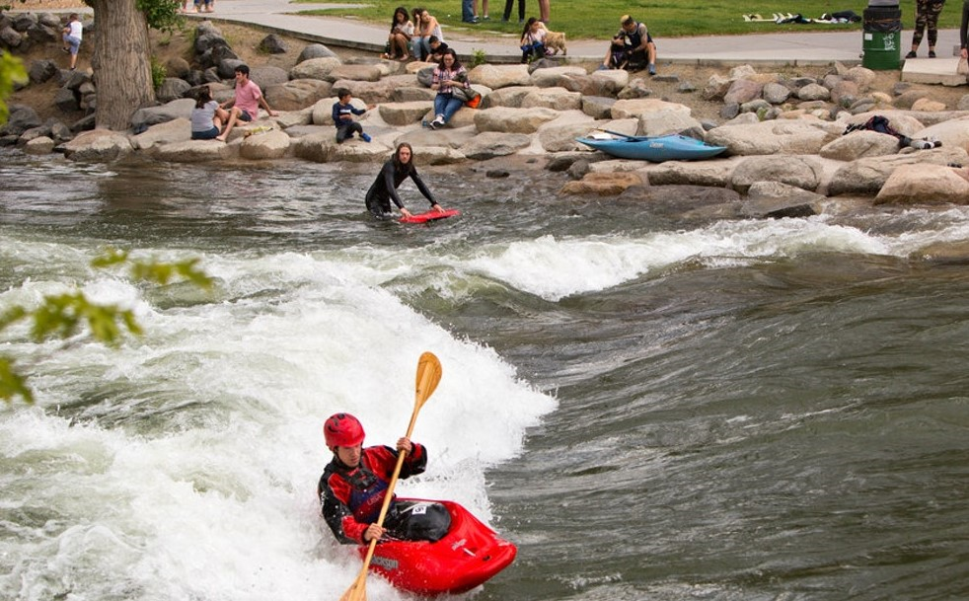
Notes:
In high spring flows, whitewater boaters come to town. They play on the waves all day, free of charge.
THEN, when the sun goes down, they drop lots of dollars in restaurants, shops, pubs, hotels, campgrounds and casinos. Studies show that whitewater parks quickly pay for themselves -- they generate VERY significant tourist revenue for their communities.

Slide 47
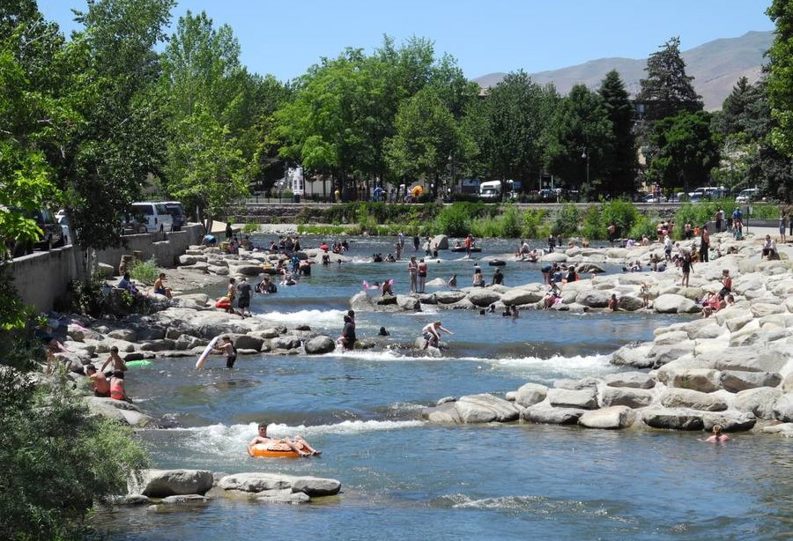
Notes:
Later in summer, when the river drops, families with tubes come out to enjoy the river.
The Truckee is one of the most heavily fished rivers in Nevada. It’s the opinion of river engineers that play features, constructed from natural materials, may be helpful to fish heading upstream or downstream.

Slide 48
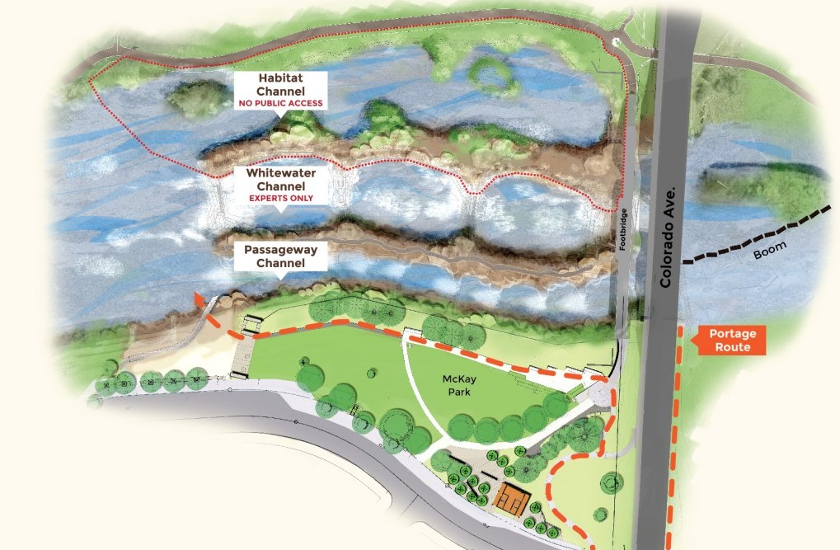
Notes:
The city of Bend, on the Dechutes River in Oregon, has developed a downtown whitewater park. On this sketch, the water flows right to left. The right channel (top of picture) is the “Habitat Channel”. No people allowed – it’s being restored for native plants, animals, fish, and water-foul. The center “Whitewater” channel has four large waves for big boys and girls. And the left “Passageway” channel, with a sidewalk alongside, is shallow, and has eight or ten small waves for kids on tubes.

Slide 49
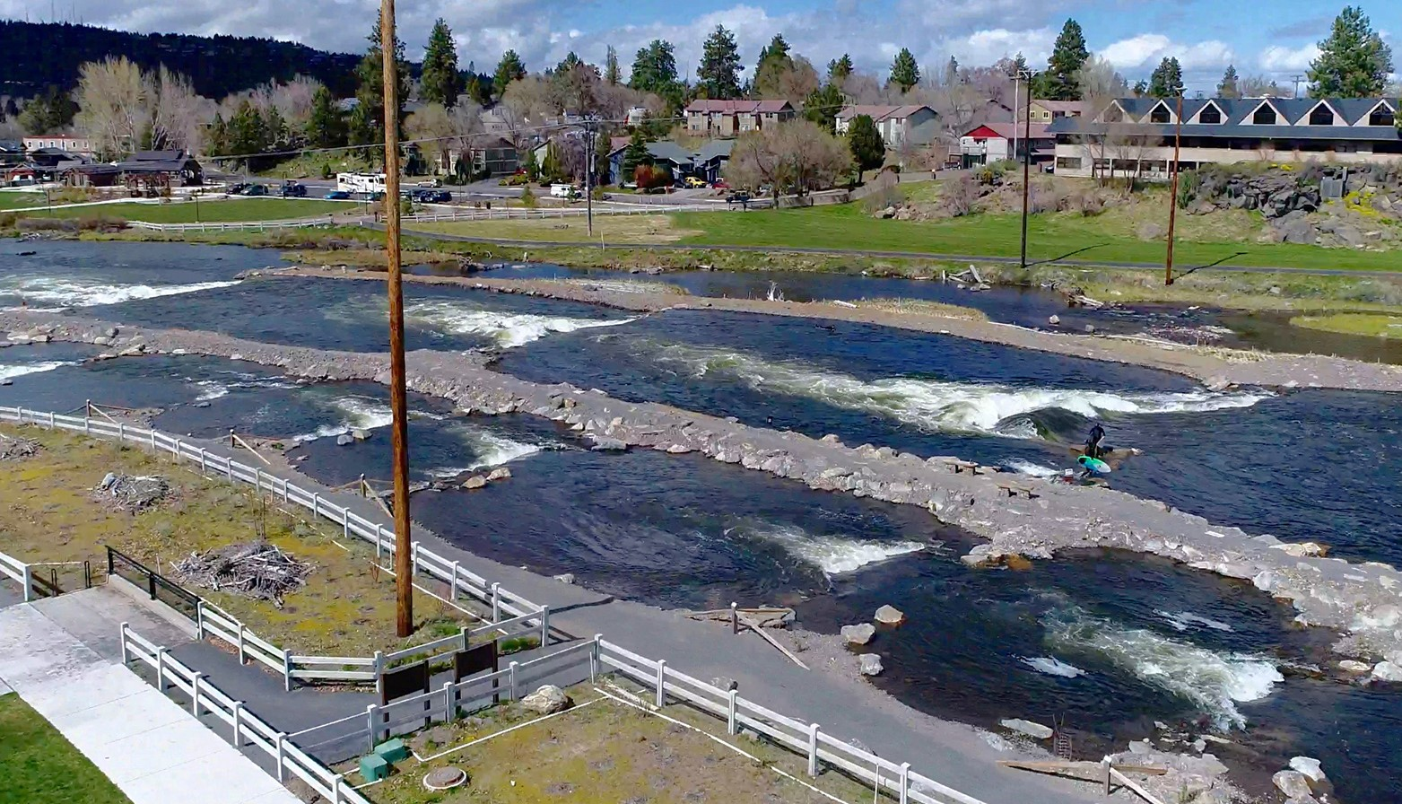
Notes:
Here’s a photo. The Bend Whitewater park is part of an ongoing campaign to restore the Dechutes River, including revitalizing stocks of sockeye, chinook, and steelhead.
Consensus seems to be that development of fish habitat, AND recreational use of the river, are not mutually exclusive.

Slide 50
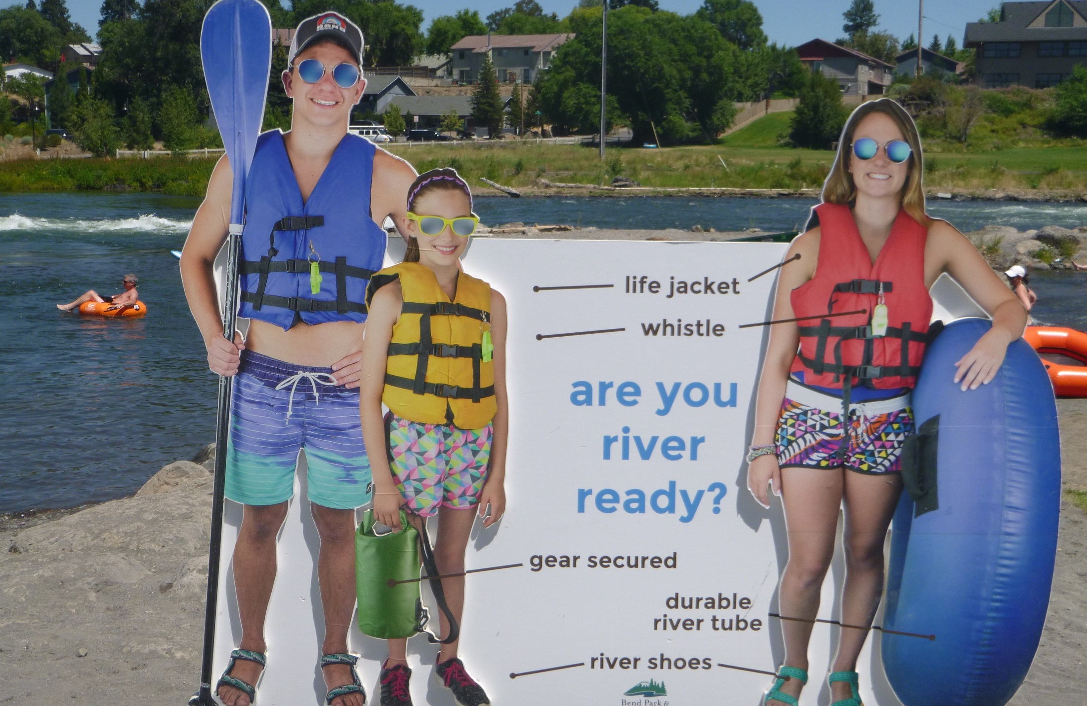
Notes:
The Bend Whitewater Park is CLEAN and SAFE. The kids’ channel can easily be supervised from the sidewalk. Garbage cans, picnic tables, and washroom facilities are only a few steps away.

Slide 51
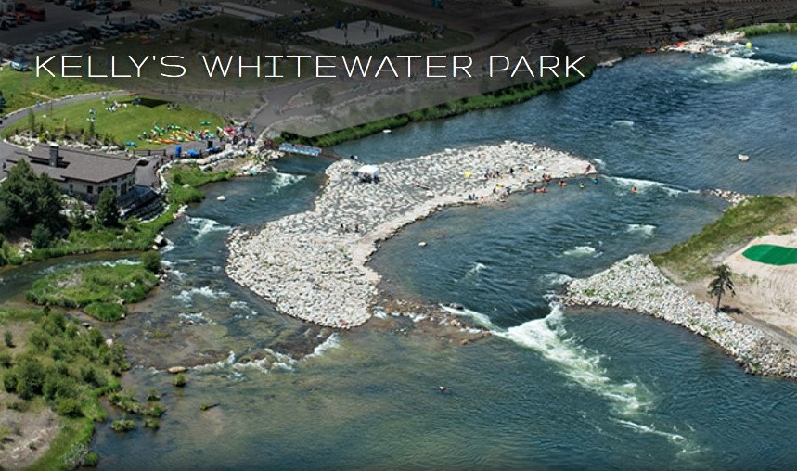
Notes:
This is Kelly’s Whitewater Park, on the North Fork of the Payette River, in southern Idaho. Here, water flows from upper-right to left-center.
The river is split into two channels – the narrow right channel has smaller waves for tubers and beginners, and the wider left channel has bigger features.
Parking, picnic tables, garbage cans, and washrooms/change rooms are open for public use.

Slide 52
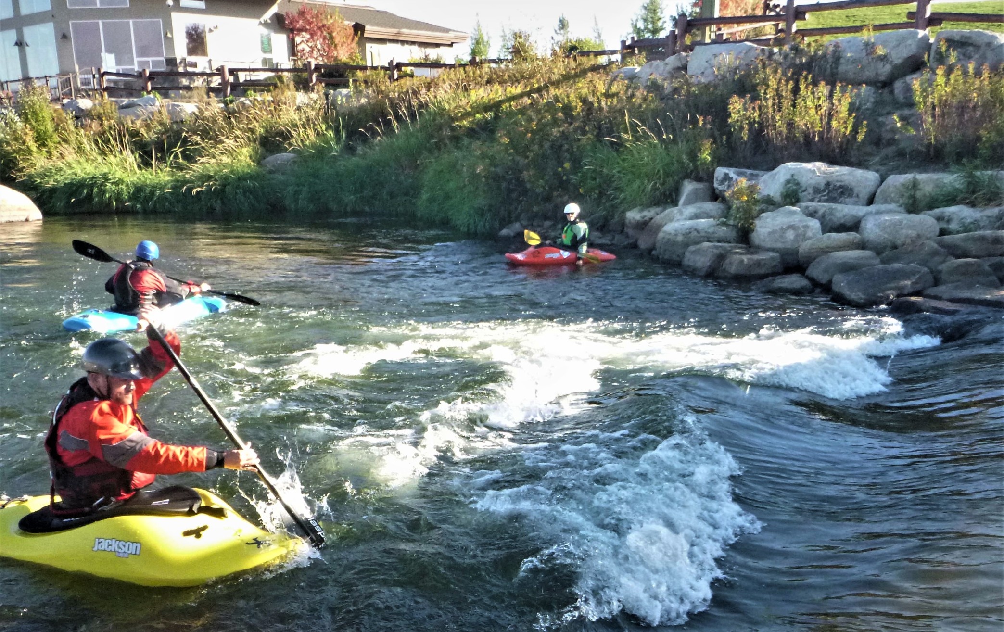
Notes:
Here’re some paddlers sampling a small wave in the right channel. And just upstream, (not in the picture,) an angler was casting for fish.
Note also the restoration of natural riparian vegetation.

Slide 53
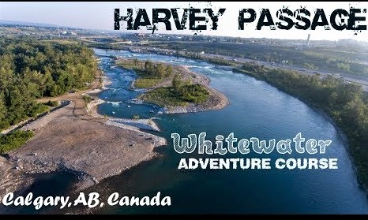
Notes:
Closer to home, Calgary removed a killer weir used for agricultural water storage on the Bow River, and replaced it with a whitewater park known as Harvie Passage.
AND in Saskatoon, plans are underway to include a whitewater playpark in conjunction with an upcoming Hydro project on the South Saskatchewan River. Cochrane, Alberta is developing a whitewater park.

Slide 54
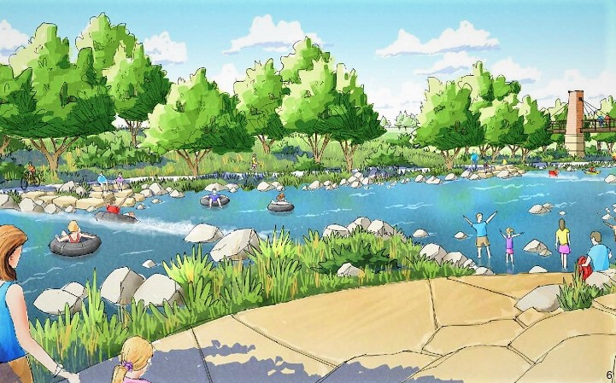
Notes:
How do play features get developed? There are river engineers whose specialty is to design recreational features on rivers. Step 1 is for them to visit a location, and prepare a feasibility study.
We have consulted the engineer who designed Kelly’s Park, and Harvie Passage, shown in the last few slides, and he has indicated interest in our project.

Slide 55
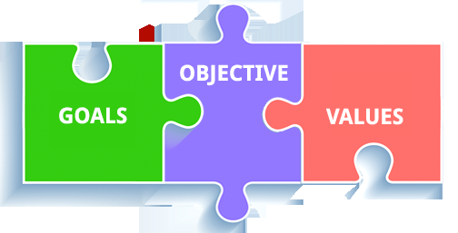
Notes:
To summarize: Our VALUES include the notion that Recreational use of our river is part of our Heritage. It does not significantly diminish the river’s natural qualities; nor does it endanger habitat or Riparian Integrity. And we know that safe Recreation supports mental health by reducing stress.
Our GOAL is NOT to propose construction of a whitewater park, but only to request that we EXPLORE THE FEASIBILITY of adding limited recreational features to our weir plans.
And, finally, our OBJECTIVE is to…

Slide 56
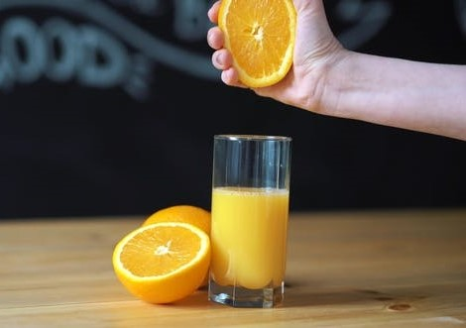
Notes:
…promote a weir that gets the most juice from the squeeze! (Metaphor by Tom Rutherford!)
OUR NEW WEIR SHOULD BE THE BEST IT CAN BE – with added value, NOT just for industry, or fish, or agriculture, but for ALL river uses, and ALL river users.
(Including Recreation!)

Slide 57
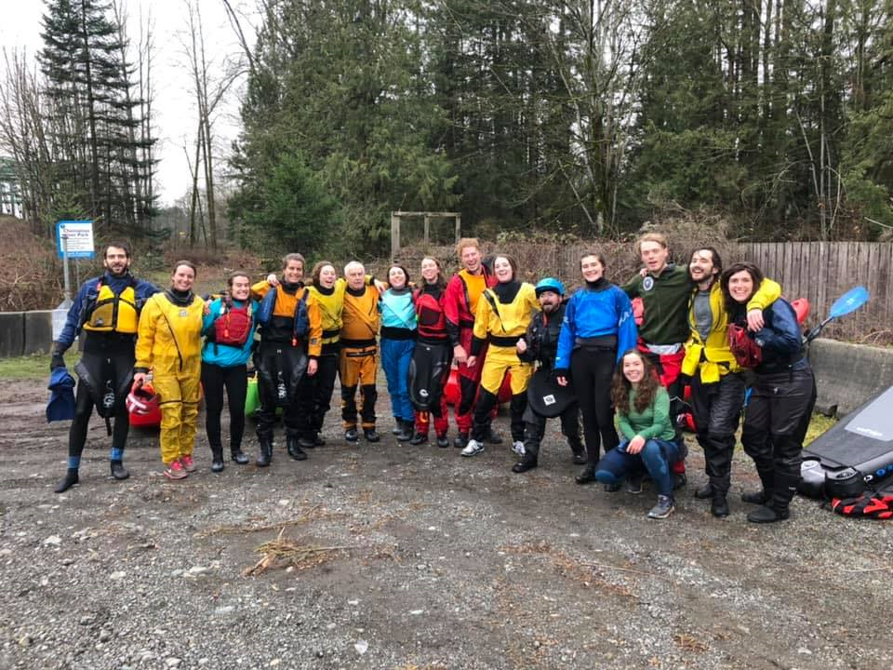
Notes:
We hope that Recreational River Users are now recognized as legitimate PARTNERS in river-stewardship, through promoting SAFE and RESPONSIBLE practices.
Please be assured that paddlers will continue to provide solid support for sound watershed management. It’s what partners do!

Slide 58
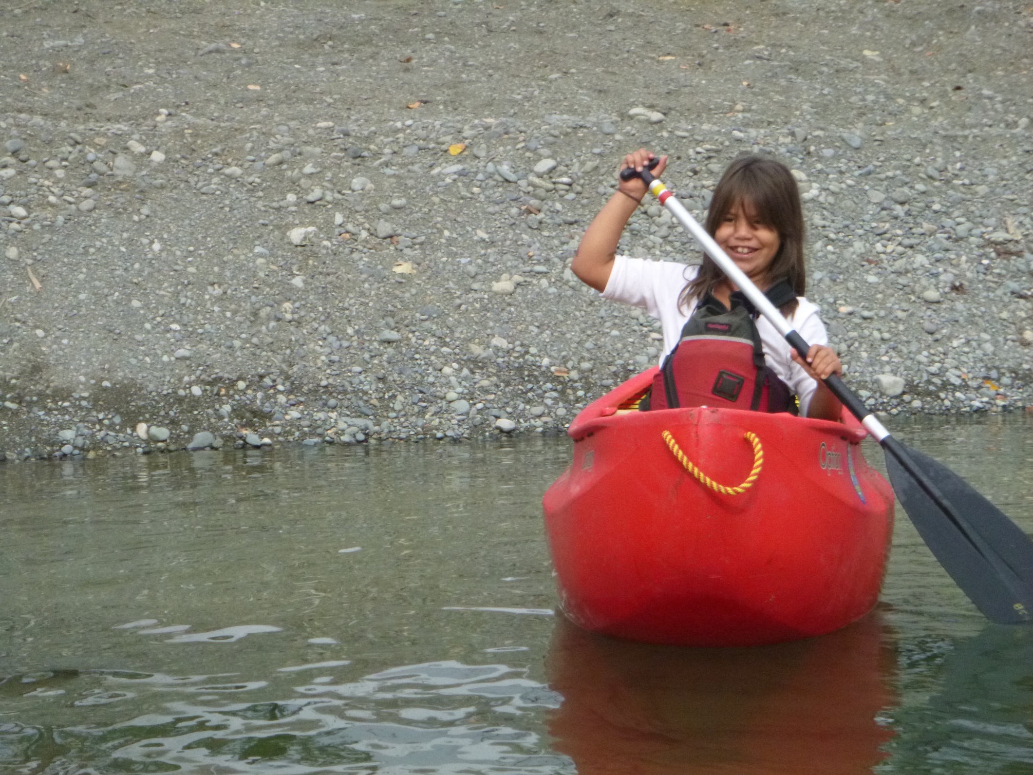
Notes:
We’d like to think that future recreationists will benefit from enlightened planning that took place way back in 2020.

Slide 59
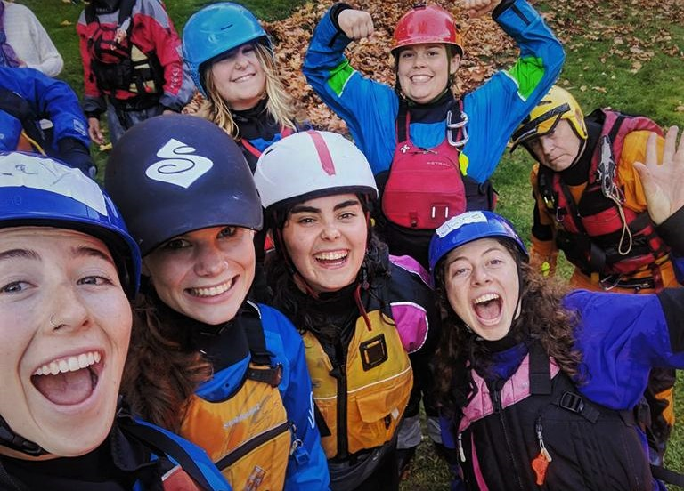
Notes:
Today’s young people are our FUTURE RIVER-STEWARDS. We hope, for their sake, that this presentation generates a positive response to our request.

Slide 60
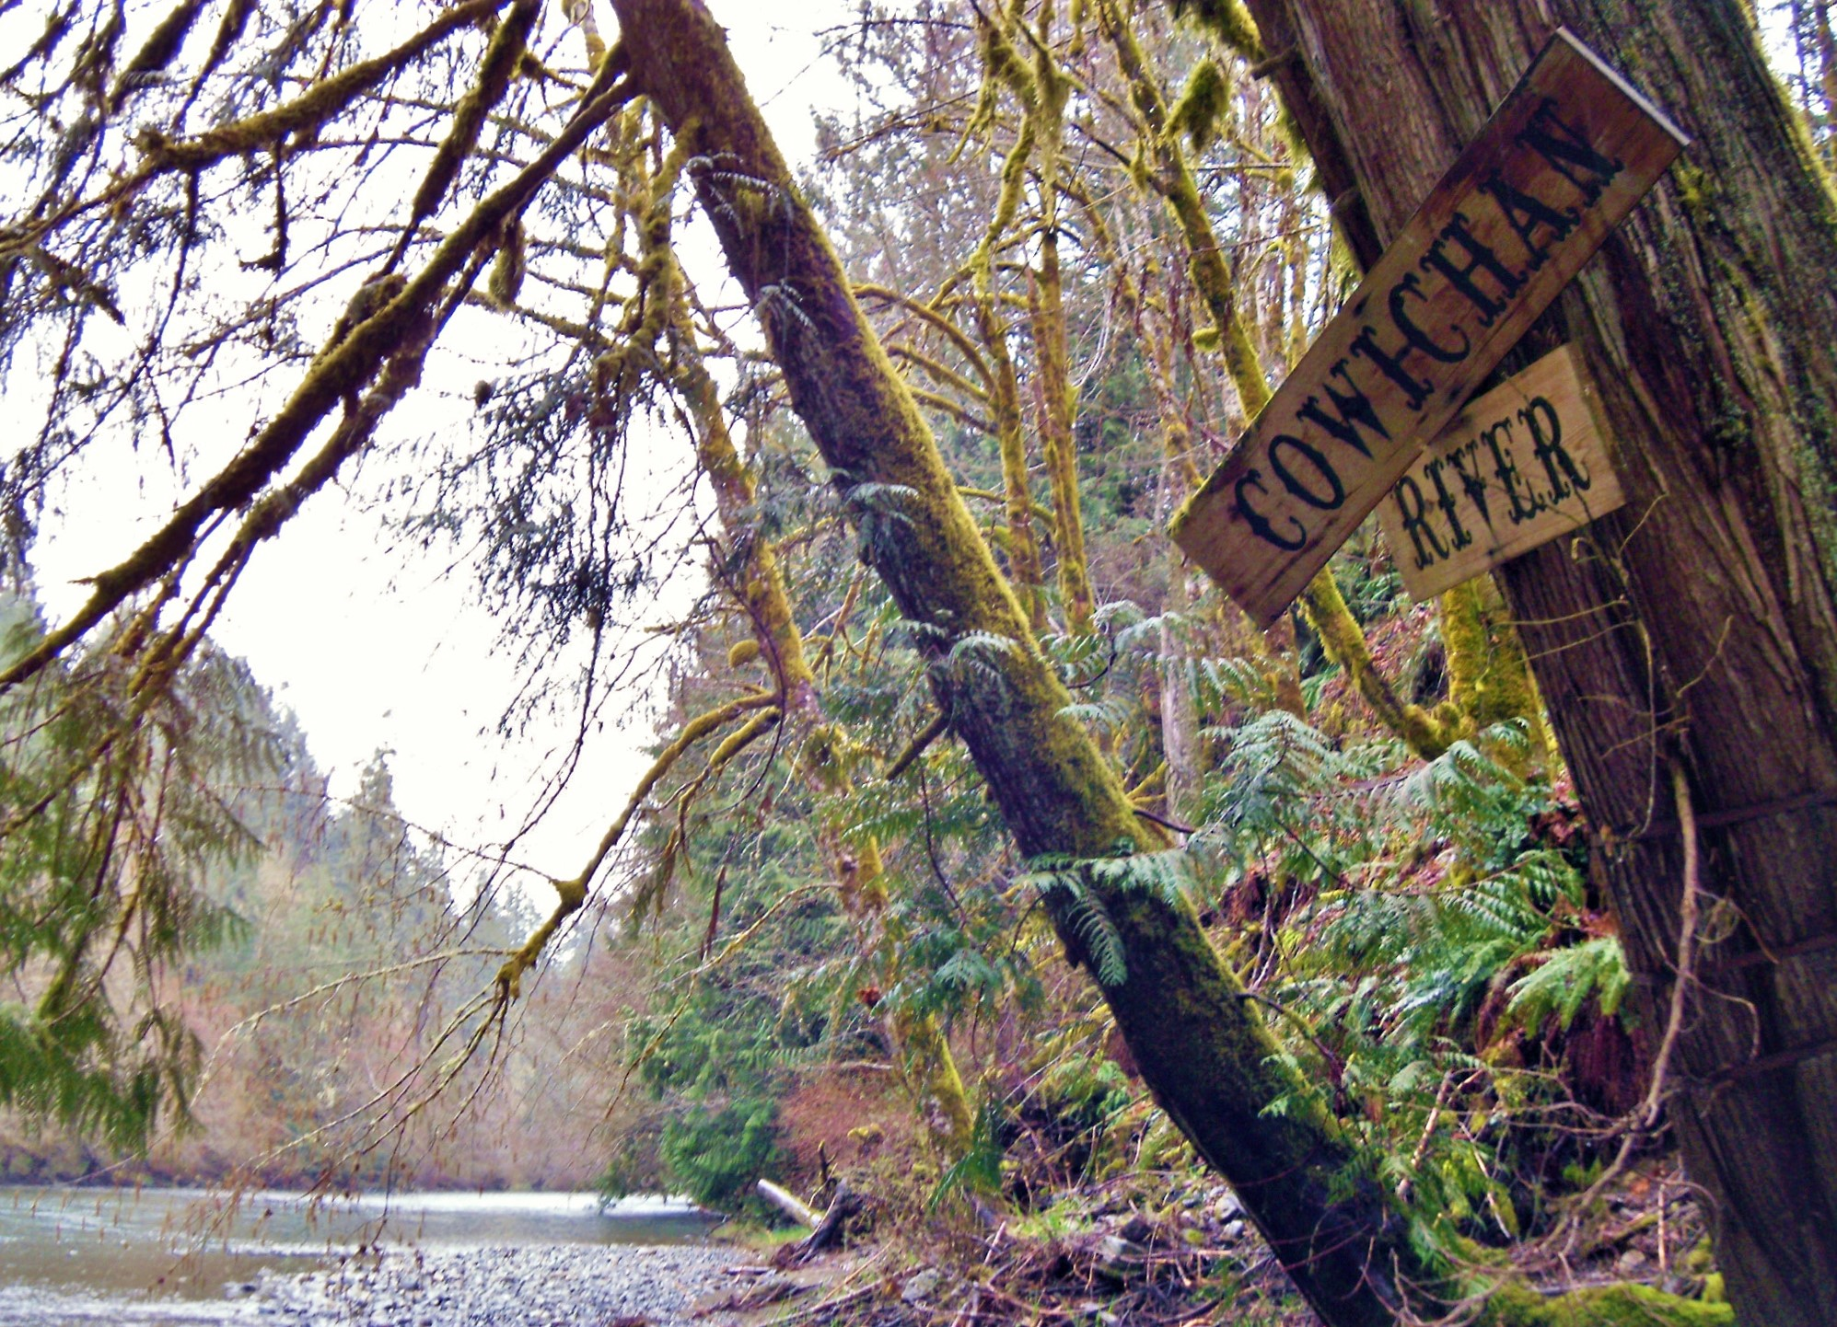
Notes:
Thank you for your attention to this presentation! SYOTR!

