Slide 2
Agenda
Emergency Program Evaluations – Gaps and Recommendations
Governance Model Options & Discussion

Slide 3
Background
The Emergency Program Act identifies Preparedness, Response and Recovery functions required by Local Authorities.
The CVRD Emergency Program Service provides some functions required under the Emergency Program Act to municipal and First Nation partners. Other functions fall under the responsibility of the local authorities.
A presentation/gap assessment of the CVRD Emergency Program Service was provided to the CAOs in December 2020 and March 2021.
A CVRD Board workshop was held in April to provide background on the gap assessment.

Slide 4
Included/not included in CVRD Emergency Program Service
INCLUDED | NOT INCLUDED
• Support for training (delivery of training to established EOCs including tabletop and functional exercises, training for ESS teams, training for ECT) | • Establishing an emergency management organization and strategic plan for that organization
• A regional emergency plan | • Establishing a committee (if not covered by policy group) to provide advice and decisions on program
• An emergency notification system | • Establishing policy group (authority to declare a State of Local Emergency)
• A redundant emergency communications network and support | • A local EOC (stocked, supplied, maintained) and team
• Emergency preparedness awareness for the public | • Community specific hazard assessments and plans to ensure an effective response
• A REOC and team | • Community-specific mitigation
• An ESS program (for small and large incidents) | • Additional training beyond that offered by CVRD Emergency Program Service

Slide 5
1. Emergency Program Evaluations – Gaps and Recommendations

Slide 6
Assessing the gaps
The local authority emergency programs were assessed using the EMBC Community Emergency Program Self Assessment Tool
Only tool provided by the provincial government to evaluate local authority and First Nation emergency programs
Tool provides a defensible benchmark for program development and improvement
Results reflect current state of our programs including the services provided by the Emergency Program Service

Slide 7
Assumptions and Limitations
Not all requirements within each category are evenly weighted within the provincial tool.
Progress for the municipalities has been generalized (some communities may be more advanced or less advanced than others in some areas).
The evaluation was completed based on available information (historic and current). Any information that was not shared would not be reflected.
Intended as a comparison against the provincial benchmarks (not each other)

Slide 9
Recommendations
32 recommendations in the Assessment Report
17 for electoral areas
21 for municipalities
10 for the CVRD Emergency Program Service
Recommendations focus on critical priorities (not intended to achieve a perfect score in each area but rather address larger risks).

Slide 10

1. Governance and Administration
Recommendation | Risks of not proceeding | EAs | Munis | EPS
1 CVRD should update bylaws for electoral areas to reflect desired committee governance. | Delegation of Authority / Roles not clearly defined, non-compliance with Act
2 Municipalities must establish/identify the “Emergency Management Organization” designated to develop and implement plans and other preparedness, response and recovery measures for the whole of the municipality, and establish by-laws and policies indicating same. | Delegation of Authority / Roles not clearly defined, non-compliance with Act
3 Each local authority or, in the event a single Emergency Management Organization is established, the EMO should develop and implement a clear written Emergency Program Overview to include scope, guiding principles, mission, goals, policies/procedures, and a strategic plan with actions and implementation schedule against a defined budget. | Delegation of Authority / Roles not clearly defined, non-compliance with Act
4 All municipalities should identify coordinator to act as central contact and point of program coordination. | No central point of coordination, responsibilities for maintenance of the program are divided up among multiple individuals/depts

Slide 11
2. Hazard Risk and Vulnerability Assessments
Recommendation | Risks of not proceeding | EAs | Munis | EPS
2.1 Each local authority, or the EMO if a single emergency management organization is established, should complete a fulsome HRVA (inclusive of all community nuances, vulnerabilities and resiliencies). This HRVA should be used to develop plans, procedures and focus the emergency program to address the greatest risks. | Risk assessment informs planning, resources and decisions. Without a current risk assessment, planning/resources may be inappropriate.

Slide 12
3. Risk Mitigation
Recommendation | Risks of not proceeding | EAs | Munis | EPS
3.1 Each local authority or, in the event a single Emergency Management Organization is established, the EMO should draft an overall resiliency assessment and mitigation plan based on the HRVA (see recommendation 2.1). | Mitigation is applied as-needed and may not be appropriate or reduce largest risks. Mitigation may not be cost effective (doesn’t consider existing resiliencies).
3.2 Each local authority or, in the event a single Emergency Management Organization is established, the EMO should develop and implement a comprehensive FireSmart strategy and program. | Increased vulnerability / lower resilience to wildfire. Current piecemeal approach will only address some risks temporarily.

Slide 13
4. Preparedness
Recommendation | Risks of not proceeding | EAs | Munis | EPS
4.1 The Emergency Program Service should continue to provide preparedness education and awareness support to community groups, neighbourhood response teams, non-government organizations and other interested parties. An awareness plan should be developed to ensure a strategic, equitable, encompassing, and measurable approach to awareness and education across the Cowichan area with a focus on vulnerable groups and neighborhood emergency teams. | Varying degrees of preparedness throughout Cowichan, ineffective use of resources.
4.2 All partners should collaborate on an annual event to generate awareness and educate residents, visitors and businesses in the Cowichan area. | Other methods may not be as effective (higher cost/ lower benefit)
4.3 The Emergency Program Service should continue to provide training to EOC and ESS teams under a shared Training and Exercise Plan. This five-year plan should include the training requirements and recommendations for designated roles in a response, and provide a schedule of exercises for each community that increase in complexity over time, culminating in a full scale multi-jurisdictional exercise every three to five years. | Training and exercises may not be appropriately planned (scheduled, benefiting multiple teams) and may have low attendance.
4.4 Each local authority or, in the event a single Emergency Management Organization is established, the EMO should establish a formal After-Action Review process and procedures to clarify when debriefs will be held and how actions will be tracked to completion. | Improvements / change may not occur.
4.5 Each local authority or, in the event a single Emergency Management Organization is established, the EMO should report annually on continuous improvement measures (and completion of corrective actions) to its council/board and to the public. | Improvements / change may not occur or may not be appropriate.

Slide 14
5. Response Planning – Emergency Plans
Recommendation | Risks of not proceeding | EAs | Munis | EPS
5.1 Each community (local authority) should develop, implement and maintain a community-specific emergency plan. This plan should be based on the hazards, risks and vulnerabilities identified in the HRVA. It should include specific procedures/people, evacuation routes, muster locations, critical services, and vulnerable groups for that community. | Response/decisions based on generalized information only, less effective responses. Potential for increased threat to life safety.
5.2 The CVRD or, if a single emergency management organization is established, the designated EMO should implement a community plan template so that plans in the Cowichan area follow a similar format and structure. This will enable interoperability, and reduce training and knowledge barriers when local authorities and First Nations support each other in response to an incident. | Less effective responses.

Slide 15
5. Response Planning – Communications
Recommendation | Risks of not proceeding | EAs | Munis | EPS
5.3 All local authorities should identify the same notification system as the emergency alert system to ensure maximum participation and increased saturation. | Public confusion, risk to life safety, poor coverage/saturation, increased costs.
5.4 All local authorities should actively advertise and promote the emergency alert system for the Cowichan area. | Risk to life safety if there is poor coverage/saturation. Less effective preparedness/response. More burden on emergency responders during an incident.
5.5 Each local authority or, if a single emergency management organization is established, the designated EMO should establish trained authorized users for the Emergency Notification System to ensure rapid deployment of public warnings and/or EOC team activations during an incident. | No warnings / delayed warnings, increased threat to life safety.
5.6 All EOC teams and alternates should be uploaded and maintained in the Emergency Notification System to enable rapid deployment. | Time delay to establish EOC response (impacting support to emergency responders on site).
5.7 The Disaster Radio program should be refreshed to include training. | Unable to use system in an emergency.
5.8 Emergency Communications exercises should be integrated into the Cowichan Exercise and Training Program. | Less effective communications in an emergency.

Slide 16
5. Response Planning – Operations
Recommendation | Risks of not proceeding | EAs | Munis | EPS
5.9 Each local authority should maintain a current roster for their local EOC. This roster should be updated regularly and should identify at minimum section chiefs (planning, operations, logistics, finance) and management staff (director, liaison, information, risk management). If a regionalized EMO is established, each partner should provide an alternate available for each essential role. | Time delay to establish EOC response (impacting support to emergency responders on site). Individuals may have to fill roles without adequate/knowledge/training.
5.10 The Regional Emergency Operations Centre should implement incident management tools and systems that support ongoing remote activities. | Remote REOC operations will be less effective, (decreased communications, common picture, less effective decisions, record management challenges).
5.11 Situational awareness and analysis procedures and roles for a response should be formalized for all EOCs/REOC. | Inability to gain adequate situational awareness. Poor decisions during a response, risk to life safety.
5.12 Damage assessment processes should be formalized and personnel in all jurisdictions trained to implement during an incident. | Inability to assess impact of incident. Poor decisions during a response, risk to life safety.
5.13 The Cowichan area should continue to build on response team capacity by increasing volunteer engagement. Volunteer teams can provide additional support to staff (which continue to provide a reliable backbone for response in the region). | Increased cost of response and emergency support services as financial reimbursement from province is reduced.

Slide 17
5. Response Planning – Operational Readiness
Recommendation | Risks of not proceeding | EAs | Munis | EPS
5.14 Each local authority should identify a secondary location for an EOC. | Time delay to establish EOC response (impacting support to emergency responders on site).
5.15 The CVRD (Emergency Program Service), or EMO if a single emergency management organization is established, should implement an operational readiness maintenance and testing plan to ensure regular and established testing and maintenance of equipment, tools and systems. | Equipment and systems may malfunction or be unavailable during a response.
5.16 Each local authority should identify prepositioned disaster supply locations based on community layout and vulnerabilities. These locations should be stocked, maintained, and part of a public awareness campaign. | Equipment and supplies may not be accessible in some areas, impact to life safety and increased reliance on emergency responders in those areas.
5.17 Secondary reception centres should be identified/confirmed in each community. Baseline requirements for these secondary centres should be established and maintained. | Primary Reception Centres may not be accessible in some areas, impact to life safety and increased reliance on emergency responders in those areas.
5.18 The CVRD, or EMO if a single emergency management organization is established, should assess mobile assets and establish an appropriate fleet procurement and management plan. Vehicles should be appropriate for daily operations as well as response activities. | Vehicles may malfunction or be unavailable during a response. Some assets may not be deployed.

Slide 18
6. Recovery Planning
Recommendation | Risks of not proceeding | EAs | Munis | EPS
6.1 Each local authority or, if a single emergency management organization is established, the EMO should develop templated recovery plans for top hazards as identified in the HRVA. Recovery plans should include the priorities to restore essential services, processes to re-establish community functions, and recovery roles. The plans must be relevant and achievable by local authorities with or without a Disaster Financial Assistance program. | Delayed recovery (increased cost and impact to essential services, some infrastructure and vulnerable groups may not recover if they are not prioritized early).

Slide 19
7. Program Evaluation
Recommendation | Risks of not proceeding | EAs | Munis | EPS
7.1 Each local authority or, if a single emergency management organization is established, the EMO should develop and implement a program evaluation process and schedule. Progress should be reported at senior levels and summarized for the public. | No continuous improvement, no commitment to the program, lack of public buy-in, reputational damage.

Slide 20
2. Governance Model Options

Slide 21
Considerations
Need to clarify our roles/responsibilities
Changes to provincial financial support model and the Act will impact all local authorities
Are we using the best model for all partners?
Is the model properly funded?
Will the model need adjustment to appropriately reflect our commitment to reconciliation with First Nations?

Slide 22
 | Regional Model | Blended Model | Single Entity Model
Description | All EM services coordinated/administered by one entity for multiple entities | Some EM services coordinated/administered centrally by one entity for multiple entities, other services coordinated managed by each single entity | Full EM Program managed by single entity
Governance | One governing body / organization | Fee for Service (select services governed by a Regional Board), and governance for the Emergency Program must be set up for each local authority to manage their independent service components | One governing organization for each entity
Program Areas | All centrally managed | Some program areas managed by each entity, some centrally managed | Each entity manages its own full emergency program
Examples | Regional District of Central Okanagan Emergency Management Oceanside North Shore Emergency Management | CVRD | City of Vancouver City of Nanaimo

Slide 23
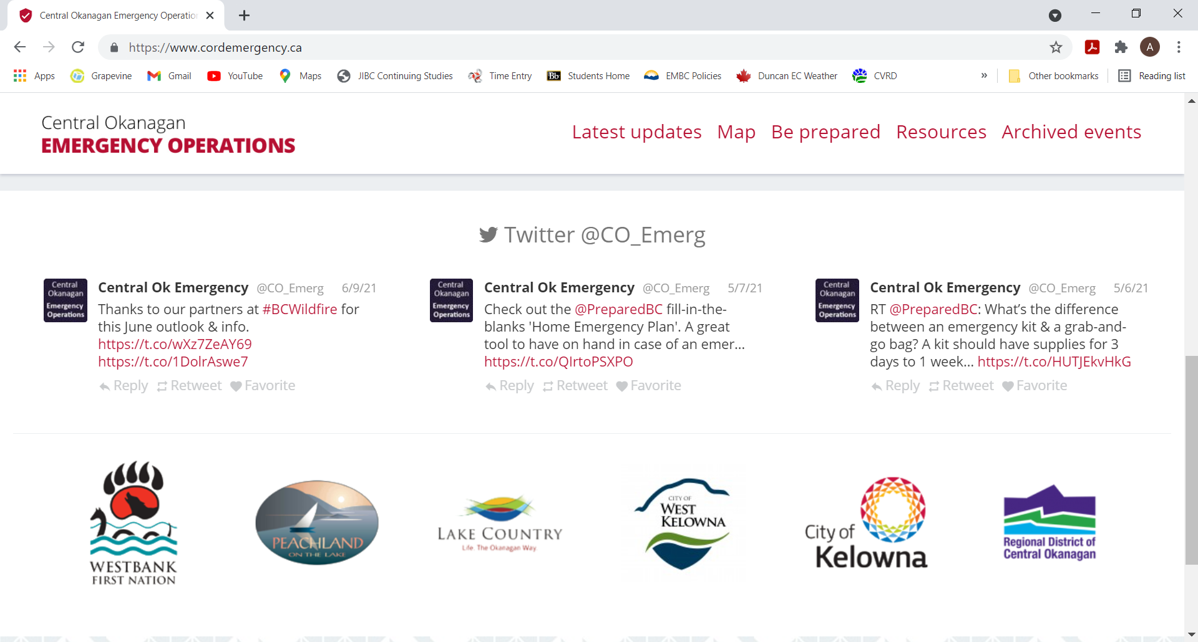

Slide 24
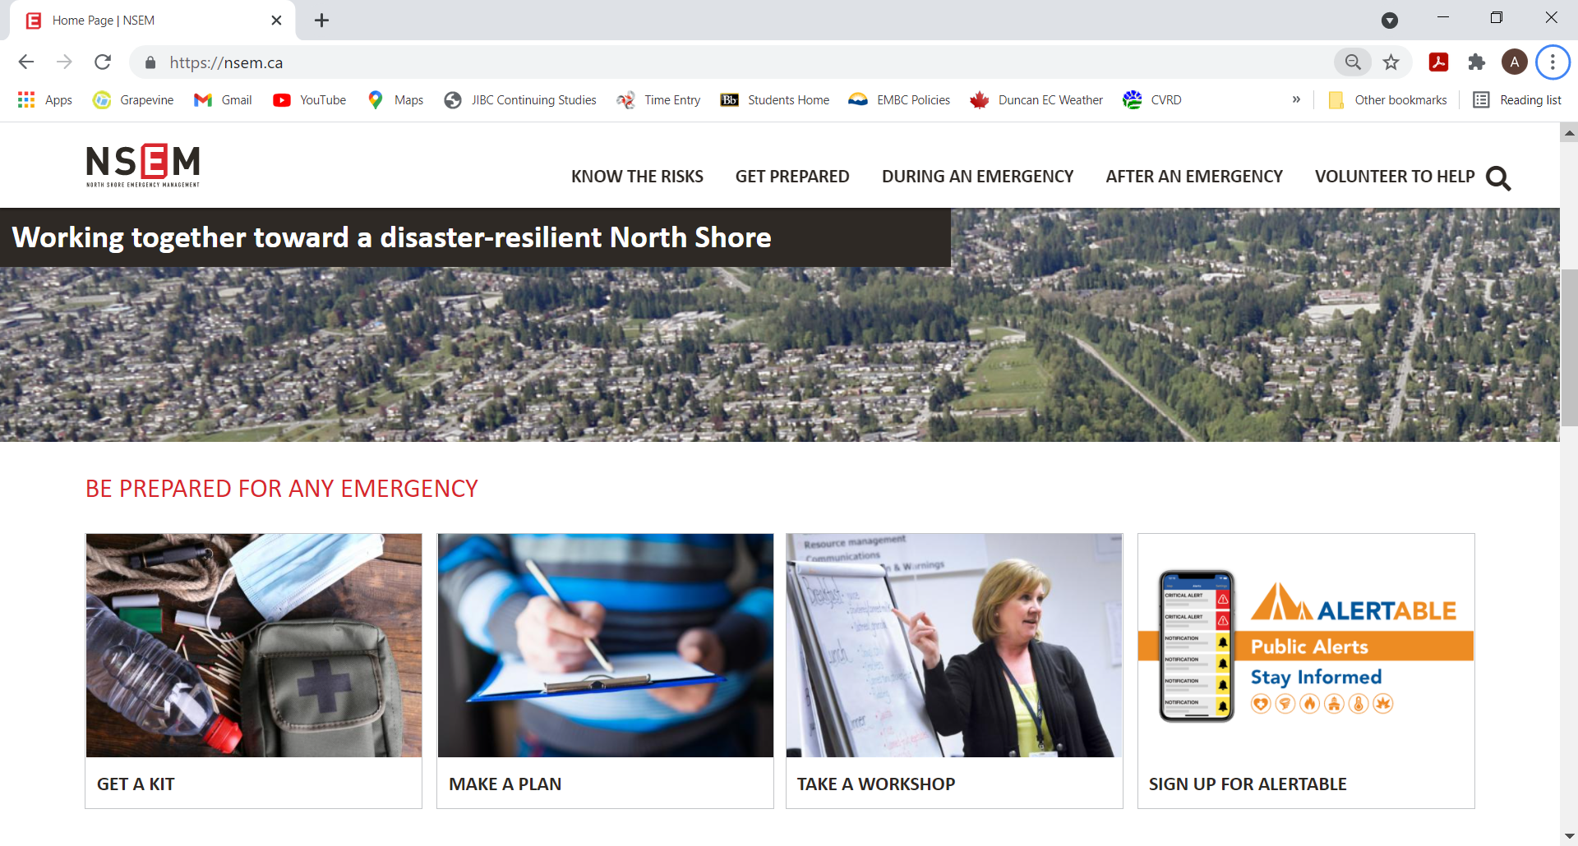
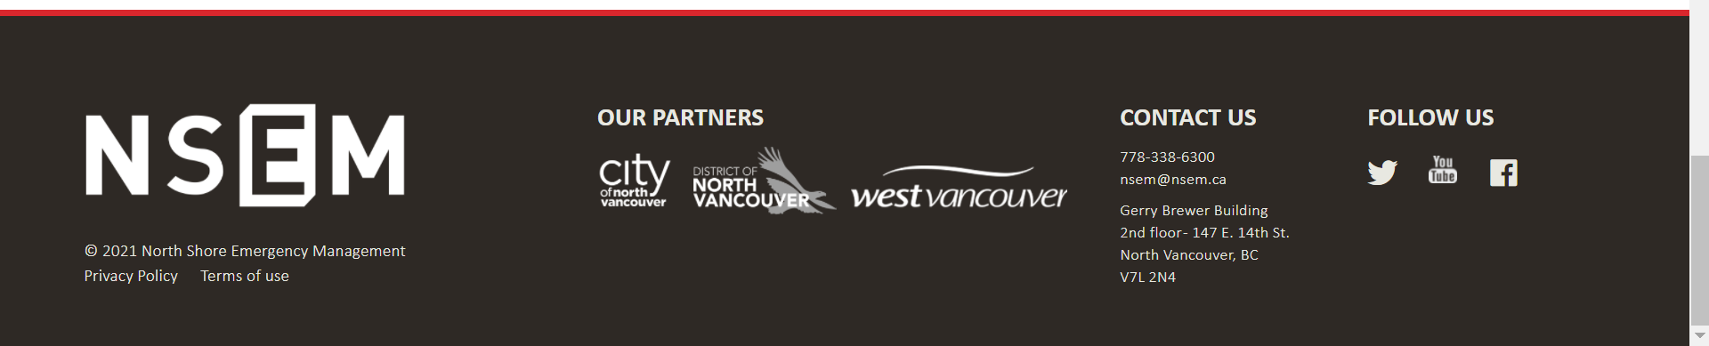

Slide 25
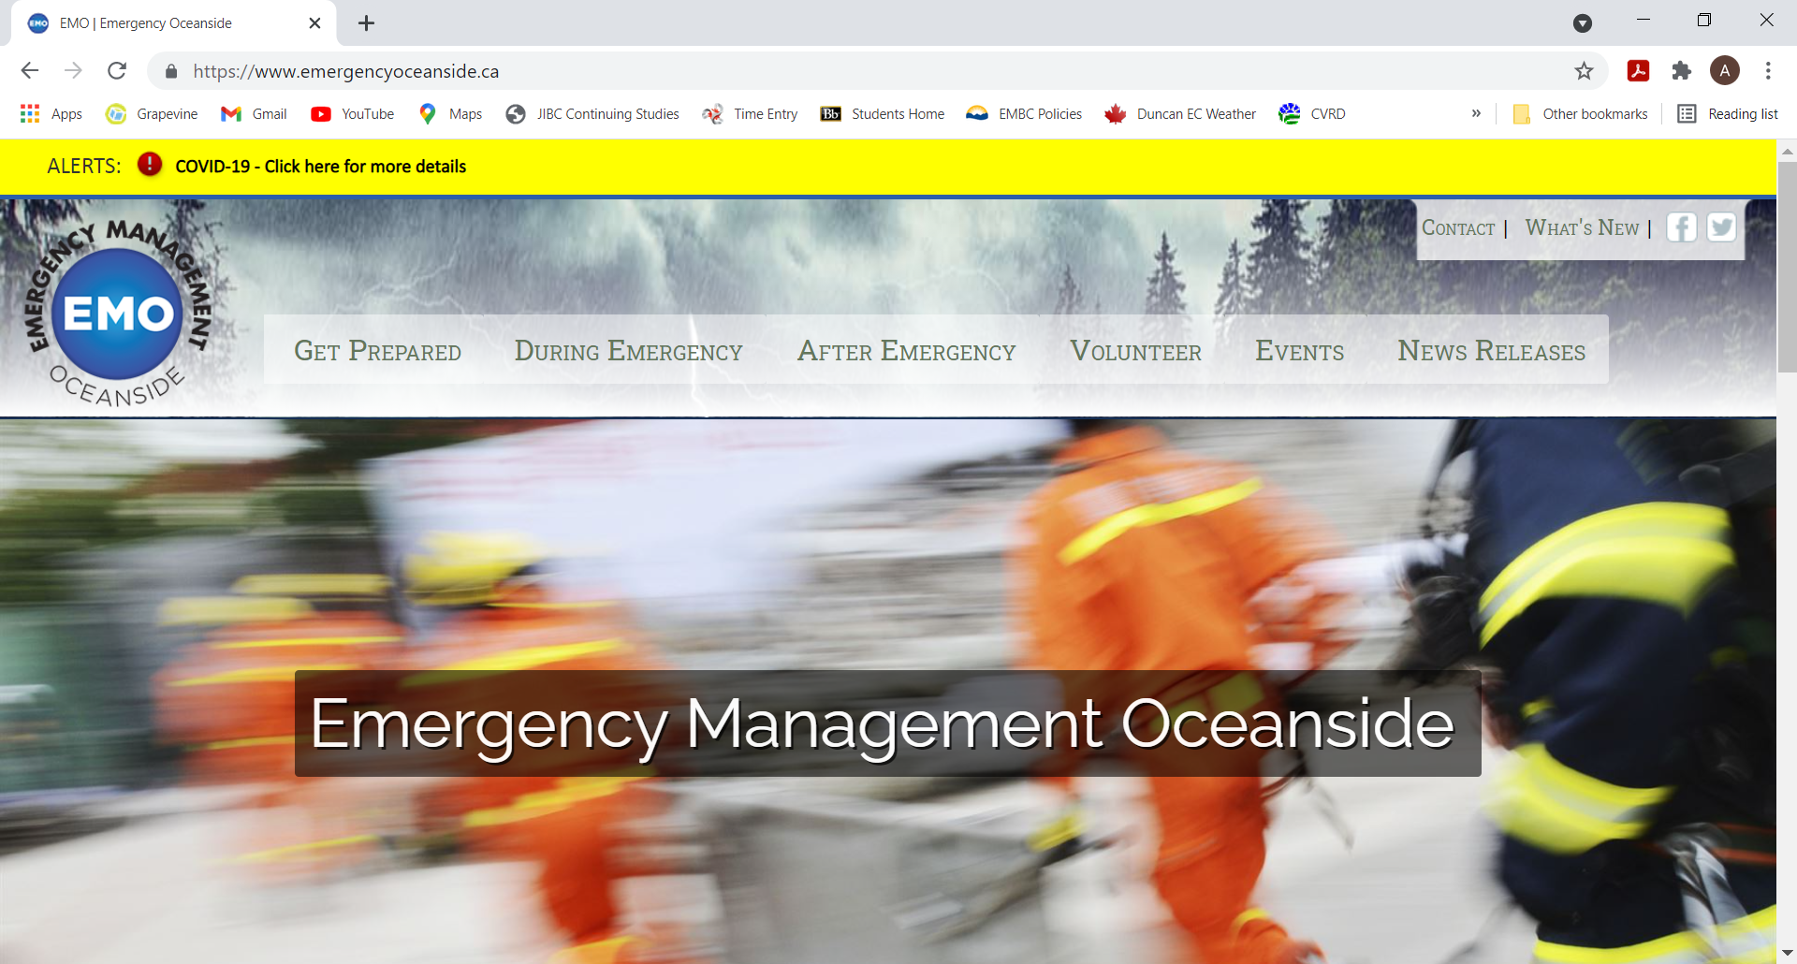

Slide 26
 | Blended Model |  |  |  |  |  |  |  |  | Regionalized Model
 | Estimate per Municipality |  |  | Estimate for CVRD (filling the gap for EAs) |  |  | Estimate for gap in Emergency Program Service |  |  | Estimate for Combined EMO
 | Development (per Municipality) | Annual Operations / Ongoing | Other resources required | Development | Annual Operations / Ongoing | Other resources required | Development | Annual Operations / Ongoing | Other resources required | Development | Annual Operations / Ongoing | Other resources required
TOTAL HOURS | 1202 hours | 1037 hours | - | 845 hours | 904 hours | - | 393 hours | 752 hours | - | 1948 hours | EMO 2136 Partners 86 | -
Hours Per Local Authority | 1202 hours | 1037 hours | - | 845 hours | 904 hours | - | 393 hours | 752 hours | - | 390 hours | 513 hours
Summary Ongoing Impact | 0.75 – 1 FTE* |  |  | 0.75 FTE |  |  | 0.5 – 0.75 FTE |  |  | 1.75 - 2 FTE for the EMO 86 hours per year for each partner (for review, consultation, etc.)

Slide 27

+ no significant change management required
- regulatory non-compliance
- missing essential program elements (increased safety risk)
-municipal resources continue to be impacted ad-hoc
- poor response to events as they increase in frequency and complexity
- escalating response costs
Option 2 - Blended Model w/ Recommendations
+ familiar model
+ local authorities can proceed at their own pace (relative to their own risk tolerance)
- complex governance
- confusing to the public
- disproportionate (may unfairly disadvantage smaller communities, larger communities may not get full value)
Option 3 - Regionalized Model
+ efficiency of resources
+ collaborative
+ increase public confidence (recognizable brand, less confusing)
+ more sustainable / adaptable
+could be phased
- governance may take time to establish
Option 1 -
Status Quo
Local Authorities
CVRD EPS
Cowichan EMO
Strengths
Challenges

Slide 28
Financial Impact – Staff Costs
Model | Staff Increase | Financial Impact | 2021 Example
Blended Model (Current Model + Recommendations) | 1. 0.75 FTE for each Local Authority 2. 0.5 FTE for the CVRD Emergency Program Service | 1. Estimate to add role to each local authority will vary depending on existing capacity and desired classification/responsibilities. 2. $80,936 increase to 205 requisition for CVRD Emergency Program Service. | Varies Cost per $100,000 household - $3.74 (up from $3.41)
Regionalized Model (one emergency management organization) | n/a 2.0 FTE for the EMO / Emergency Program Service | 1. No local authority requirement to add positions – plan for 86 hours per year to support consultation, review and approval of program pieces. 2. $323,743 increase to 205 requisition for CVRD Emergency Program Service. | n/a Cost per $100,000 household - $4.70 (up from $3.41)

Slide 29
Financial Impact - Other Considerations Included
Element | Justification | Development / One Time Cost | Annual Operating Cost
HRVA | Consultant/engineering firm (technical expert) to facilitate process | $25,000 (per local authority) OR $35,000 – 50,000 for all under one EMO | n/a
Emergency Planning / Firesmart Program | Consultant/firm to support development of keys plans/programs | $50,000 | n/a
Addition of vehicle(s) | Disaster supplies and 2nd ESS Trailer require towing. ESS is often required to transport victims and taxis are not available 24/7. | $120,000 | $10,000

Slide 30
Financial Implications – Not included
Element | Justification | Development / One Time Cost | Annual Operating Cost
Dedicated REOC / Training Centre | Ensures availability of an EOC/REOC for all partners. Options range from renovating the CCC as a dedicated space (lower operational cost than current operational cost) to a new site and lease (higher operational cost). | $100,000 - $750,000 | Current operating cost is $58,000/year. New costs could be +/- $25,000 to 50,000.

Slide 31
Option 3 - Phases
PHASE 1 - 2022
Establish governance with Local Authorities and First Nations
Agreed Work Plan for EM Organization
Grants
PHASE 2 – 2023
Assess EPA act, implement requirements
Dedicated regional EOC
Implement full program

Slide 32
Recommendations:
Establish a single regional Emergency Management Organization (EMO) for all Cowichan area local authorities.
Through the newly established Cowichan EMO, implement the report’s recommendations in a phased approach.

