Slide 1



Our Health, Our Community
A Cowichan Valley Region Health & Wellness Survey
For the Town of Lake Cowichan
By Dr. Shannon Waters & Vanessa Daether
December 13, 2022

Slide 2

Survey Overview
Unique opportunity for Cowichan Valley Region
Local-level data on the health & wellness, neighbourhood characteristics, & community belonging of Cowichan Valley residents who are 18 years & older
Standardized and region-specific questions will be developed in consultation with our communities
  80+ questions (with adjustments)
  We want to far surpass 4,500 responses!!

Slide 3
Value to Local Government
Our goal is for the results of this survey to identify the health status, health inequities & priorities of Cowichan Valley residents & to support local evidence-based decision-making around:
  Community health & wellbeing programs & initiatives
  Healthy community planning & creating health-promoting environments
  Healthy public policy development & implementation
  Resource allocation & funding opportunities
  Much more!

Slide 4






How this survey data has been used in other regions
Used to inform the GP For Me Initiative & the development of the Patient Medical Home pilot project
Used to determine service gaps & allocate resources accordingly in Metro Vancouver
Used for planning programs & services to address key health indicators & risk factors
Used to inform the City of Vancouver’s Health City Strategy
Used to inform the Walk30 Burnaby New West initiative
Source: myhealthmycommunity.org

Slide 5
What are some priority areas for the Cowichan Valley Region that this survey could help inform response on?

Slide 6
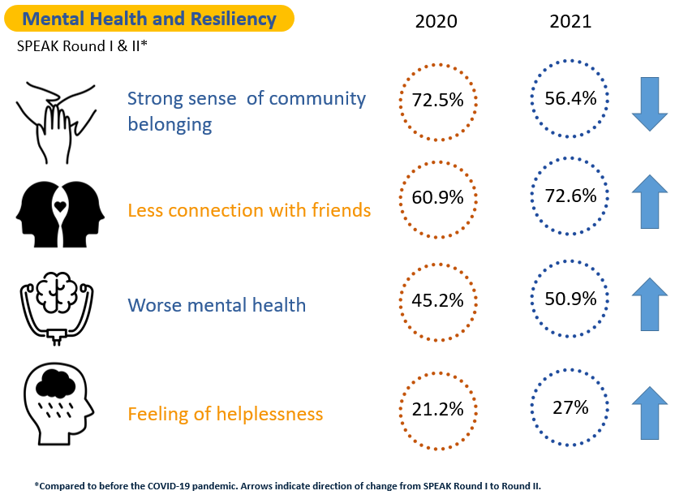
Mental Health & Resiliency
(Cowichan Valley North)

Slide 7
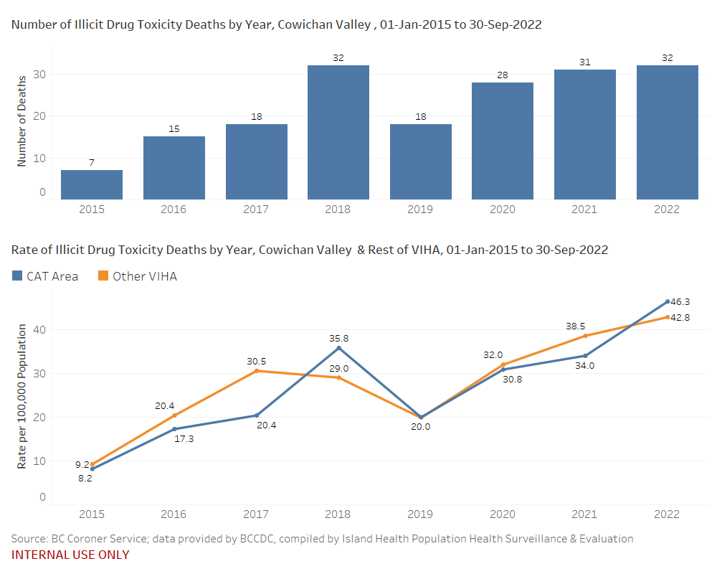
Illicit Drug Toxicity Crisis

Slide 8
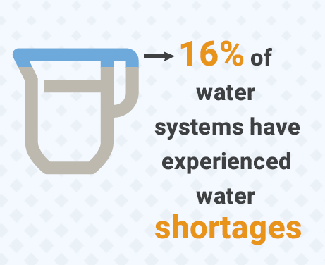
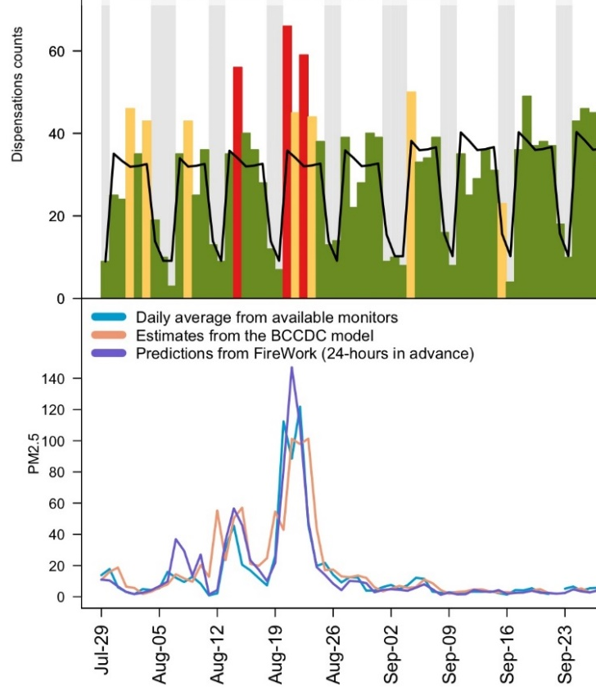
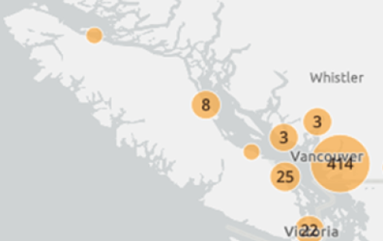
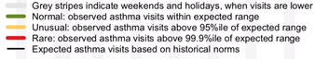
Climate Crisis
2021 Island
Health Drinking
Water Operator
Survey
Asthma
Monitoring
Salbutamol
Dispensations
for Cowichan
LHA, 2018/19
Air
Quality
Heat-related mortality during 2021 Heat Dome

Slide 9
Survey Timeline
Survey Development (Winter 2022-2023)
Launch Survey & Analysis (Spring 2023)
Report back (Summer 2023)
Community Engagement (Ongoing)

Slide 10
Inform
Discuss the survey, share resources & information, & share back results
Involve
Partner with communities on survey design, engagement, & analysis plans that meet community needs
Collaborate
Work with communities to interpret survey results & identify ways to use the data for action
Empower
Support communities to use the survey results for meaningful change
Consult
Engage our communities to identify local priorities & survey questions
Community Engagement
Adapted from the IAP2 Spectrum of Public Participation

Slide 11
Working Together
What are your health & wellness question priorities?
Submit 5x questions by January 25, 2023
Promote the survey!

Slide 12


Thank you
For more information:
www.ourcchn.ca/survey
Shannon.Waters@islandhealth.ca
vanessa@daether.ca

