Slide 1

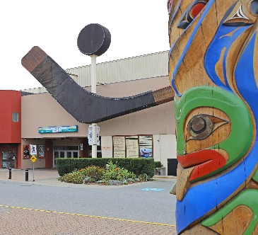
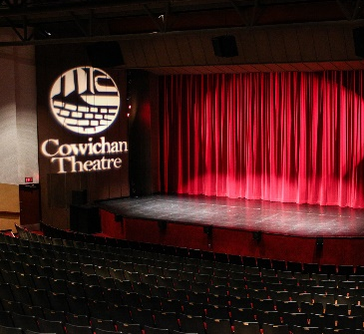
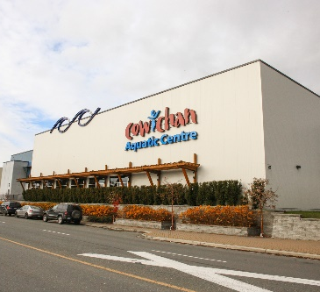
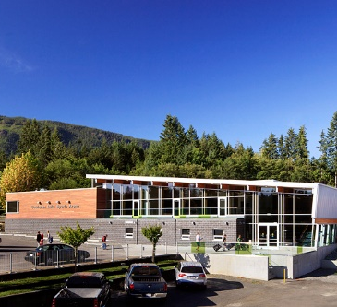
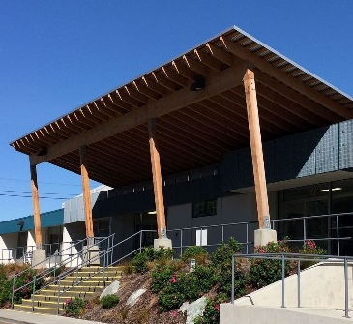
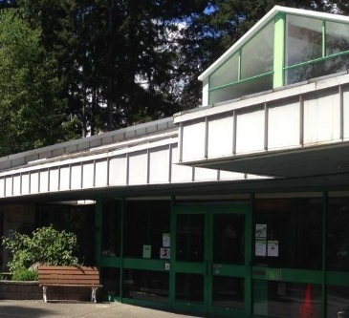
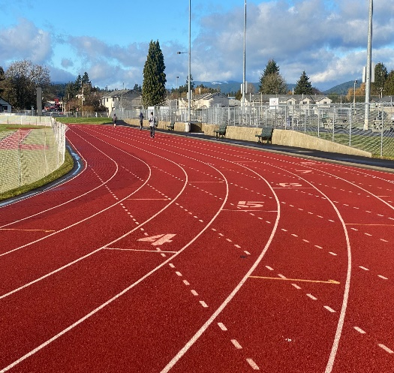
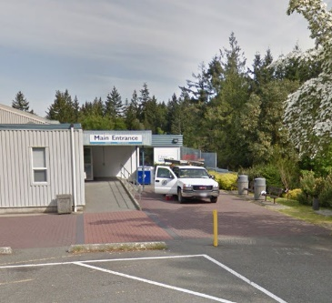
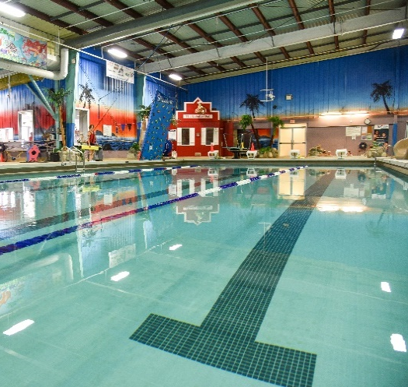
PLAY FAIR PAY FAIR
CVRD Regional Referendum
Regional Recreation Funding Services
Town of Lake Cowichan
October 3, 2022

Slide 2
BACKGROUND
Fuller Lake Arena
(late 1960’s)
7 Other Recreation Facilities
Cowichan Aquatic Centre
(2008)
Notes:
The fair, equitable funding for Cowichan’s publicly funded recreation facilities has been an issue since Fuller Lake Arena was constructed in the late 1960’s.
Since the 1960’s:
7 other major Recreation facilities have been constructed
Some facilities have a better direct correlation between taxpayers and users, than others
The ninth major facility, and the most recently constructed was the Cowichan Aquatic Centre, which opened in 2008.

Slide 3
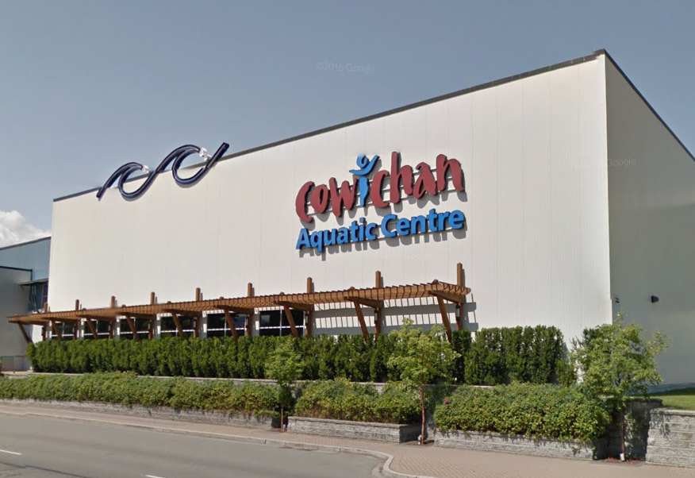
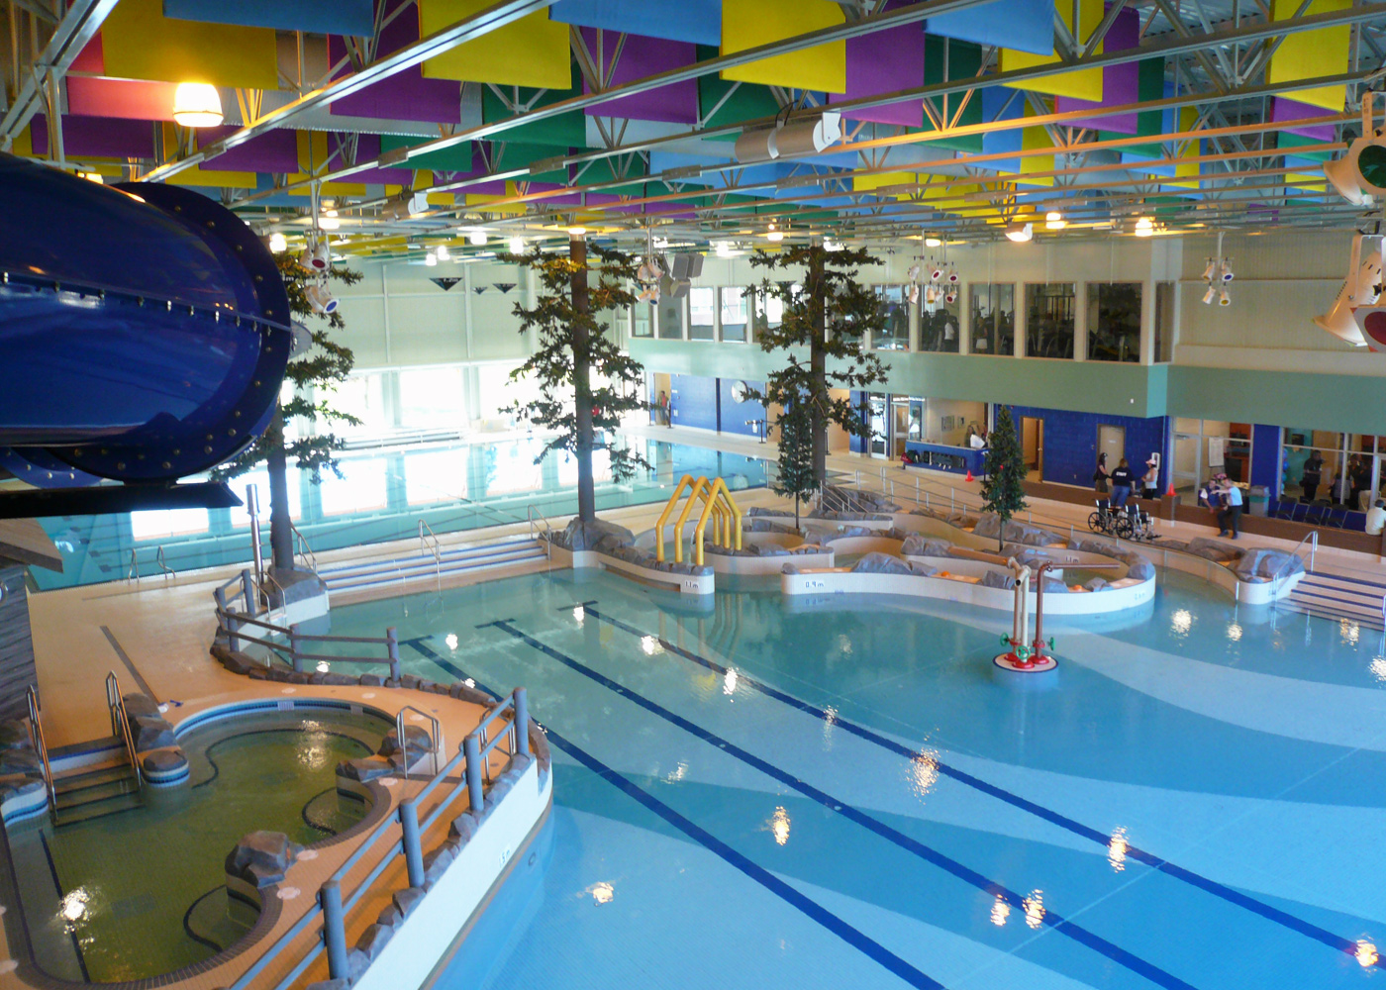
BACKGROUND
Cowichan Aquatic Centre
Notes:
North Cowichan and Duncan, prior to construction of the Cowichan Aquatic Centre, sought other jurisdictions to contribute tax dollars to the facility.
North Cowichan and Duncan said at the time that for areas where there was no tax support, residents would be subject to a higher admission fee.
Cowichan Tribes was the only jurisdiction at that time to contribute funding.
North Cowichan and Duncan exempted Areas G, H and Ladysmith from the higher admission fees, because of their existing contributions to the Frank Jameson Community Centre in Ladysmith.
Residents of all other Electoral Areas, and the Town of Lake Cowichan, were subject to “two-tiered fees” to use the Cowichan Aquatic Centre.
Over the next few years, each jurisdiction, either individually or as part of a group, negotiated with North Cowichan and Duncan on a contribution to the Cowichan Aquatic Centre to remove the two-tiered fees.
Some areas’ contribution was publicly approved and some were directed through another CVRD function.

Slide 4
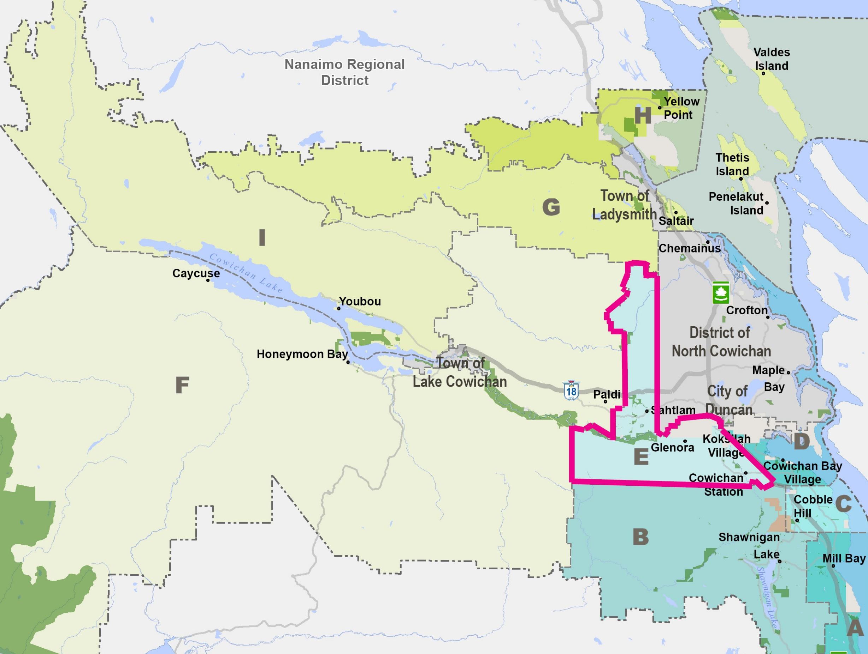
BACKGROUND
Electoral Area E
Cowichan Station / Sahtlam / Glenora
Notes:
Electoral Area E, Cowichan Station / Sahtlam / Glenora, negotiated with North Cowichan and Duncan to have an initial contribution and public consent process, to eliminate the two-tiered fee, and to have a second public consent process to raise the contribution to appropriate levels.
An Alternate Approval Process (AAP) was conducted in Electoral Area E in 2015 to raise the contribution to the Cowichan Aquatic Centre. The AAP failed, and the results were reported to the CVRD Board in the fall of 2015.

Slide 5
BACKGROUND
The CVRD Board directed that a review of funding for Recreation across the region be conducted.
North Cowichan and Duncan chose not to re-impose two-tiered fees until that review had been concluded.
Since October 2015, the CVRD has undertaken a Regional Recreation planning initiative.
Notes:
The CVRD Board directed that a review of funding for Recreation across the region be conducted. North Cowichan and Duncan chose not to re-impose two-tiered fees until that review had been concluded.

Slide 6
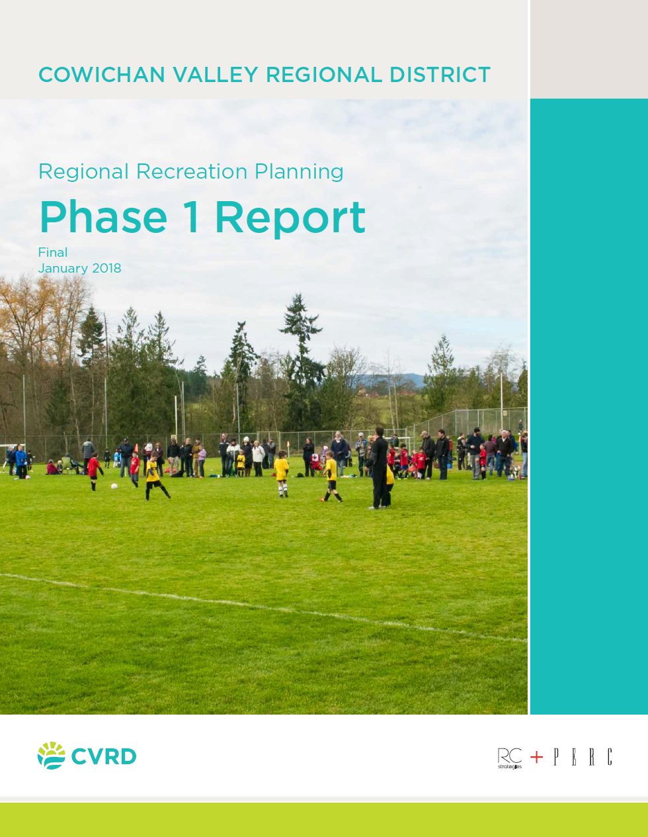
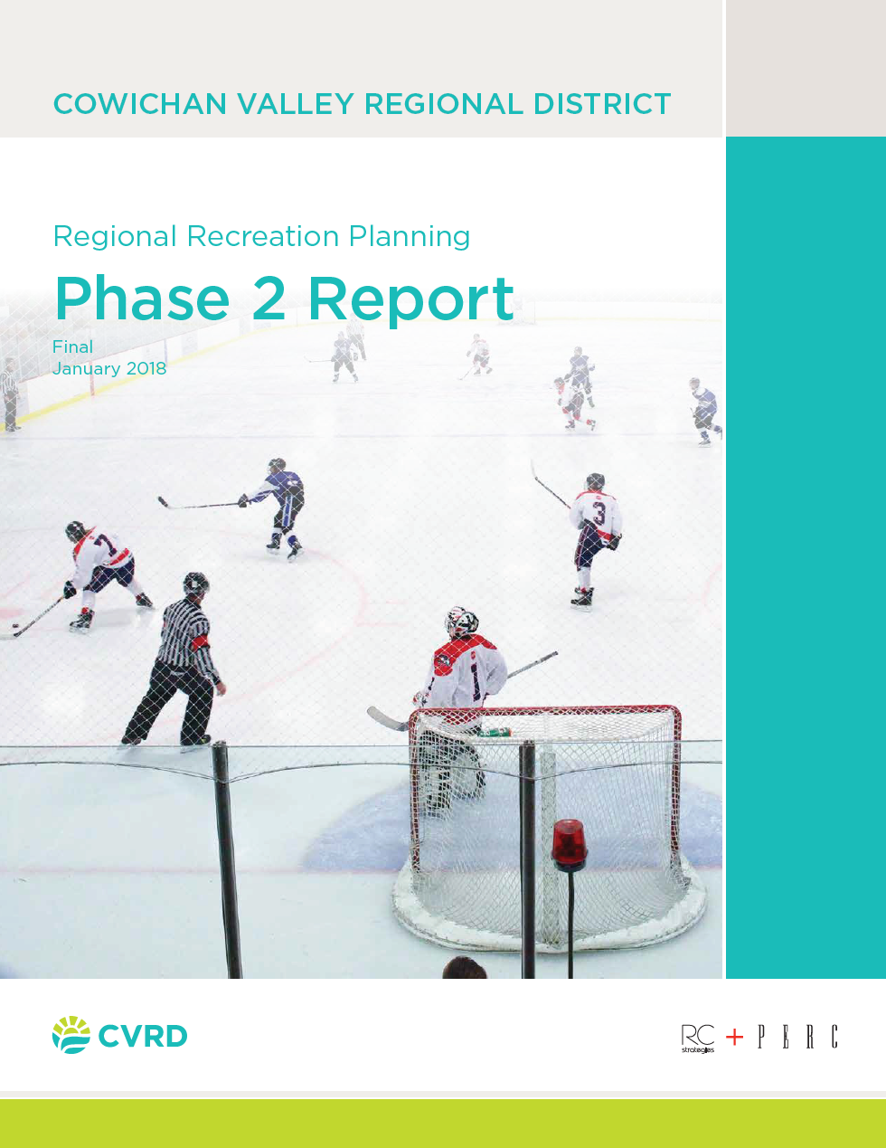

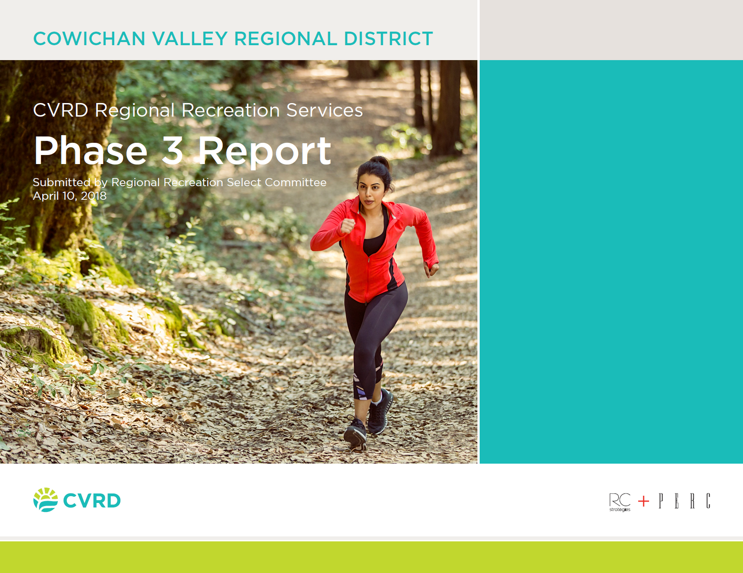
BACKGROUND
This Regional Recreation initiative included the following four phases:
Phase 1: Initial Public Engagement to Identify Gaps
Phase 2: Determine Geographic Residency of Major Facility Users
Phase 3: Identify Potential Regional Funding Models
Phase 4: Regional Recreation Strategic Plan
Notes:
The work was broken into four phases.
Phase 1: Large public engagement exercise to get input on the wants and needs of the community for recreation services, now and in the future.
Phase 2: Facility use study – for the nine regionally significant facilities, we gained information on residents of which areas used which facilities.
Phase 3: A review of funding models. The Board was unable for a time to choose an appropriate alternate funding model, so Phase 4 was completed before a return to phase 3.
Phase 4: A Regional Recreation Strategic Plan to identify priorities, and facility and amenity strategies.
All of these reports can be found on the Plan Your Cowichan project site.

Slide 7
MOVING FORWARD
In August of 2019, the Board passed a resolution to approve, in principle, funding nine regionally significant recreation facilities on the basis of the residency of uses.
Notes:
We returned to Phase 3, and in August of 2019, the Board passed a resolution to approve, in principle, funding nine regionally significant recreation facilities on the basis of the residency of uses, including the Cowichan Community Centre, the Cowichan Performing Arts Centre, the Cowichan Aquatic Centre, the Cowichan Lake Sports Arena, the Kerry Park Recreation Centre, the Shawnigan Lake Community Centre, the Cowichan Sportsplex, Fuller Lake Arena, and the Frank Jameson Community Centre in Ladysmith.
It should be noted that the nine regionally significant recreation facilities are owned and operated by different public entities, which complicates governance. Five facilities are owned and operated by the Cowichan Valley Regional District (CVRD), three are owned and operated by municipal governments, and one is owned by a municipality but operated by a not-for-profit society.

Slide 8

ASSUMPTIONS & PRINICIPLES
Zero Sum Result
Debt
Funding Now vs. Funding in Future
Participation
Current Capital
Changes to Ownership or Operating Entity
Notes:
The following assumptions and principles have been developed that underpin what needs to be done to make the new funding formula work. These are explained further in the “Frequently Asked Questions” portion of the Plan Your Cowichan project site. I’ll go into these in the next few slides.

Slide 9
ASSUMPTIONS & PRINICIPLES
Zero Sum Result
Shift who pays in the current funding model for regionally significant recreation facilities
No intent to change the overall level of funding
Notes:
Zero Sum Result:
This new funding model would shift who pays into the current funding for regionally significant recreation facilities. There is no intent in this new model to change the overall level of funding, which is a separate decision.

Slide 10
ASSUMPTIONS & PRINICIPLES
Debt
Taxpayers in the jurisdictions that authorize debt for regionally significant recreation infrastructure, need to assume it
Taxpayers will only participate in funding of debt service charges associated with that function, if they agreed to the debt initially
Notes:
We considered debt.
Taxpayers in the jurisdictions that authorize debt for regionally significant recreation infrastructure, need to assume it. While other jurisdictions can contribute to the operation of a specific regional recreation function, they will only participate in the funding of the debt service charges associated with that function if they agreed to the debt initially. They can’t be forced to participate in debt servicing after the fact.

Slide 11
ASSUMPTIONS & PRINICIPLES
Funding Now vs. Funding in Future
New debts in future will require new authorization
Notes:
Funding Now vs. Funding in Future:
Committing to fund the operation of a specific regionally significant recreation amenity should not obligate a jurisdiction to fund future changes to the facility or any future long term debt. Any new debt will require new authorization. Any new facilities added to a funding model will require separate authorization to develop that facility before it gets added to the regional funding formula.
Let me give an example at this point. Let’s say, ten years from now, three electoral areas would like to move ahead with a new aquatic facility. The residents of these 3 electoral areas would be responsible for construction costs, and any debt related to the construction. And those three areas should request the rest of the region contribute to the operating and ongoing capital costs, with each area’s contribution determined by their usage.

Slide 12






ASSUMPTIONS & PRINICIPLES
Participation
All jurisdictions need to participate in the function for the new funding formula to work effectively
Notes:
Participation:
All jurisdictions need to participate in the function for the new funding formula to work effectively. This model falls apart if any jurisdictions in the region are not a part of it.

Slide 13
ASSUMPTIONS & PRINICIPLES
Current Capital
Operating budgets and short-term capital budgets are both required to maintain a current level of service
Significant additions to a facility and/or incurring long term debt to develop a new facility need to be treated separately
Notes:
Let’s talk about capital.
Operating a recreation facility also involves current capital. Maintaining the functionality of a facility includes operating costs, but also includes long term lifecycle maintenance funding, replacement of small capital items and emergency capital outlays (e.g. if a roof starts to leak or piece of major equipment breaks down and needs to be replaced, the operator has little choice but to incur a capital cost that is required to keep the building operational). So, operating budgets and short-term capital budgets are two sides of the same coin and both are required to maintain a current level of service, and both are included in the usage-based funding model.

Slide 14
ASSUMPTIONS & PRINICIPLES
Changes to Ownership or Operating Entity
No changes to the ownership or operating entity of facilities are required
Current collaboration / cooperation is sufficient
Notes:
Changes to Ownership or Operating Entity:
No changes to the ownership of facilities are required, nor is any change necessary to the operating entity of any facility. Across BC there are many examples of regionally significant recreation facilities that are financed by regional taxpayers, but are not operated by the Regional District. There are also many examples where a Regional District contributes to the operation of a facility which is owned and operated by a municipality or a not-for-profit society.

Slide 15
REFERENDUM
On October 28, 2020, the CVRD Board approved a referendum to seek elector approval to implement usage-based funding of the nine regionally significant recreation facilities be held in conjunction with local government elections in October 2022.

Slide 16
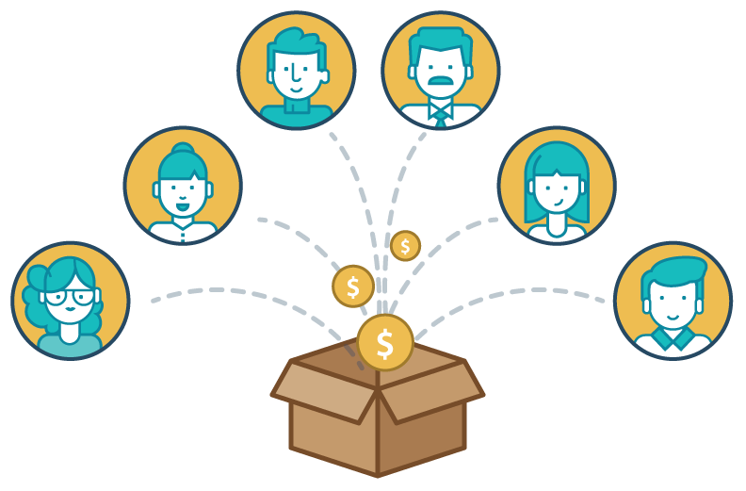
ADOPTING NEW FUNDING FORMULA
2021 / 2022 Facility Use Analysis
Presentation to Board of Financial Implications to Jurisdictions
Provincial approval of a proposed service bylaw
Voter Consideration
Creation of New Region-Wide Recreation Function
Phasing-In the New Funding Formula
Updating the Usage Data
Mandated Review
Notes:
To continue to move forward, we did another facility usage analysis from last September (2021) through this March (2022). The averages of usage through this, and the 2017 / 2018 study are being used to calculate impacts. The Board was presented a snapshot of financial implications. We’re currently on step 4, with Voter Consideration in the upcoming Regional Referendum.

Slide 17
ADOPTING NEW FUNDING FORMULA
Creation of New Region-Wide Recreation Function
Would set a limit of total funding which allows some variance and emergency capital funding
Intended to replace current funding through existing functions
Notes:
There would be a limit of total funding which allows for some variance and emergency capital funding in order to not unduly limit the sustainability of the operation of the nine facilities. This new function would be intended to replace current funding through existing functions and programs for a net zero overall effect on total funding of the nine facilities (no increase or decrease in funding, but a shift from where the funding is derived).

Slide 18
ADOPTING NEW FUNDING FORMULA
Implementing the Funding Process
Each facility operator would prepare their budget, clearly identifying the requisition amount
Budgets would then be considered by the CVRD Board
Notes:
Implementing the Funding Process:
The budget for each facility would be prepared by the operator, clearly identifying the requisition amount. This budget would then be sent to the CVRD Finance department and each of the nine facilities’ requisition would be allocated based on usage of the 13 jurisdictions.
As you can see on this slide, budgets are decided by the CVRD Board.

Slide 19
ADOPTING NEW FUNDING FORMULA
Phasing-In the New Funding Formula
New funding model would be phased-in over three years
1st year: 1/3 of funding allocated on the basis of usage (new model) and 2/3 based on existing
2nd year: 2/3 of funding allocated on the basis of usage (new model) and 1/3 based on existing
3rd year: All net costs apportioned on basis of usage
Notes:
Here’s where we talk about Phasing-In the New Funding Formula:
Because significant change in shifting to a new funding formula will cause some stress on some taxpayers, the change from the current funding model to the new funding model is to be phased-in over three years. In 2023, one third of the net costs would be allocated on the basis of the new usage model and two thirds based on existing sources of funding. In the second year, two thirds of the net cost would be funded on the basis of the usage model and one third based on the past model. In the third year of the shift, and each year thereafter, all the net costs should be apportioned on the basis of the new usage based model.

Slide 20
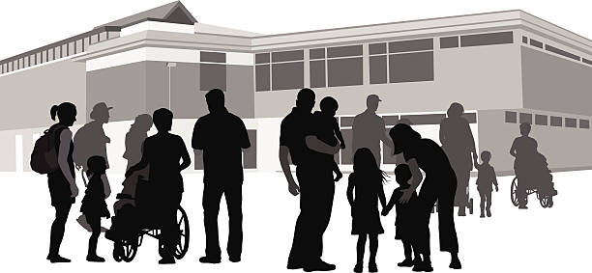
ADOPTING NEW FUNDING FORMULA
Updating the Usage Data
5 year data collection cycle would be adopted
Rolling average of past 3 data collection cycles moving forward
Notes:
Updating the Usage Data:
Collecting the usage data and assigning residency to it is a significant undertaking that will have cost attached to it. To track changes in the residency of uses and update the funding formula, a five year data collection cycle would be adopted. Every five years the residency of uses of the regionally significant recreation facilities would be collected. In order to soften any significant changes from one data collection cycle to the next, a rolling average of the past three data collection cycles would be adopted to smooth out peaks and valleys. Until a third set of data is collected in 2027, and for the next five years, we would be using the average of the 2017 and 2022 data collection periods.

Slide 21
ADOPTING NEW FUNDING FORMULA
Review of Governance & Funding for New Function
New funding model would have built-in review period
This will potentially improve the funding model and governance system
Notes:
There will be a review of the new function in six years time.

Slide 22
FINANCIAL IMPLICATIONS
3 Examples for Town of Lake Cowichan (TLC)
EXAMPLE #1: Cowichan Aquatic Centre
In 2019, total tax requisition from all jurisdictions: $2,881,707
In 2019, total tax requisition from TLC: $12,200
TLC usage of Cowichan Aquatic Centre: 2.25%
What TLC would pay under usage-based model (2019): $64,838
An increase of: $52,638
Notes:
So what does all this mean for, in this case, Town of Lake Cowichan? The information here was presented to the Board on May 11, and is a snapshot if facilities in 2019, the last year pre-Covid, had budgets based on usage.
Note that the percentage of use is based on the average between 2017 and 2022 facility use data
So the Cowichan Aquatic Centre.
In 2019, the total tax requisition for the Cowichan Aquatic Centre was, $2.88M. Of that, Town of Lake Cowichan paid $12,200.
We’ve determined Town of Lake Cowichan’s usage of the Cowichan Aquatic Centre is 2.25%. Under the usage based model, Town of Lake Cowichan should have paid $64,838, which is an increase of $52,638.

Slide 23
FINANCIAL IMPLICATIONS
EXAMPLE #2: Cowichan Lake Sports Arena
In 2019, total tax requisition from all jurisdictions: $1,727,771
In 2019, total tax requisition from TLC: $404,796
TLC usage Cowichan Lake Sports Arena: 30.55%
What TLC would pay under usage-based model (2019): $527,834
An increase of: $123,038
Notes:
Now, the Cowichan Lake Sports Arena.
In 2019, the total tax requisition for Cowichan Lake Sports Arena was $1,727,771. Of that, the Town of Lake Cowichan paid $404,796.
We’ve determined Town of Lake Cowichan’s usage of Cowichan Lake Sports Arena is 30.55%. Under the usage based model, Town of Lake Cowichan should have paid $527,834, which is an increase of $123,038.

Slide 24
FINANCIAL IMPLICATIONS
EXAMPLE #3: Fuller Lake Arena
In 2019, total tax requisition from all jurisdictions: $694,280
In 2019, total tax requisition from TLC: $0
TLC usage of Fuller Lake Arena: 1.65%
What TLC would pay under usage-based model (2019): $11,456
An increase of: $11,456
Notes:
Note the next one, Fuller Lake Arena. Currently Town of Lake Cowichan does not pay for this facility. Under the usage-based model, Town of Lake Cowichan would have contributed $11,456 in 2019.

Slide 25
FINANCIAL IMPLICATIONS
TOTALS FOR TOWN OF LAKE COWICHAN
In 2019, total tax requisition from all jurisdictions: $15,790,267
In 2019, total tax requisition from TLC: $416,996
What TLC would pay under usage-based model (2019): $681,270
An increase of: $264,274
Notes:
For the nine facilities in 2019, the Town of Lake Cowichan’s expenditure, based on usage, would have exceeded the amount actually paid. In 2019, the Town of Lake Cowichan paid $416,996 to the nine regionally significant recreation facilities. Under a usage-based funding model, Town of Lake Cowichan would have paid $681,270, which is an increase of $264,274.

Slide 26

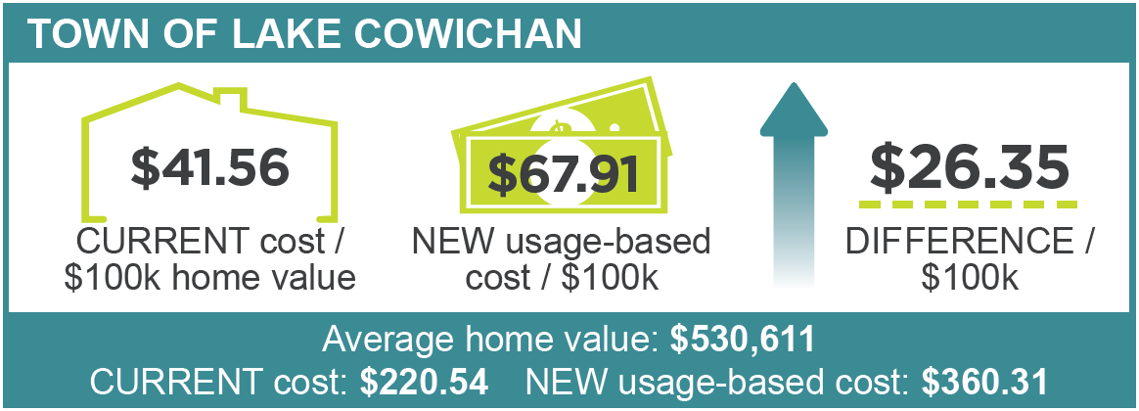
FINANCIAL IMPLICATIONS
WHAT DOES THIS MEAN FOR YOU?
Notes:
So what does this all mean for the residents of the Town of Lake Cowichan?
It means that you will see an increase in your taxes of approximately $26.35 per every $100k of your assessed home value.
This means that as an average home in the Town of Lake Cowichan is assessed at $531k, current annual cost for recreation services is around $221; under the new funding model their annual cost would be $360 which is an increase of $139 per year.
NOTE: Both current costs and usage-based costs are based on 2019 budget numbers to best represent normal expenditures from before the COVID-19 pandemic.
The percentages of use by jurisdiction are based on the average between the 2017 and 2022 data collection cycles.
Average home values are based on 2022 BC Assessment values.

Slide 27
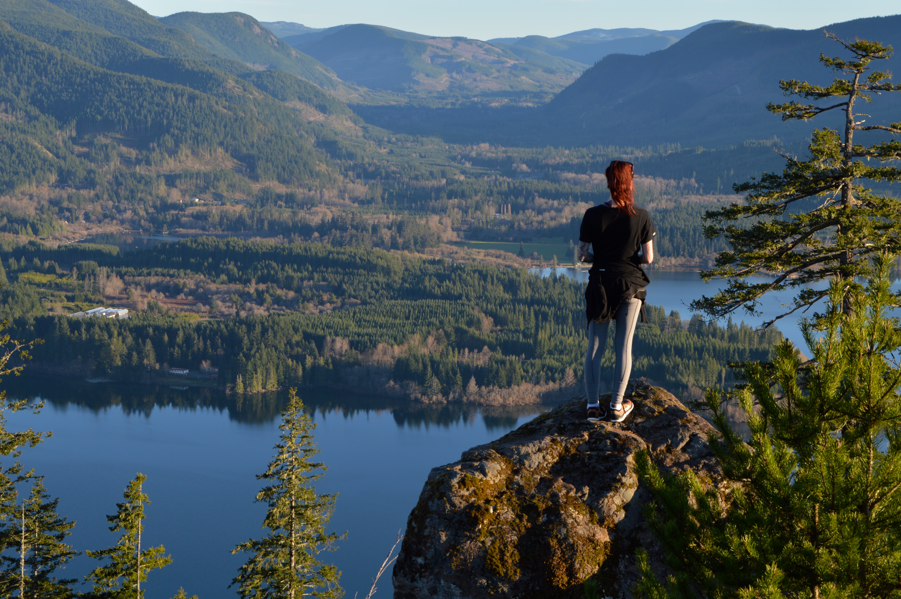
Questions?
Notes:
Thank you.

