Slide 1
Regional Recreation Facility Needs Assessment
Summary Presentation

Slide 2
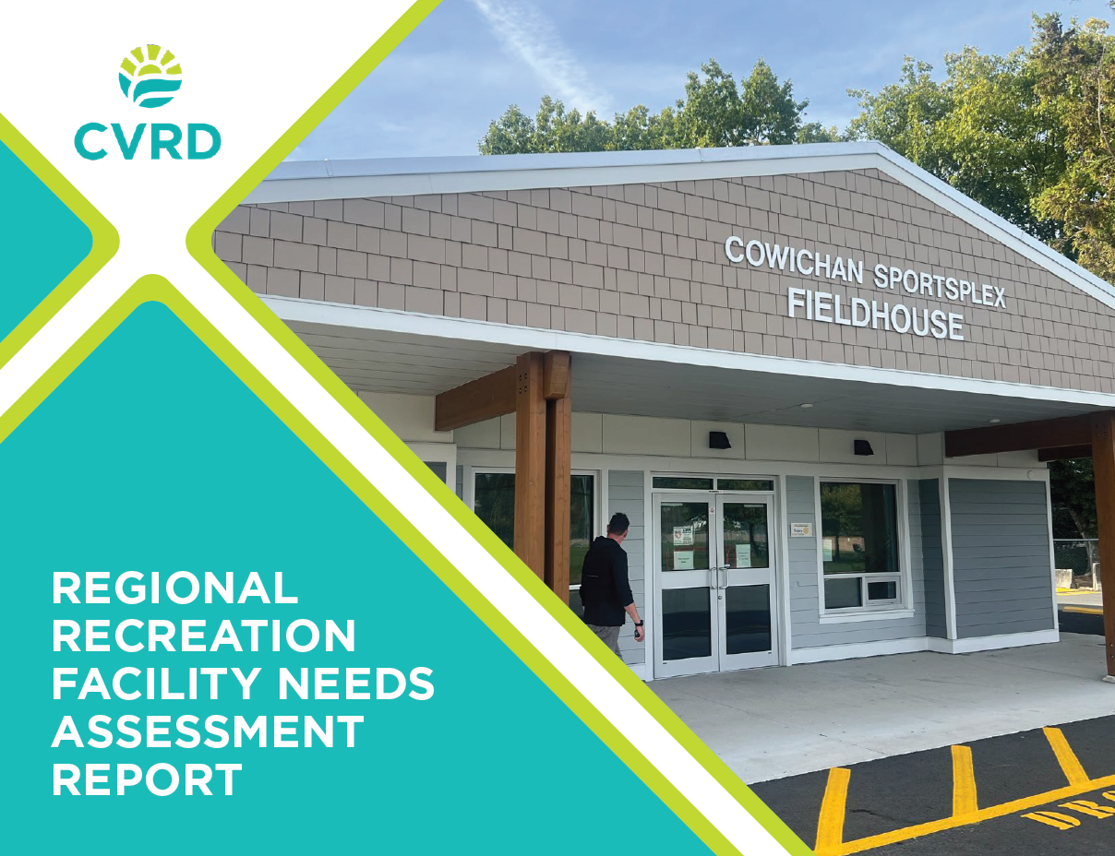
Presentation Overview
Needs Assessment Purpose and Process Overview
Recommended Infrastructure Strategies (Summary of Key Themes)
Questions

Slide 3
Study Purpose
Assess the current state of regional recreation amenity needs (trends, changes, gaps, etc.).
Review and update priorities from the 2019 Regional Recreation Strategic Plan.
Provide a resource that will help ensure future decision making is based on sound data and rationale.
*The focus on the Needs Assessment was on regionally supported recreation infrastructure and is not intended to supersede local municipal planning and priorities.

Slide 4
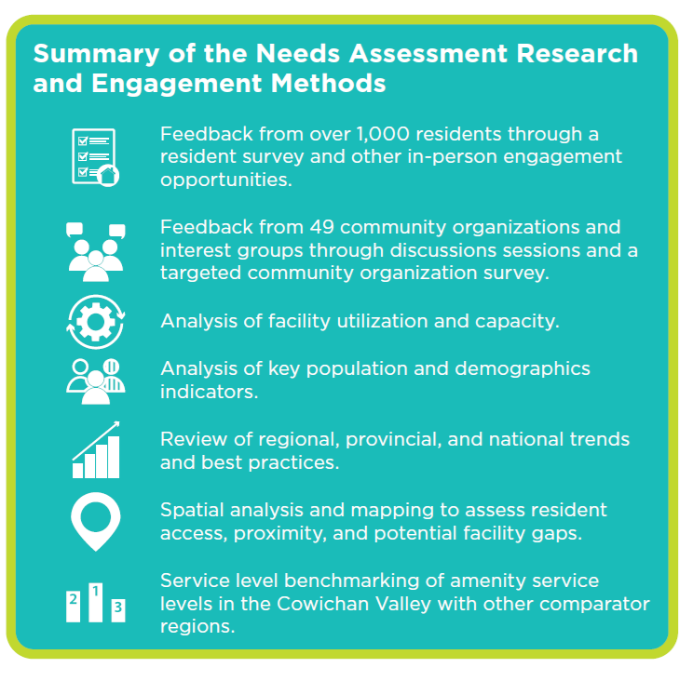
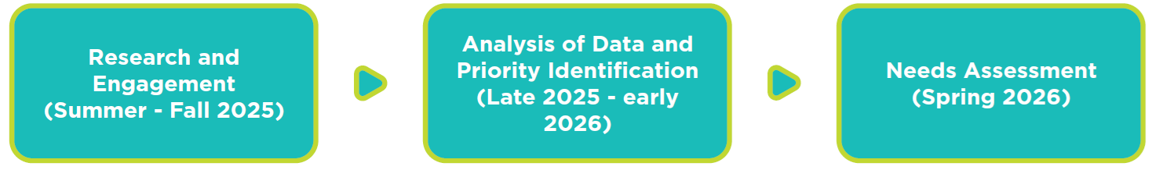
Study Process & Inputs

Slide 5
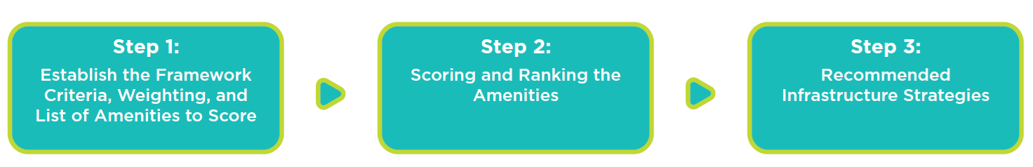
Recommendations and Priorities
The study contains strategies for 11 different types of recreation amenities, including those that currently exist at regionally significant facilities or may warrant future consideration for regional provision.
A 3-Step Prioritization Framework was used to inform the strategies.

Slide 6
Key Strategy Themes
Strategies Aimed at Sustaining Aging Infrastructure
Recommended as an overarching priority for the CVRD and regional partners.
Reinvestment into existing arenas, aquatics facilities, community programming spaces, the Cowichan Sportsplex (including track replacement), and Cowichan Performing Arts Centre to sustain existing service levels and best position these facilities for the future.

Slide 7
Key Strategy Themes
Planning Required for Potential Major Facility Development (Strategies to Help Plan the Next Generation of Regional Facilities)
1-2 new ice sheets by 2040, ideally as part of a multi-sheet facility.
Concept planning and cost validation for a third regional indoor aquatics facility to serve the south.
Options for a smaller scale performing arts venue to complement the CPAC.
As part of future major future facility development, identify opportunities to efficiently meet other amenity needs (gymnasiums, indoor walking tracks, and fitness spaces).

Slide 8
Key Strategy Themes
Strategies Suggesting that Trends Monitoring or Further Needs Analysis is Required
Feasibility study or regional pickleball strategy to explore a major ‘hub’ pickleball site.
Cowichan Sportsplex investments to explore: Covering the Weyerhaeuser Thunderbox and improvements to the natural surface infield to improve functional capacity (surface improvements, drainage upgrades, lighting).
*Improved data collection practices for casual / spontaneous use amenities are also recommended to help inform future planning.

Slide 9
Thank You!

