Slide 1



Covid-19 Vulnerable Populations
Cowichan Task Force
Emergency Response Plan
Start Date: May 19, 2020
CHA Annual Report
Town of Lake Cowichan
Regular Council
September 28, 2021

Slide 2
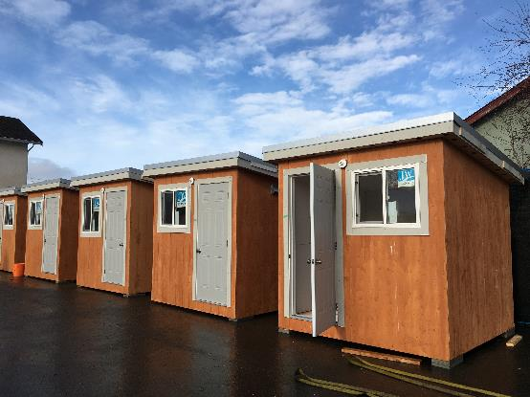
Year in Review - Outline
April 1, 2020 – March 31, 2021
“Compassion and tolerance are not a sign of weakness, but a sign of strength.” – Dalai Lama
The Year of the Pandemic
Our Programs
Regional Housing Service Highlights
Covid-19 Task Force for Vulnerable Populations
Financials (Breakdown of Funding)
Housing Crisis, Challenges and Needs Assessment
Emerging Issues
Housing Policy Challenges and Recommendations
Notes:
Year in Review
April 1, 2020 – March 31, 2021

Slide 3
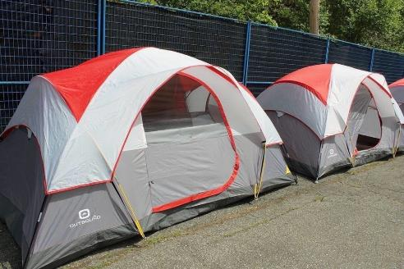
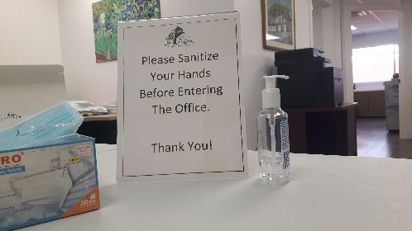
The Year of the Pandemic
March 11, 2020 WHO declared COVID-19 a pandemic
Concern for homeless population to access services and self-isolate
BC Housing funding to create temporary housing for people experiencing homelessness
Covid-19 Task Force for Vulnerable Population created emergency housing plan
Increase in homelessness: 270+ on waitlist for 99 units of supportive housing
      129 identified in 2020 PIT count
Dramatic rise in housing prices – average sale price for a single-family home $693,200, 28% jump in 12 months
Two pandemics (COVID & Opioids) and a housing crisis
Photo (above): Cowichan Valley Citizen
Notes:
March 11, 2020 World Health Organization declared COVID-19 a pandemic
Concern for homeless population to access services and self-isolate
BC offered funding to assist with the creation of temp. housing for people experiencing homelessness
Covid-19 Task Force for Vulnerable Population was born to create an emergency housing plan
Increase in homelessness: 200+ on waitlist for 99 units of supportive housing on Drinkwater Rd. and White Rd. (129 identified in 2020 PIT count)
Dramatic rise in housing prices – avg. sale price for a single-family home $693,200, an 28% jump in 12 months (84% jump in 5 years) – condos increased by 50%
Within the last 12 months, prices have risen by 28%.
This dramatic increase is changing the face of our communities, and making it much harder for working people, whether in the low wage service industry or mid-career professionals, to find housing that they can afford.
BC gov’t imposed rent freezes and prohibited evictions
CERB and other financial aid were distributed

Slide 4
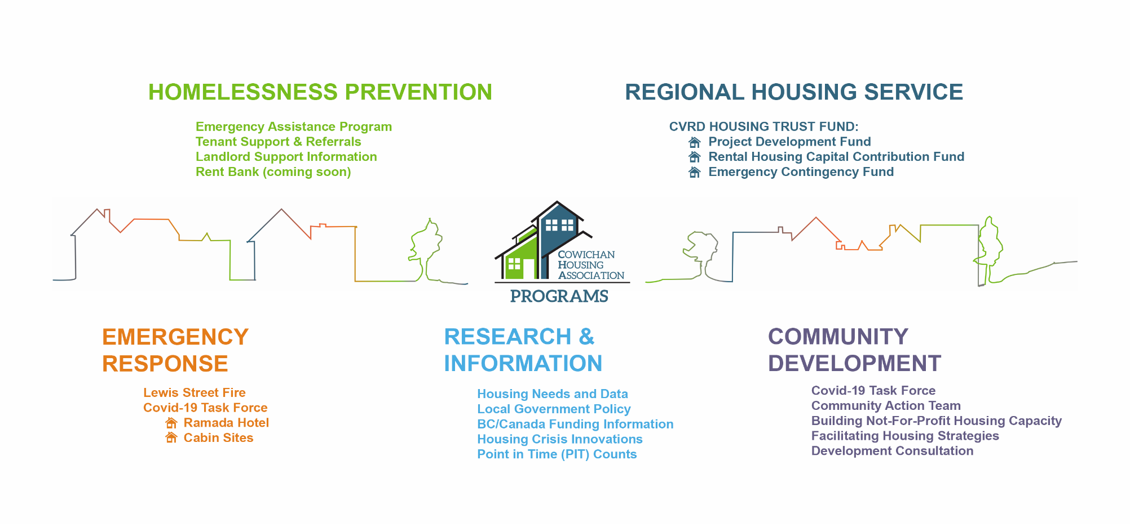
Our Programs

Slide 5
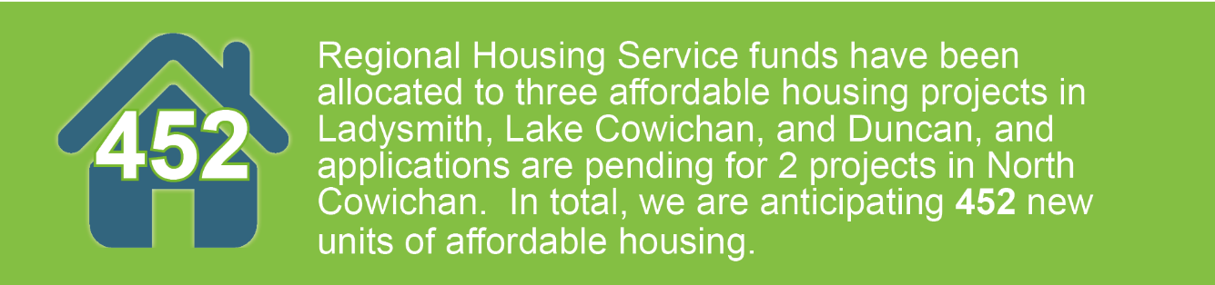
Regional Housing Service
1. Rental Housing Capital Contribution Fund -
^{85% ($425,000)}
In March 2021, Cowichan Lake Elder Care Society was successful in their application for $175,000 towards an affordable seniors’ development in the Town of Lake Cowichan.
2. Project Development Fund – 13% ($65,000)
$75,000 in total PDF was awarded in 2020-2021 to the Duncan Housing Society and to the Cowichan Lake Elder Care Society to further develop their proposed projects in the City of Duncan and the Town of Lake Cowichan.
3. Emergency Contingency Fund – 2% ($10,000)
$20,000 was approved by the CVRD in 2021 to assist those displaced by the Lewis Street apartment fire on December 31, 2020.
Notes:
We just wrote a cheque to the LRCA for $371,000. LRCA are the first ever recipients of the Rental Housing Capital Contribution Fund
ECF Funds covered expenses such as:
^{First month rent}
^{Damage deposits}
^{Moving trucks and expenses}
^{Transportation}
Replacement of necessities lost in the fire
Retrieval of items for non-ministry clients

Slide 6
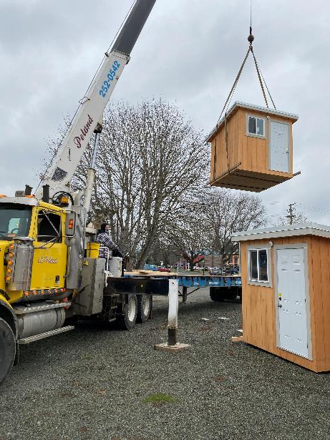
Covid-19 Task Force
BC Housing operations funding in place for Ramada/cabin sites until March 31, 2022
  Ramada closure expected November
  New supportive housing:
  Drinkwater Rd – 51 units – opening November (?)
  White Rd – 49 units – opening Spring 2022
UBCM Application for $2.5 million – 1 year emergency homelessness response – 40 new cabins and wrap-around support
Rapid Housing Initiative re-submission Aug. 31, 2021 ($21.9 million; 52 new homes) – Cowichan Tribes partnership
$1.6 million COVID Emergency Response Dollars administered by CHA in 2020-2021
Notes:
Covid-19 Task Force, representing all levels of government, together with the non-profit sector and (to a more limited extent) the business community, has achieved great things this year by working collaboratively towards common goals.

Slide 7
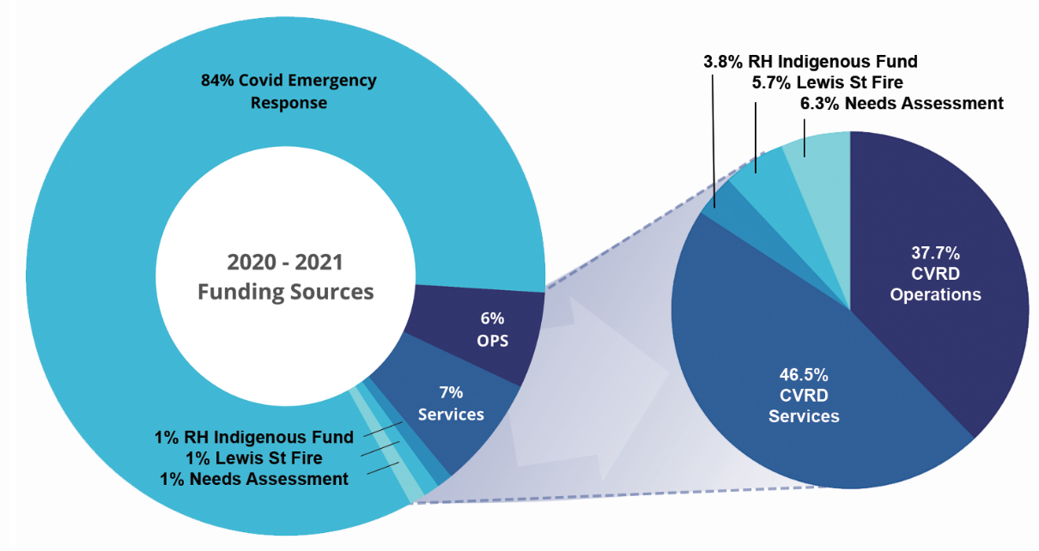
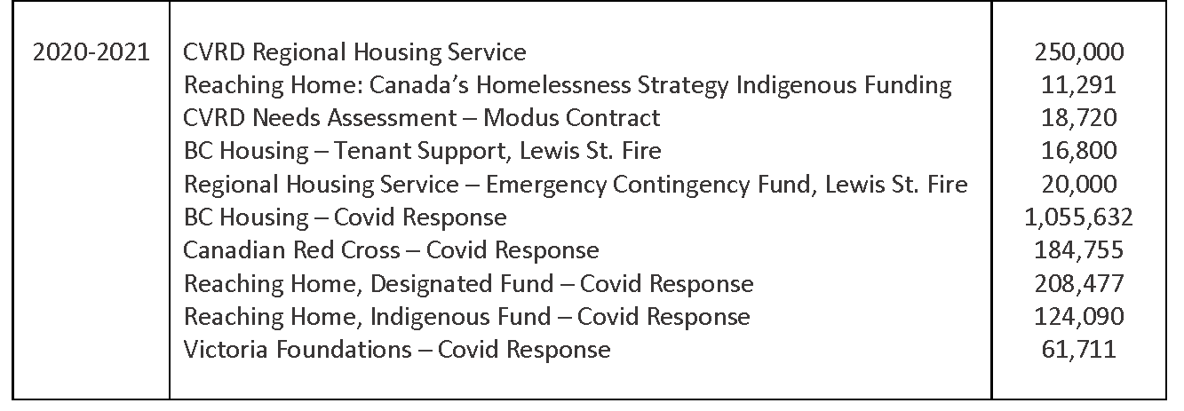
Financials
Operations 6%: CVRD Funding of $112,000 for affordable housing support, administration and overhead.
Services 7%: CVRD funding of $138,000 for Regional Housing Trust Fund-related development, research, data collection, community collaboration and education.
RH Indigenous 1%: Emergency Assistance Program
Lewis St. Relocation 1%: Tenant Support for relocation
CVRD Housing Needs Assessment 1%: Research and data collection, community engagement and education.
Covid Response 84%: Combined funding to shelter homeless population during Covid-19
  2020-21 Total Budget $1,951,476
Notes:
2020-21 Total Budget $1,951,476

Slide 8
Housing Crisis and Challenges
Dramatic rise in housing prices – avg. sale price for a single-family home $693,200, an 28% jump in 12 months
Most affected are first time home buyers
Acute rental shortage
Rental prices ballooning (i.e., $1000/month for a bachelor’s suite)
Renovations/renovictions
Vacation rentals
First Nation, youth, minorities, and people receiving income or disability assistance find it extremely difficult to find rentals due to discrimination
Notes:
Housing prices sky-rocketing:
Up 28% for SFD over this time last year
Up 84% for SFD over 5 years
Average rents do not appear to be increasing rapidly … but the experiences of individuals who are wanting to enter into new rental arrangements is shocking. Not unusual to be asked $2500-$3000 / month for apartment or townhome rentals.
Protections for people who are in long-term leasing situations
Risks: multiple renovictions in the region in the past year … for apartment buildings as well as for individual housing units. With travel opening up again, more lucrative to do short-term rentals than to have regular local tenants.
Extremely low vacancy rates – stories of landlords receiving 100 calls for a single rental unit; stories of a lot of substandard housing being rented out at high rates
Experiences of discrimination in the rental housing market, in two ways:
Prejudice, based on previous rental experience or personal appearance or heritage
Access … people are priced out of the market, or they physically are unable to access the housing that is available – lack of transportation or disability
Clear demonstration that if the market cannot take care of affordable housing needs; strong need for policy interventions at the federal, provincial and local government levels.

Slide 9
Emerging Issues
Lack of appropriate (zoned, accessible) land for social housing projects
      Women’s shelter
      UBCM appeal for land and no local government land holdings
      Rapid Housing Initiative 2 - no appropriately zoned land available for sale
      Workforce housing challenges
            New hospital = more jobs = housing need
            Tourism and retail sectors
      Increase of citizens living in non-standard housing, couches, and vehicles
      Aging rental stock – fires & renovictions causing displacement of lower income individuals
      Ending of COVID specific policies re housing protections

Slide 10
Comprehensive & Consistent Regional Affordable Housing Policy
Framework Needed
Policy Framework: 4 themes
Land provision and acquisition
Preservation of rental housing
Housing market barrier controls
Increase affordable rental stock
Beyond Policy:
Relax bylaw enforcement on non-standard housing
Notes:
Land provision and acquisition
Local government land provision and acquisition
Community amenity contributions to include affordable housing
Pre-zoning land for increased density
Land trust partnerships
Direct affordable housing fund contributions held by various jurisdictions to the creation of affordable housing
Preservation of rental housing
Use the new rental zoning powers
Prevent “renovictions”
Require replacement of any affordable housing units lost
Regulate vacation rentals
Allocate a portion of the MRDT to the creation of affordable housing
Housing market barrier controls
Ensure family friendly housing in the affordable range
Encourage pet friendly policies
Lobby for inclusion of the CVRD within the speculation tax region
Promote government financing of developments, i.e. BC Housing HUB Development Financing, for example
Increase affordable rental stock
Fast track affordable housing applications
Require minimum proportion of affordable units within any development – with a clear definition for affordability, that is not subsidized
Waive DCC’s for non-market housing projects
Waive property taxes for a period of time to assist with project stabilization and affordability
Stop waging war on the poor
Decide to ease up on bylaw enforcement for non-standard housing until there is no longer a housing crisis
Valemont Example

Slide 11
Recommendations
Identify, protect, and acquire all land suitable for affordable housing
Land acquisition and protection policies
Have zone-ready land for future Rapid Housing funding calls with fast-tracked development permitting processes
Support a region-wide workforce housing strategy and implementation
      Relax bylaw enforcement on non-standard housing and develop policy to allow for temporary housing such as RVs (see Valemont, BC policy)
      Develop vacation rental business license for stats purposes to understand affects on rental stock

Slide 12
THANK YOU
Questions?

