Slide 1
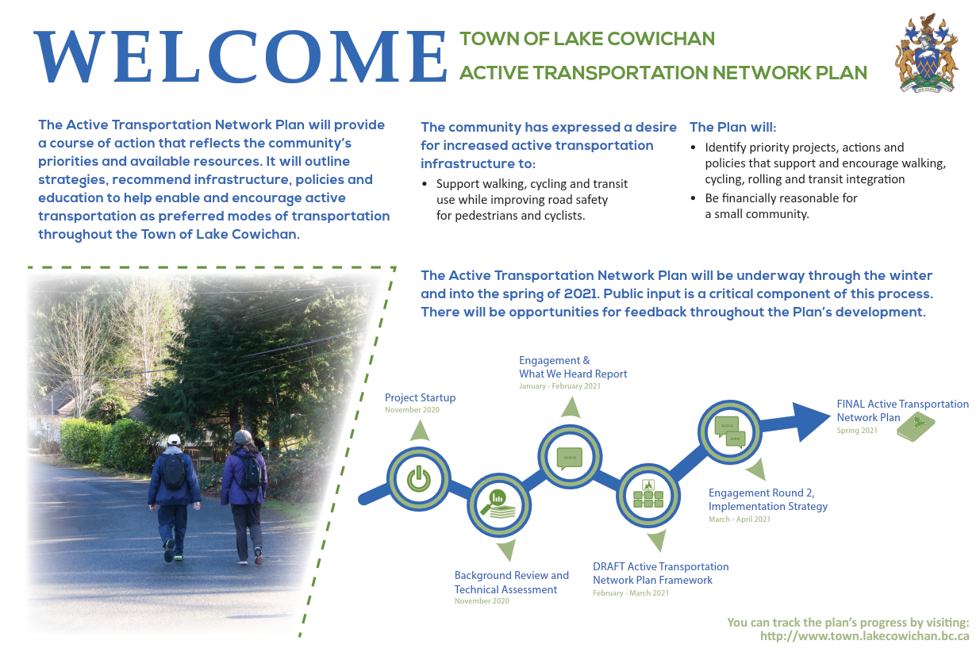
Active Transportation network Plan
Virtual Open House No. 1
Town of Lake Cowichan
February 3, 2021

Slide 2

Virtual Tips & Tricks
We’d like to hear from everyone. Please respect all participants and be open to their perspectives.
When you are not speaking please keep yourself muted.
We will have opportunities for discussion and questions so please save them until after our presentation. You can also enter them into the chat feature and we will get to them

Slide 3
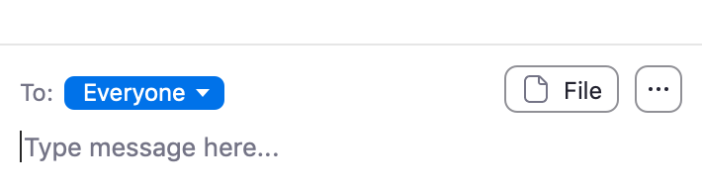
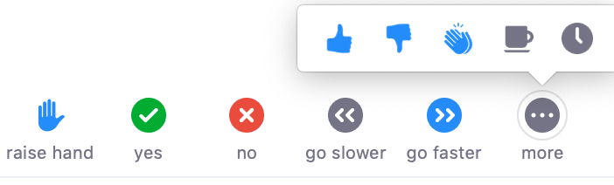

YOUR ZOOM DASHBOARD
Use these functions to turn your microphone and camera on / off
Notes:
There are a few security features we are using today, one of which is to lock the meeting so uninvited guests are not able to pop in and interrupt. That also means if you leave the meeting, you will not be able to get back in.
Pictured here is another snapshot of the participants view in Zoom. The video and audio settings are on your left if you are using a computer – the order can be reversed if you are using a mobile device. We invite you to keep your video on for the session. However if you are experiencing connection problems, turning your video off can sometimes help.
We will be muting your microphones throughout much of the session to eliminate any background noise. We ask that if you would like to speak to the entire group, you “raise your hand” (which we will cover in a second) and one of your hosts will unmute your microphone when there is an opportunity to do so.
So how do you raise your hand? You will also notice there is a Participants button on the menu ribbon at the bottom. When you click on that you see a little blue hand – you will also see that you can provide a yes/no answer, and other feedback as we go. Let’s try out the raise hand feature – if you have found that feature, can you please click on it now to raise your hand. **assume they do**. That’s great. It looks like everyone has found that. To lower your hand you simply click that button again. Please go ahead and do that now.
Next to the participants feature is the Chat function. If you have comments or questions during the session, and you haven’t had a chance to verbally offer them, you can type them into the Chat feature. Some of questions may be answered in the chat by our co-hosts but more technical questions will be referred to our presenters to answer directly. We will have designated times throughout the session when you will have opportunity to ask questions – but feel free to include them in the chat as we go. The chat will be saved at the end of the session.
We will do our best to answer all your questions. However if time doesn’t allow us to get to them all, we will make sure you get an answer following the session.
Just to be sure that everyone has found the Chat feature -- lets have everyone type in *ice breaker question*.

Slide 4
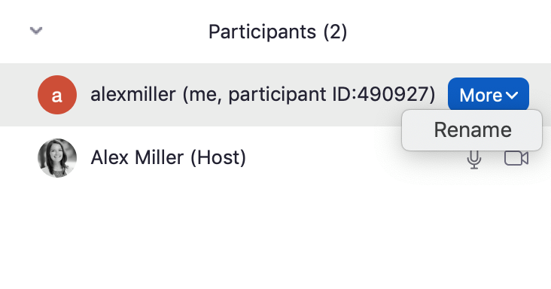
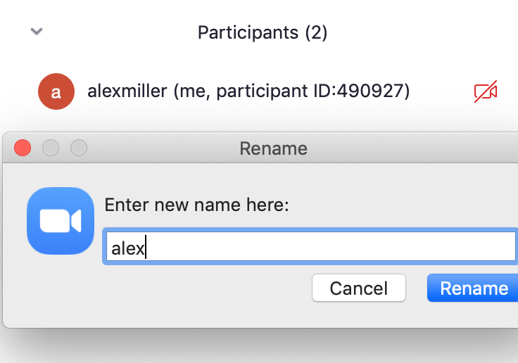
YOUR ZOOM DASHBOARD
Notes:
Before we begin with the presentation, we’d like to take a moment to make sure that everyone is comfortable using the Zoom dashboard.
We would like to ask everyone to re-name themselves to include only your first name in the zoom platform.
This is done by clicking on your participants button, and then on your own name. You will then click the “rename” option under the “more” tab.
This will bring up a window where you can edit the name that will appear on your video screen.

Slide 5
Introductions

Slide 6
Virtual Question and Answer Session
Agenda
Overview of the planning process and engagement activities (10 Minutes)
DRAFT Active Transportation Network Plan Walk-Through (15 minutes)
General Discussion and Questions (Time remaining)

Slide 7
Project funding
BC Active Transportation Planning Grant
Lake Cowichan received funds from this grant opportunity to complete this work
Network planning grants help communities develop active transportation network plans to support active transportation for all ages and abilities.
Once a plan is in place the Town will also be eligible for infrastructure grants from the Province and other funding sources

Slide 8
Active Transportation
Definition
Active transportation relates to human-powered forms of commuting to work, school, recreation, socializing or running errands. It can take many forms and is continually evolving as new technologies emerge. It includes:
Walking (including the use of a mobility device)
Cycling
Rolling (skateboarding, in-line skating)
Winter focused (cross-country skiing, snowshoeing)
Water focused (kayaking, stand-up paddleboard)
Other emerging modes

Slide 9
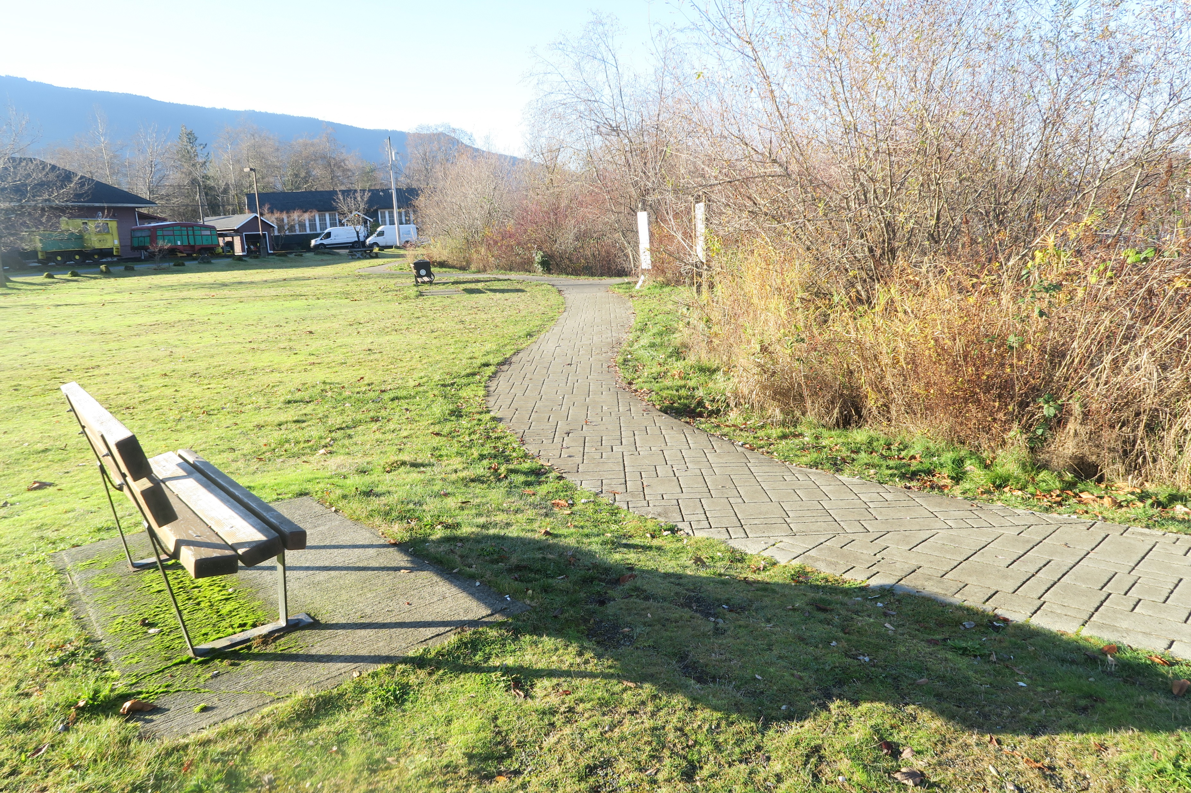
Why active transportation
“I would love to see Lake Cowichan lead the way as a more environmentally friendly community. Encouraging a pedestrian and cyclist friendly town is a great start.”
- Survey respondent
benefits
Health
Quality of Life
Equity
Safety
Environment
Local Economy
Financial (affordability)

Slide 10
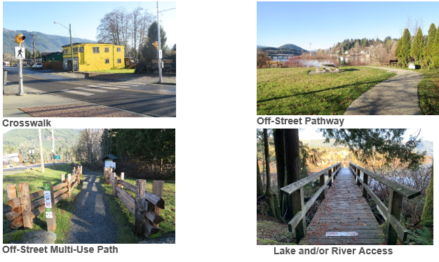
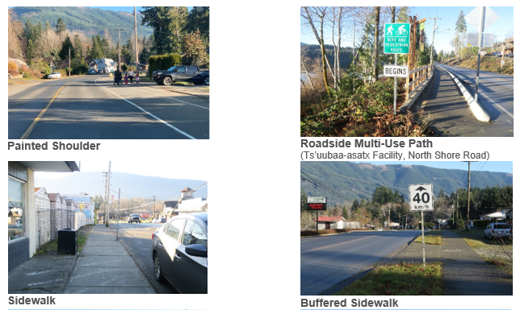
Active transportation facilities
Within Town of Lake cowichan

Slide 11
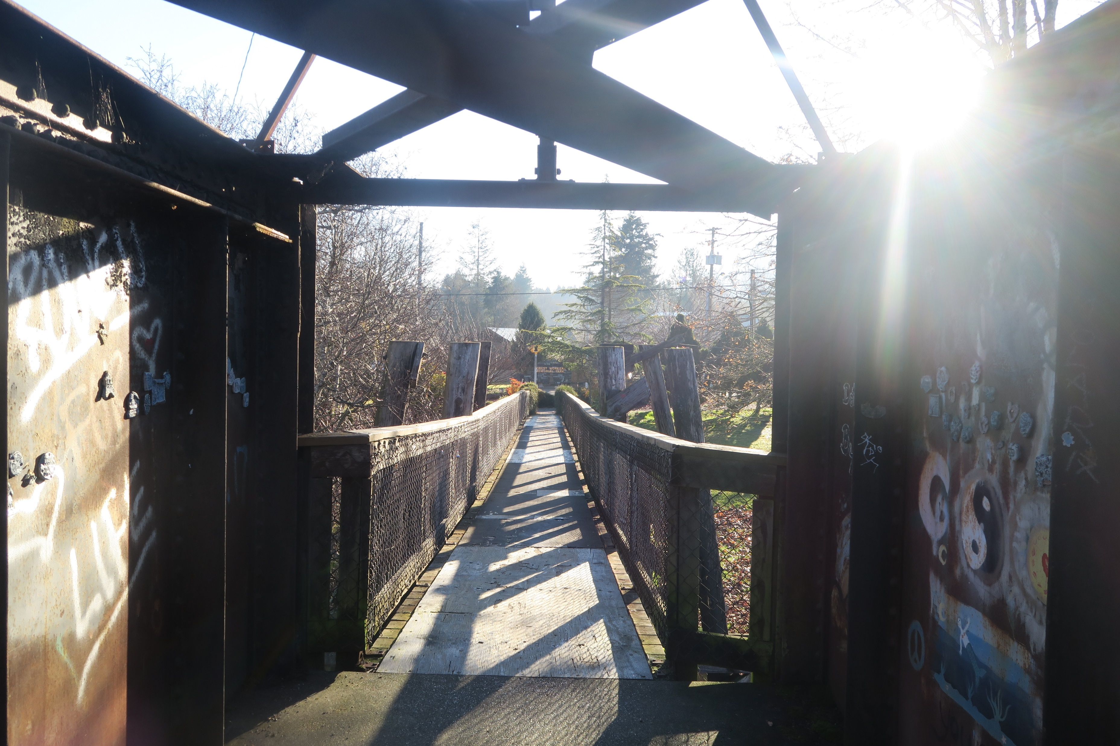
Active Transportation in Lake Cowichan Today
Current Conditions
Walkable downtown and uptown areas
Beautiful forest trails and lake side community amenities
Regional multi-use pathways (TransCanada Trail)
Relatively compact community supports trips made by active transportation
Challenges
Active transportation amenities are more limited beyond the downtown and uptown areas
No on-street bicycle facilities
Opportunities
Improved connectivity within the community
Improved accessibility and safety opportunities
Better access to water-based modes

Slide 12
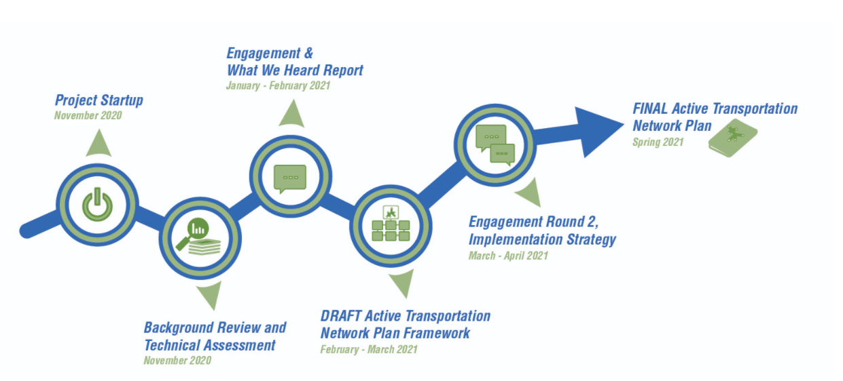
Timeline

Slide 13
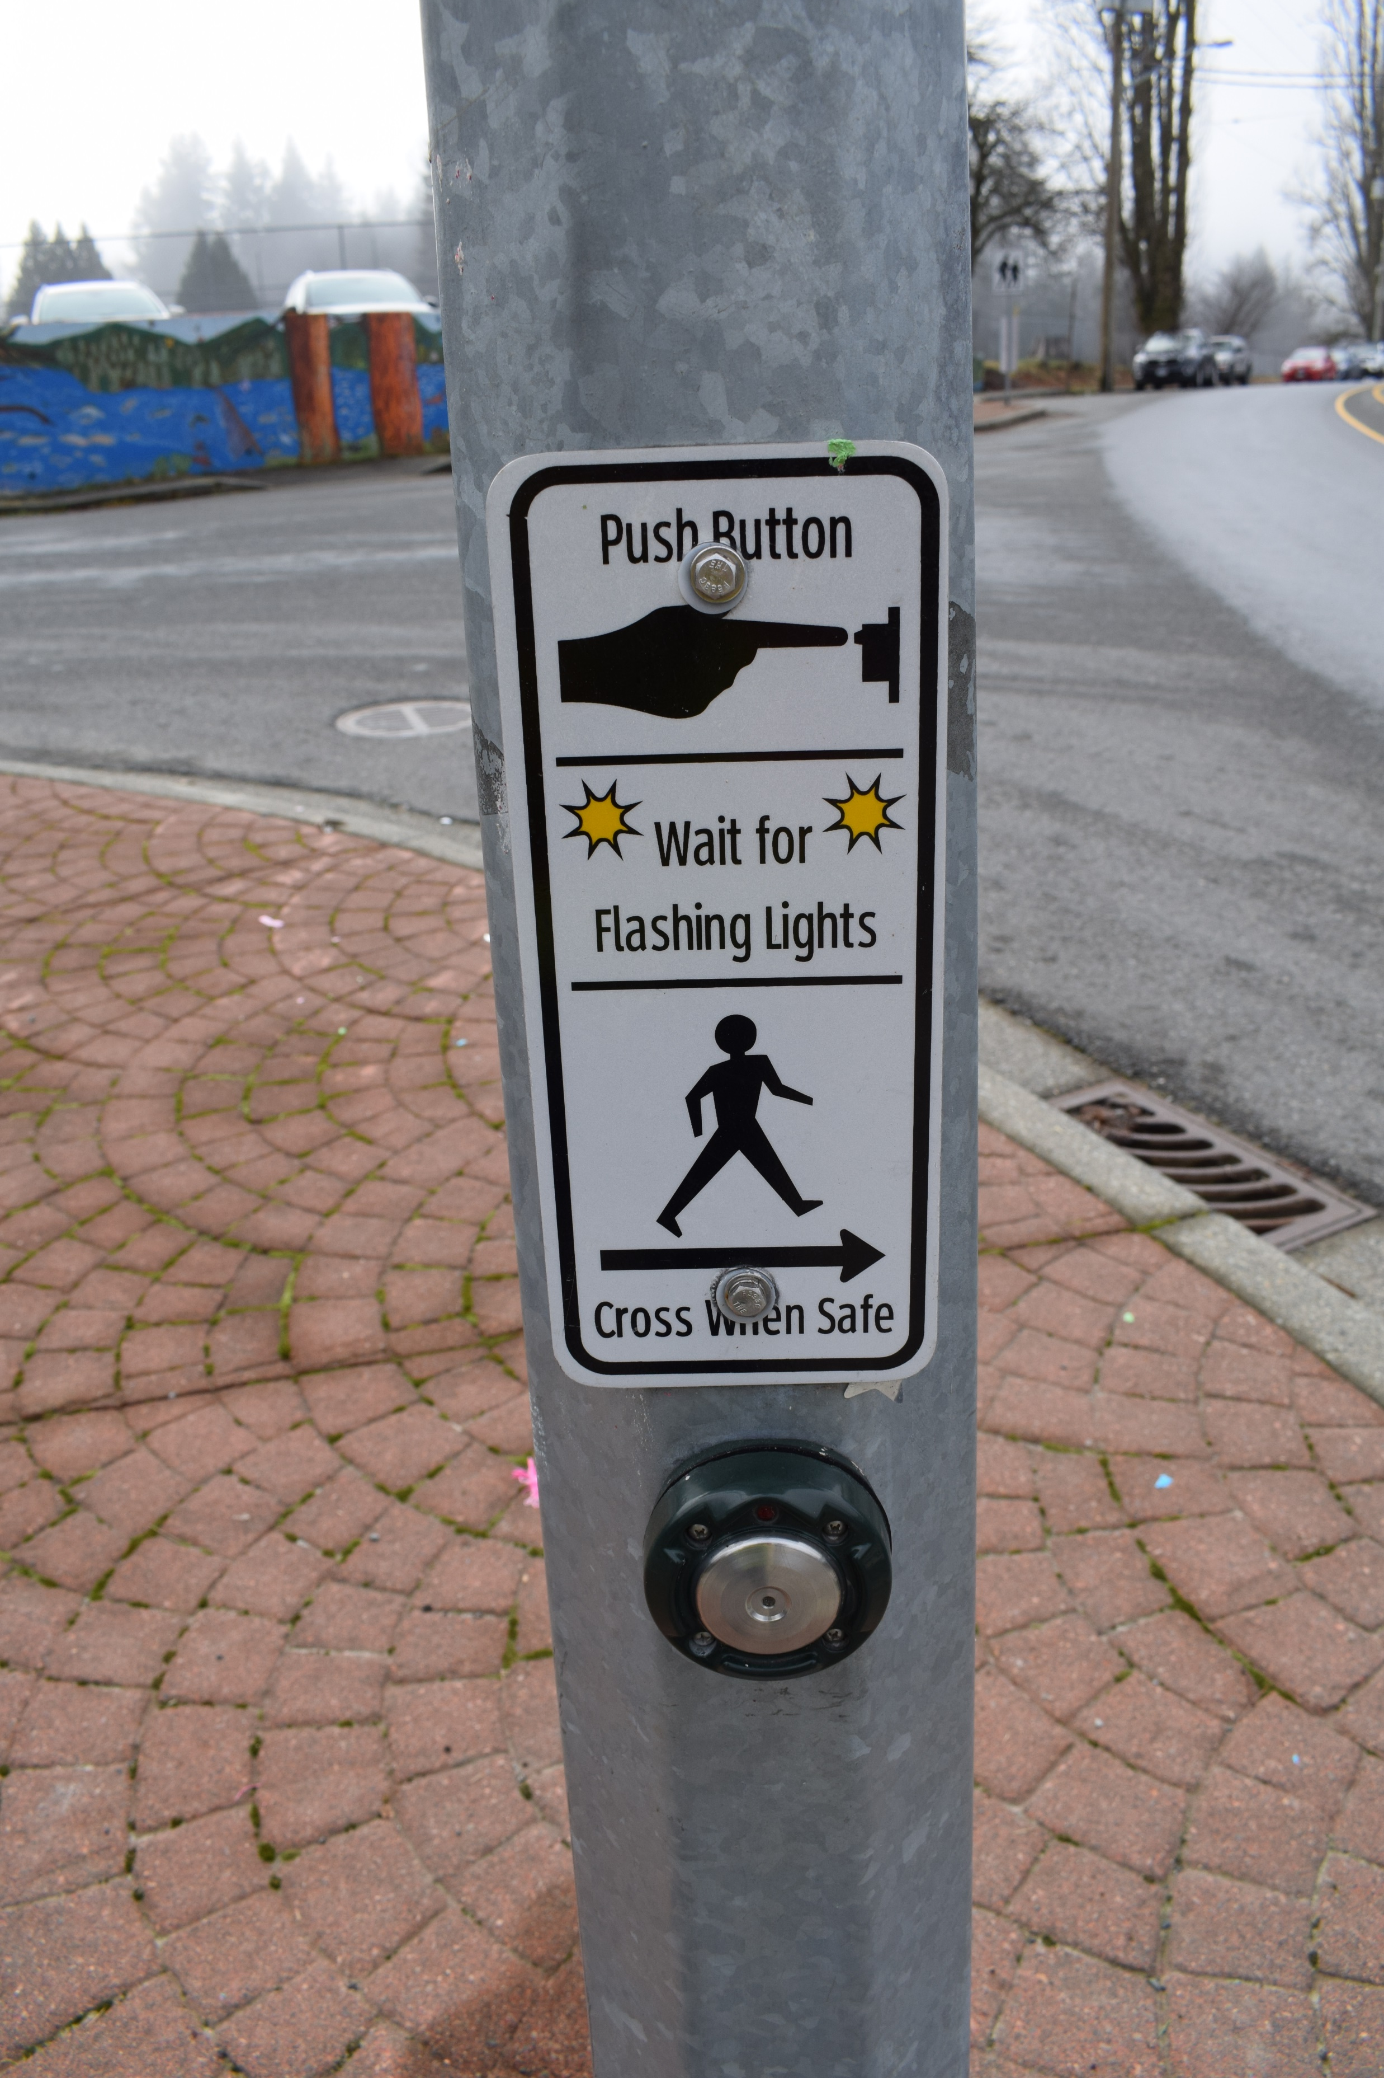
The DRAFT PLan
The Plan will be used to inform priorities and guide investment in active transportation facilities.
It will be used to inform capital planning and public investment in infrastructure
It will also communicate to Provincial and Federal funding agencies the community’s priorities for walking and cycling infrastructure to support future grant applications

Slide 14
DRAFT Active transportation Plan

Slide 15
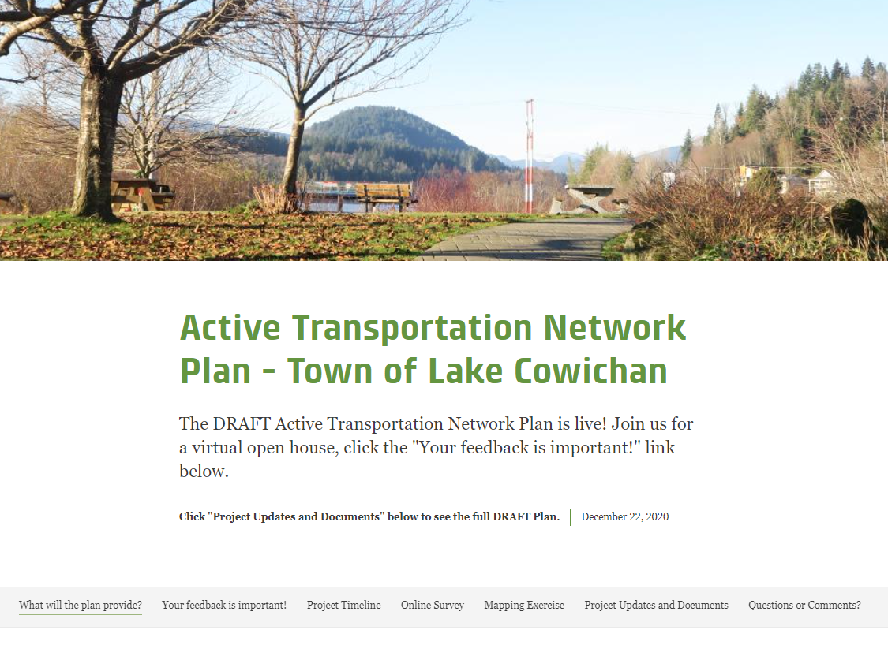
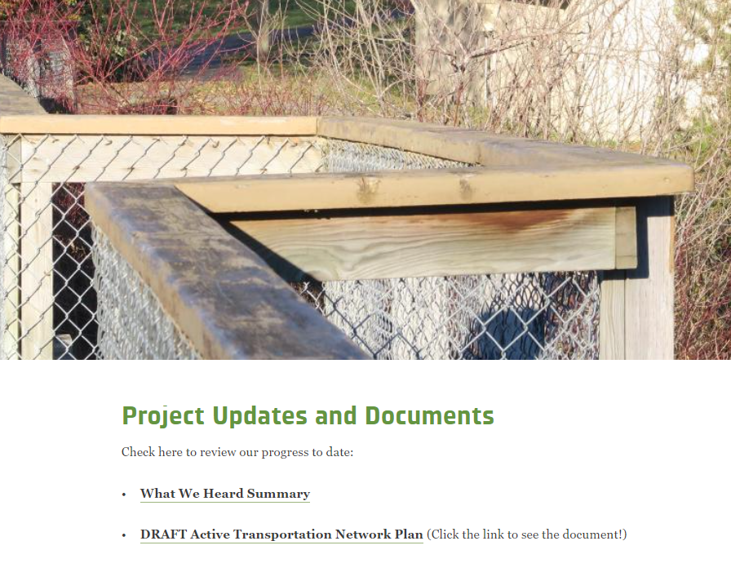
DRAFT PLAN – AVAILABLE ONLINE

Slide 16
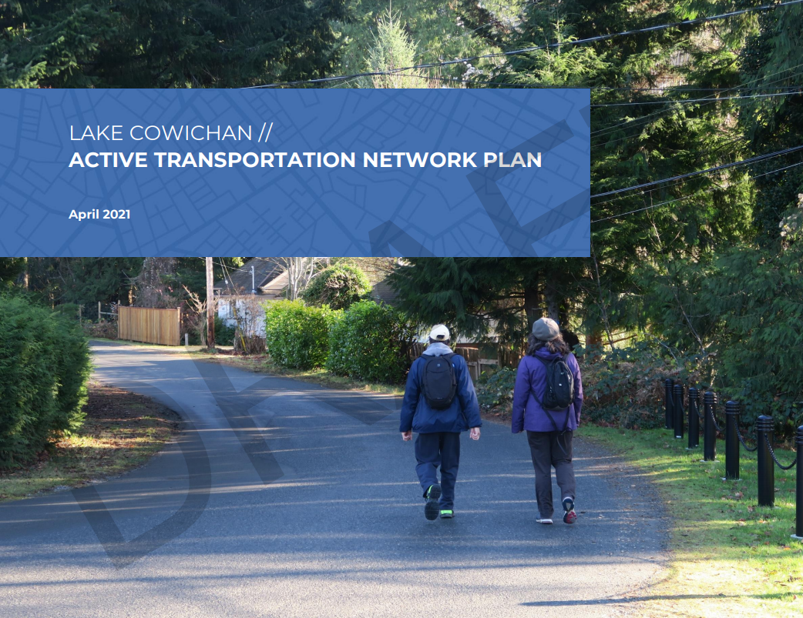

Slide 17
Thank you!
Please encourage your friends and neighbors to review the document and provide feedback or join us on Saturday

