Slide 1


Town of Lake Cowichan
Housing Needs Assessment
February 23, 2021
Notes:
Good afternoon, my name is John Horn from the Cowichan Housing Association and I am here today with George Parker from G.P. Rollo to present the results of the Town of Lake Cowichan Housing Needs Assessment.

Slide 2
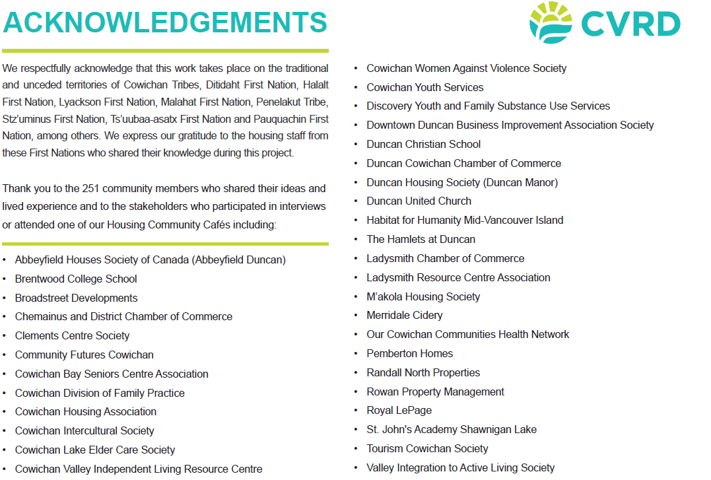
Notes:
I would like to begin by acknowledging that this work took place on the traditional territories of Cowichan Tribes, Ditidaht First Nation, Halalt First Nation, Lyackson First Nation, Malahat First Nation, Penelakut Tribe, Stz’uminus First Nation, Ts’uubaa-asatx First Nation and Pauquachin First Nation among others and we are grateful to the housing staff from these First Nations who shared their knowledge during this project. Thank you also to the more than 250 community members who shared their ideas and lived experience and the long list of stakeholders who participated in interviews or attended one of our Housing Community Cafes.

Slide 3
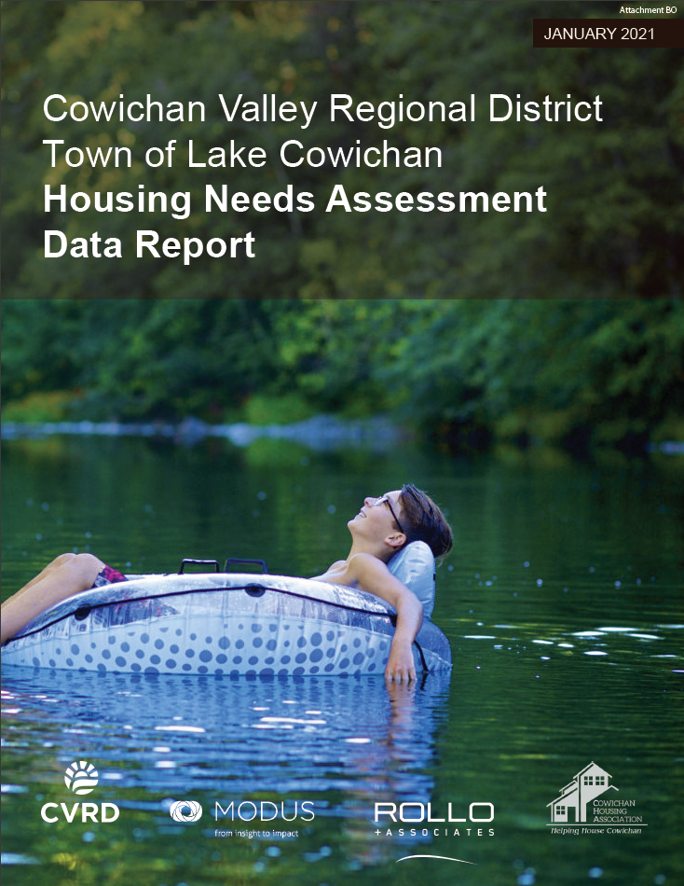
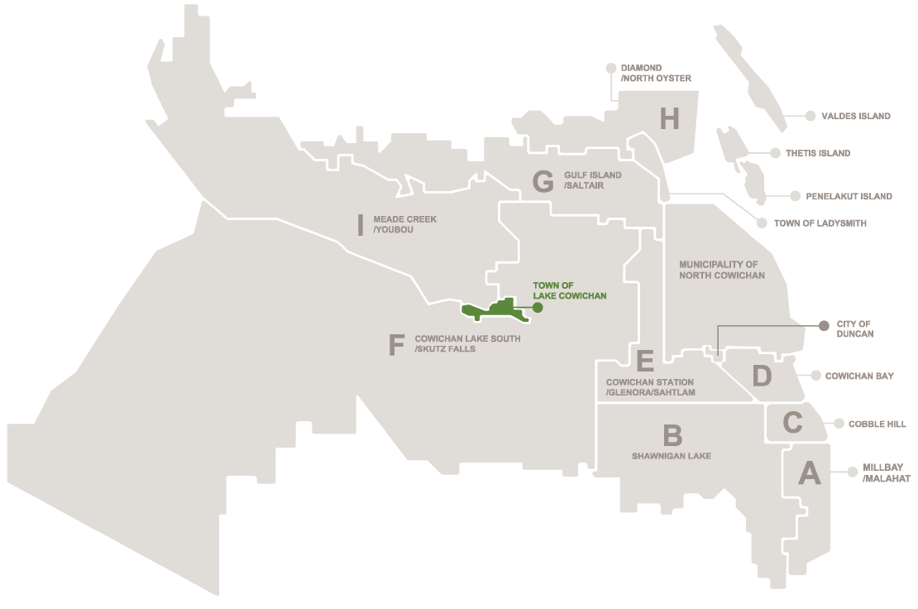
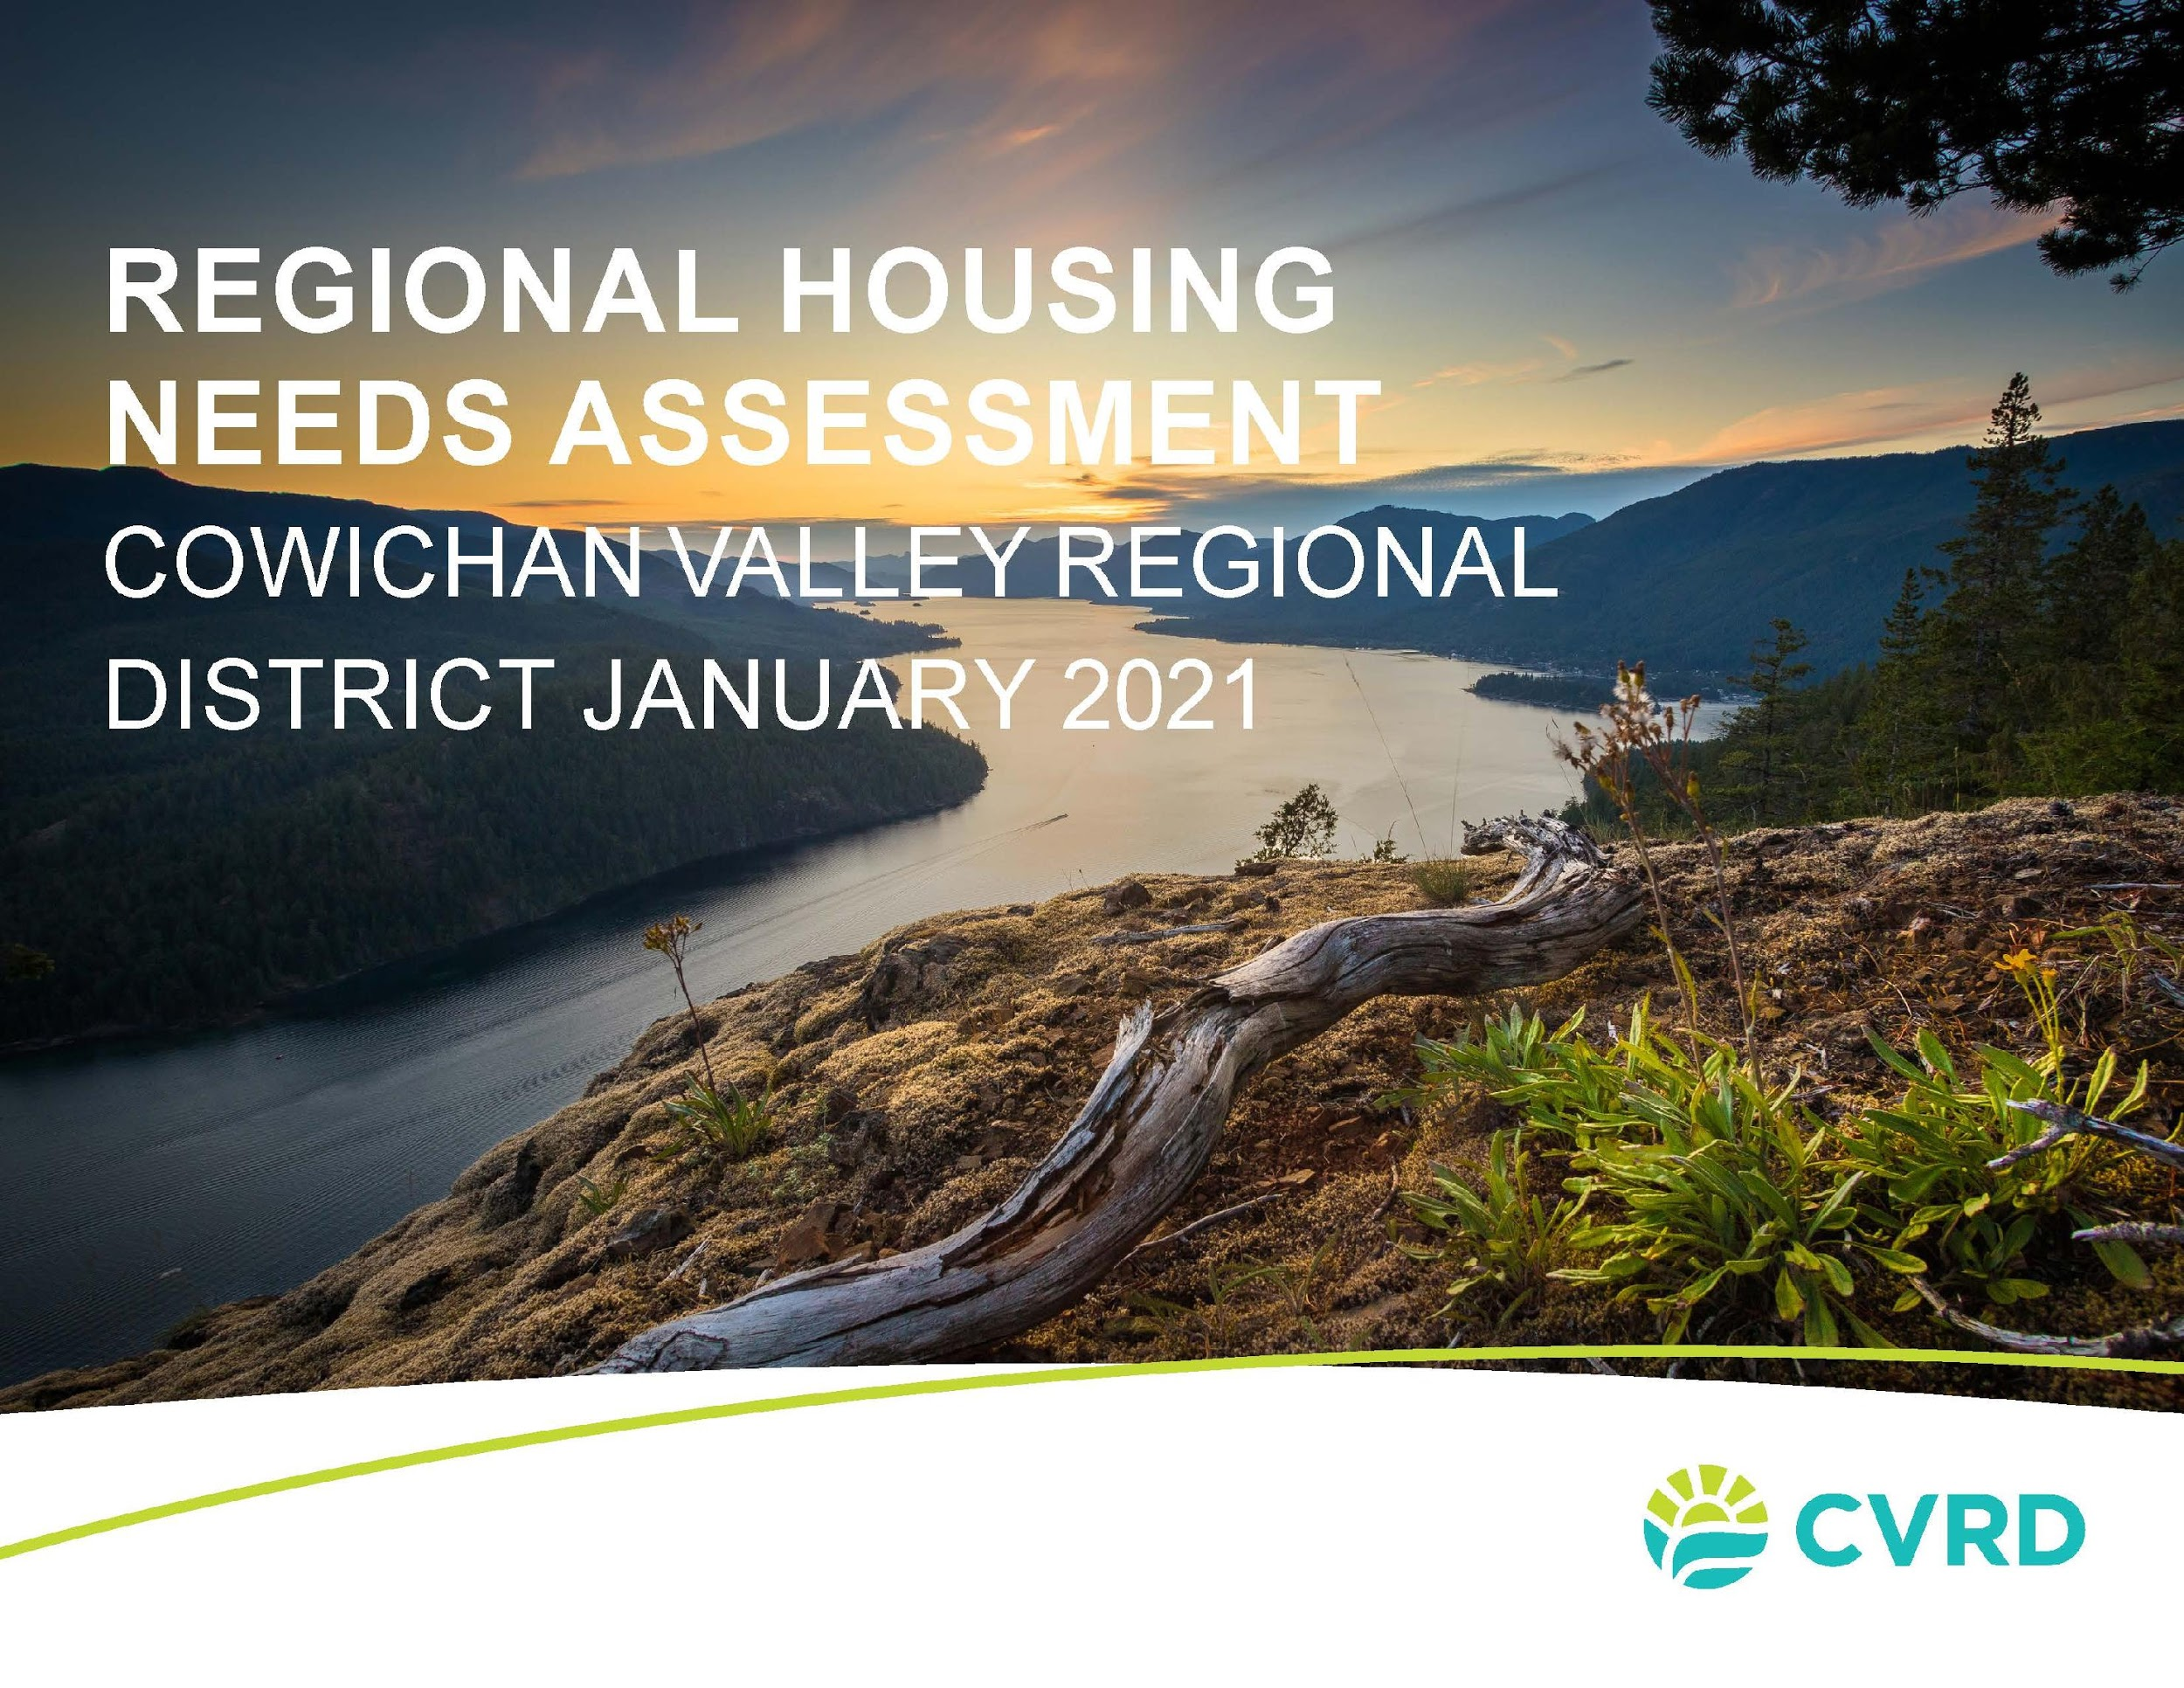
Notes:
The report we are presenting today is one of a family of reports. We are presenting the Town of Lake Cowichan housing needs assessment today, but this work also included a regional report and 12 other sub-regional reports. Please refer to the regional report for more details on the regional context.

Slide 4


Qualitative Findings – Community Engagement
Quantitative Findings – Data, Methodology & Projections
Notes:
We will begin with the qualitative findings, including an overview of our engagement activities, key themes we heard from the community and key findings by population group.
We will then go into the quantitative findings, including information on housing affordability and housing projections.

Slide 5

Community Engagement
PlaceSpeak Questionnaire
Virtual Community Cafés
Stakeholder Interviews
First Nation Housing Manager Interviews
Notes:
Our regional engagement process included the following engagement activities:
A PlaceSpeak questionnaire that run ran through September and October and received over 250 respondents.
3 virtual community cafes which brought together 16 organizations including health authorities, community service organizations, schools, chambers of commerce, business and tourism associations. Each community café was focused on one of three themes: housing and health, housing and youth/families and housing and economy
We also reached out to 33 organizations for interviews including community organizations, housing organizations, housing providers and developers and we also interviewed housing managers of 8 First Nations

Slide 6

Engagement Key Themes
One-bedroom apartments are most in need
Variety of affordable housing types and a shift towards smaller dwelling sizes is needed
Seniors moving out of community due to shortage of supported and assisted homes
Younger generations have housing challenges
Lack of purpose-built rental buildings
Notes:
I will now share some of the key themes emerging from this engagement:
One-bedroom apartments were identified by respondents as being most in need and many concerns were expressed to the decrease in available rentals of all types
The Town of Lake Cowichan has an aging housing stock which may put further pressure on housing availability
There is a limited availability of assisted care homes and independent living facilities. This shortage has required some seniors to seek supportive housing outside of their communities. Some
senior respondents indicated that they struggled to maintain their homes as a result of advancing age and associated mobility challenge. Many seniors are looking for options to age in place
4. Younger generations have housing challenges- participants shared concerns about housing instability and unaffordability for youth and young families, as well as extreme challenges in finding a home with landlords preferring a more mature tenant.
5. Lack of purpose-built rental buildings for all population cohorts and demographics: young families, youth, those with mental health challenges, singles and seniors

Slide 7

Engagement Key Themes
Housing costs are misaligned with regional wages
Affordable housing for families is hard to find
There is a need for more non-market housing options, supportive and emergency housing options
Servicing and lack of infrastructure a barrier to housing development
Notes:
Housing costs are misaligned with regional wages- workers are locating where housing is available rather than where they would prefer to live, resulting in high transportation costs
Affordable housing for families is hard to find. Young families, low-income families and lone parent families at high risk of housing instability
Need for more non-market housing options, supportive and emergency housing options- homelessness is a critical issue and more supportive housing is needed for those with mental health conditions and cognitive or physical disabilities
Servicing and lack of infrastructure a barrier to housing development - this challenge was identified by the neighbouring Ts’uubaa-asatx First Nation

Slide 8

Key Findings by Population
People experiencing homelessness
Youth at risk of homelessness
Housing for newcomers
People with special needs
Workforce housing
Notes:
I will now touch on some key findings by specific population
And finally, for people experiencing homelessness, the Town of Lake Cowichan has seen a new and growing cluster of homeless individuals. The need has been identified for emergency housing and long-term options for those experiencing homelessness, and a need for distributed supportive services to address parallel challenges of mental health and substance abuse.
Youth at risk of homelessness have unique needs such as staff supervision. There is a need to take into account the unique social, educational and developmental needs not met in adult facilities
Newcomers to the region have a specific need for multi-generational housing, communal spaces, space for gatherings and pedestrian access to services. Smaller dwelling sizes are appropriate housing for this group.
People with mental illness and people with disabilities are having difficulty meeting their housing needs in Lake Cowichan. For people with special needs, there is a need for a distributed model that provides supportive housing and services in people’s communities, and there is a need for accessible units near community services.
Lake Cowichan is the most affordable area in Cowichan for market housing and is known to attract young families and younger professionals seeking starter home purchases. It is often viewed as a bedroom community to Duncan. The cost of starter homes are becoming increasingly prohibitive for young professionals to enter the market, therefore developing purpose-built affordable rental housing will be key to maintaining a stable workforce for Lake Cowichan and the region as a whole.

Slide 9
Qualitative Findings – Community Engagement
Quantitative Findings – Data, Methodology & Projections

Slide 10


Background Research
Notes:
As part of the Housing Needs Assessment, we were required to process a great deal of data from the 2006, 2011, and 2016 Censuses.
The government of BC provided a custom dataset specifically for this purpose.
The data in this dataset might differ from other Census data you’ve seen because it excludes individuals outside of private households, for example people living in care homes
This government-sanctioned dataset is used throughout this research in the interest of consistency.
We don’t have time to cover all the background research, so this is a curated selection.

Slide 11
Population
Population growth from 2006 - 2016
Notes:
This graph shows the rate of population growth of BC, the CVRD, and Lake Cowichan in the last five years (teal) and in the last ten years (green). We’ll typically be comparing these three jurisdictions, unless otherwise indicated.
Between 2006 and 2016:
BC grew in population from 4.1 million – 4.6 million (12% growth)
The CVRD grew from 75,000 – 82,000 (8% growth)
Lake Cowichan grew from 2,900 – 3,200 (10% growth)
So the region grew at about 2/3 the pace of the province, and the Town grew at a pace somewhere between the two. You can also see that most of the Town’s growth in that decade growth occurred in the first five years.

Slide 12
Housing Tenure
Share of households renting in 2006, 2011, and 2016
Notes:
This graph shows the share of households that rent, over time.
From 2006 – 2016, renters as a share of all households in BC increased slightly, from about 30% to about 32%.
A smaller share of households in the CVRD are renters, but the same upward trend is present (from 20% to 22% over the decade).
Lake Cowichan is somewhere between the two, and also exhibits an upward trend, from 23% in 2006 to 26% in 2016.

Slide 13
Median Household Income
Notes:
This graph shows median household income in each jurisdiction over time.
The CVRD was slightly less affluent than BC throughout this decade, and Lake Cowichan was less affluent still.
From 2006 – 2016, median household income
Increased in BC (from $62,000 to $70,000)
Increased in the CVRD (from $60,000 to $65,000)
Decreased slightly in Lake Cowichan ($54,000 to $52,000).
But the above are nominal figures that include inflation.
Accounting for inflation…

Slide 14
Median Real Household Income
Notes:
…median household income in BC stagnated (from $76,000 to $75,000) , in the CVRD it declined (from $73,000 to $70,000), whereas in Lake Cowichan declined considerably ($65,000 to $56,000). These figures are in constant 2019 dollars.

Slide 15
Income Distribution
British Columbia
Lake Cowichan
Notes:
This shows household income distribution in BC versus in Lake Cowichan, just to give you a sense of what income distribution tends to look like.
The main difference here is that Lake Cowichan is less affluent than the province but also has less income inequality. You can tell because BC has more people in its lowest-income and highest-income groups.

Slide 16
Income Distribution
Owner Households
Renter Households
Notes:
This is a similar comparison between owner households in Lake Cowichan and renter households in Lake Cowichan.
For sake of reference, in 2016 owner households in the Town had a median income of $60,000 while renter households had a median income of $39,000. So, owner families have about one third more income than renter families in Lake Cowichan.

Slide 17
Income vs. Tenure
Notes:
This slide explores that very statistic. The solid teal bar is owner household income, the hatched teal bar is renter household income, and the green bar shows their ratio.
A higher green bar means owners and renters are more unequal.
By this measure, the CVRD exhibits slightly more inequality between tenure groups than BC generally, and Lake Cowichan has about the same degree as inequality as the province, although at a lower income level.

Slide 18
Bedroom Counts
British Columbia
Lake Cowichan
Notes:
This slide compares BC to Lake Cowichan with respect to bedroom counts.
In BC there was about an even split between 2-bedroom, 3-bedroom, and 4+ bedroom units (about 27% each in 2016) with fewer one-bedroom units (16%) and even fewer studios (1%).
Whereas in Lake Cowichan 3-bedroom units dominate (almost 40%), followed by 4-bedrooms (31%) and 2-bedrooms (22% each), and very few 1-bedroom units (about 9%).
Over this Census decade the share of 3-bedrooms shrank and the share of 4-bedrooms grew.

Slide 19

Housing Standards
Suitability
Adequacy
Affordability
Notes:
Statistics Canada defines three housing standards:
suitability, meaning that the dwelling is not overcrowded and has an adequate number of bedrooms. In BC, the share of all households falling below the suitability standard decreased between 2006 and 2016. Compared to BC, households in Lake Cowichan are less crowded.
adequacy, meaning that the dwelling does not need major repairs. The share of all households falling below the adequacy standards in BC remained constant between 2006 and 2016. Compared to the province, a greater share of Lake Cowichan’s households live in inadequate housing conditions.
affordability, defined as housing expenses falling below 30% of household income. In BC, the share of all households falling below the affordability standard remained constant between 2006 and 2016. Compared to BC, Lake Cowichan began the decade with a slightly smaller share of households in core housing need and ended the decade with a slightly greater share of households in core housing need.

Slide 20
Rental Market
Monthly housing costs for renters
Notes:
This graph shows rental housing costs in 2016 in the CVRD.
In 2016, the region had an average monthly rental housing cost (rental rate plus utilities) of $940.

Slide 21
Housing Price Trends
Notes:
This graph shows average assessed value per unit over time, by property type in Lake Cowichan. As you can see, single family homes have consistently been the most valuable type of units, with all other types typically having similar levels of value on a per-unit basis.
Housing prices were stable from 2008 – 2016 or in some cases even declined because land supply kept up with demand.
This was likely due to the Global Economic Crisis of 2008 and following recession.
Since 2016, prices have increased in all categories, suggesting demand has increased more than supply.

Slide 22
Affordability Today
Income Distribution Among Owner Households in Lake Cowichan (2019)
Notes:
One purpose of this Housing Needs Assessment is to compare housing costs with household incomes.
For owner households, housing costs are a function of housing prices
For renter households, housing costs are a function of rental rates.
Housing prices can be inferred from property assessment data, but the most recent government data on household incomes is from the 2016 Census.
So, we needed another source for more current data. We elected to use the socio-demographic estimate produced by Environics Analytics, a research firm specializing in this kind of product. At the time of this analysis, the most recent Environics estimate was for 2019 (shown here).

Slide 23
Affordability Today
Distribution of Housing Values Per Unit (excluding purpose-built rental) (2019)
Notes:
This graph shows the distribution of housing values per unit in Lake Cowichan in 2019. We combined these two sources of data (this slide and the previous one) to produce an estimate of housing affordability for owner households in each jurisdiction.

Slide 24
Affordability Today
Household Income vs. Housing Costs for Owner Households
Notes:
We performed this analysis for each jurisdiction in the CVRD. Each line on this graph represents a jurisdiction.

Slide 25
Affordability Today
Household Income vs. Housing Costs for Owner Households
Notes:
This is the graph for Lake Cowichan. As you can see, owner households with mortgages making less than about $46,000 per year would be expected to spend more than 30% of their income on housing.
That’s 17% of owner households, which is in line with the trend observed during the Census period.

Slide 26
Affordability Today
Household Income vs. Housing Costs for Renter Households
Notes:
This graph is similar to the last graph, but for renters rather than owners.
As income increases, so do housing costs, but typically not as quickly.
Renters with a household income below $48,000 will tend to spend more than 30% of their income on housing. That’s 62% of renter households, which is worse than during the Census period.
Renters with a household income below $26,000 will tend to spend more than 50% of their income on housing. That’s 29% of renter households.
Overall, including both owners and renters, 29% of Lake Cowichan households are in core housing need, which is a continuation of the worsening trend observed during the Census period.

Slide 27
Projections | Population and Housing
Lake Cowichan Population by rennie Scenario
Notes:
We were asked to use the population and housing projections produced by rennie intelligence in 2019, but rennie produced four projections.
What are the 4 rennie scenarios?
Baseline Scenario: This scenario combines a sociographic model with historic trends and land use data to produce a projection
Scenario 1: Takes the same total regional quantity of growth described in the Baseline Scenario but assumes that 90% of electoral area growth will occur within the Urban Containment Boundary
Scenario 2: Takes the same total regional quantity of growth but assumes that 90% of all growth will occur within the Urban Containment Boundary
Scenario 3: Takes that same total regional quantity of growth but assumes that 75% of all growth will occur in areas with water services, sewer services, or both.
Which is the most appropriate scenario for Lake Cowichan? We originally went with the more aggressive Scenario 2, which would have the Town’s population increase to more than 4,000 by 2025. However, in response to our first draft we received a recommendation from the Lake Cowichan’s Consulting Town Planner that a population projection of 3,600 by 2025 would be appropriate. As you can see in this graphic, this is quite close to rennie’s Scenario 3, so we went with that projection instead.
Under this Scenario, Lake Cowichan would grow from 1,500 households in 2019 to 1,542 households in 2025, achieving overall growth of 3%, which would be much slower than the 17% growth in households seen from 2006 to 2016. In this same scenario, population would grow by 4%, from about 3,400 in 2019 to more than 3,500 in 2025 as shown in this graphic. Population rising faster than households would imply that the average household size is increasing slightly, from about 2.26 to 2.29 according to rennie.

Slide 28
Housing Need by Number of Bedrooms
Notes:
Statistics Canada defines housing suitability as follows:,
No less than one bedroom per household member, except for couples, and except for children depending on their age and sex.
It may not be evident, but this definition is extremely austere. Merely meeting this requirement throughout a community would produce extremely cramped housing.
Both Environics and rennie provide estimates of population per household, but we lack information on the age and sex distribution within households.
Therefore, to generate an estimate of housing need by bedroom count, we simplified the Statistics Canada standard to the following:
No less than one bedroom per household member, but couples may share a room. This is both practical and produces more generous housing needs estimates.
The stipulation that couples may share bedrooms is very important because a huge number of households contain couples. In Lake Cowichan in 2016 (according to the Census):
83% of two-person households consisted of a couple
73% of three-person households contained a couple
73% of four-person households contained a couple
64% of households with five or more people contained a couple.
Defining housing need in this way (only slightly more generously than Statistics Canada) produces the counterintuitive outcome represented here.
The majority of housing need (shown in green) is for one-bedroom units, but the majority of housing in the Town (shown in teal) has three or more bedrooms. In other words, most households in Lake Cowichan have more bedrooms than they need.
In fact, existing supply in 2016 already exceeded housing needs in 2025 for units with two or more bedrooms.
However, it would be an error to interpret this as suggesting that only one-bedroom units should be constructed in the future.
This represents the minimum number of bedrooms, not the ideal number of bedrooms. This is the number of units by bedroom count that would be require to avoid overcrowding.
In other words, because most households in Lake Cowichan have more than enough housing, housing need by bedroom count is not a very useful or informative statistic. It might be a useful statistic in a place with widespread overcrowding, but Lake Cowichan is not such a place.
Although it is still worth noting that the Town could use more one-bedroom units, which was also a finding of the community engagement research.

Slide 29
Household Income
Households by Income Group
Notes:
GPRA has modified the household income projection from Environics to produce two income projections for Lake Cowichan:
Rapid Recovery Scenario: Assuming rapid economic recovery from the COVID-19 pandemic. This is based directly on Environics
Slow Recovery Scenario: This projection assumes a slower economic recovery from the COVID-19 pandemic, reducing household income.
The reality is likely to be somewhere between these two scenarios.
Median nominal household income:
2019: $59,486
2025 (Rapid Recovery Scenario): $71,004
2025 (Slow Recovery Scenario): $65,890
Median real household income (2016 $):
2019: $56,162
2025 (Rapid Recovery Scenario): $59,497
2025 (Slow Recovery Scenario): $55,211
TENURE

Slide 30
DISCUSSION & QUESTIONS

