Slide 1
Lake Cowichan Active Transportation network Plan
council Meeting
Town of Lake Cowichan
February 9, 2021

Slide 2
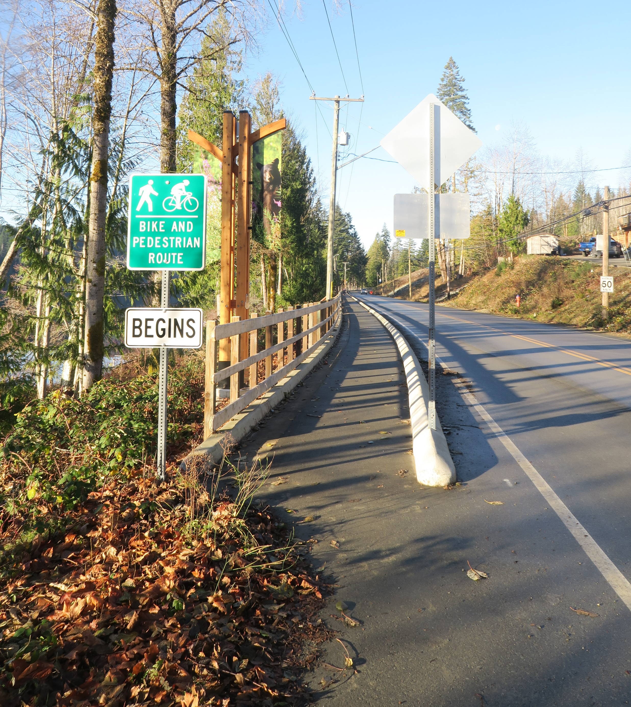
Why Active Transportation?
Health
Quality of Life
Equity
Safety
Environment
Local Economy
Financial
It’s fun!

Slide 3
ATNP Overview
What is the ATNP?
Describes the community’s vision and priorities for active transportation
Who is the ATNP For?
Residents, Town staff, Council,
neighbouring communities, external agencies, land developers (and anyone else!)
How will the ATNP be Used?
Guide Town policies + regulations
Inform capital planning + public investment
Direct land development
Communicate priorities to external funding agencies

Slide 4
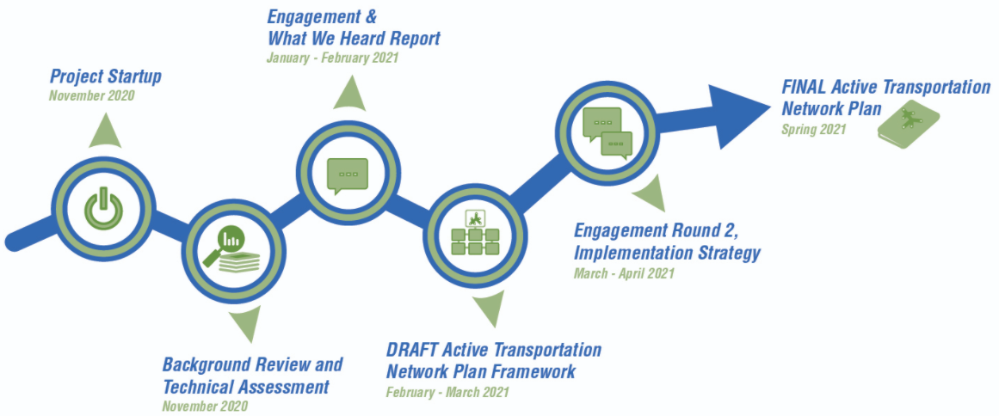
Project timeline

Slide 5




Getting Around
Commute Trips
by Walking
Commute Trips by Bicycle
Commute Trips
by Vehicle
Commute Trips to Locations Outside Lake Cowichan
6%
1%
90%
67%

Slide 6
Official Community PLAN (OCP)
Transportation
“Complete streets” and comprehensive network of pedestrian + cycling facilities
Greenways
Improvements + enhancements
Wayfinding signage
Accessibility
Universal design guidelines
Waterfront + Blueways
Improving access, expanding network
North Shore Road Greenbelt trail
Recreation, Parks + Institutions
Age-friendly
TARGET MODE SHIFT
 | Current | 2030 Goal
Driver | 82% | 65%
Passenger | 8% | 12.5%
Transit | 1% | 1.5%
Walk | 6% | 15%
Bicycle | 1% | 5%
Other | 3% | 1%

Slide 7
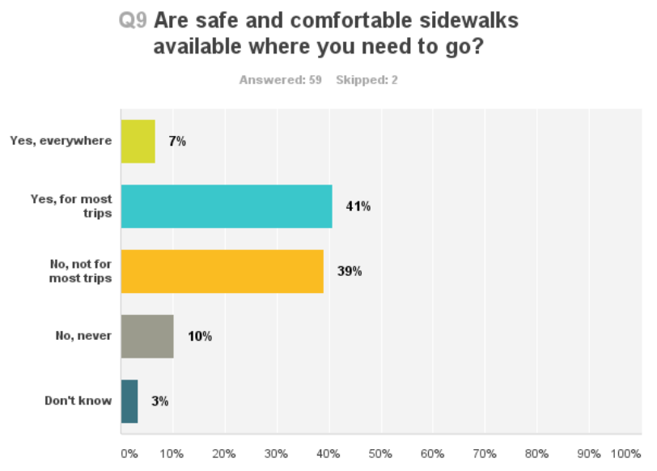
Age Friendly Plan
What are the top three LEAST age-friendly aspects of Lake Cowichan?
Housing
Transportation (transit, rides)
Infrastructure & Built Environment (roads, sidewalks, trails, signage, parks buildings)

Slide 8





Engagement by the numbers
344
70
29
20
20
Visits to
Story Maps Page
Survey Responses
Social Media Shares
(from 4 posts)
Sounding Board Participants
Comments at
1st Open House

Slide 9
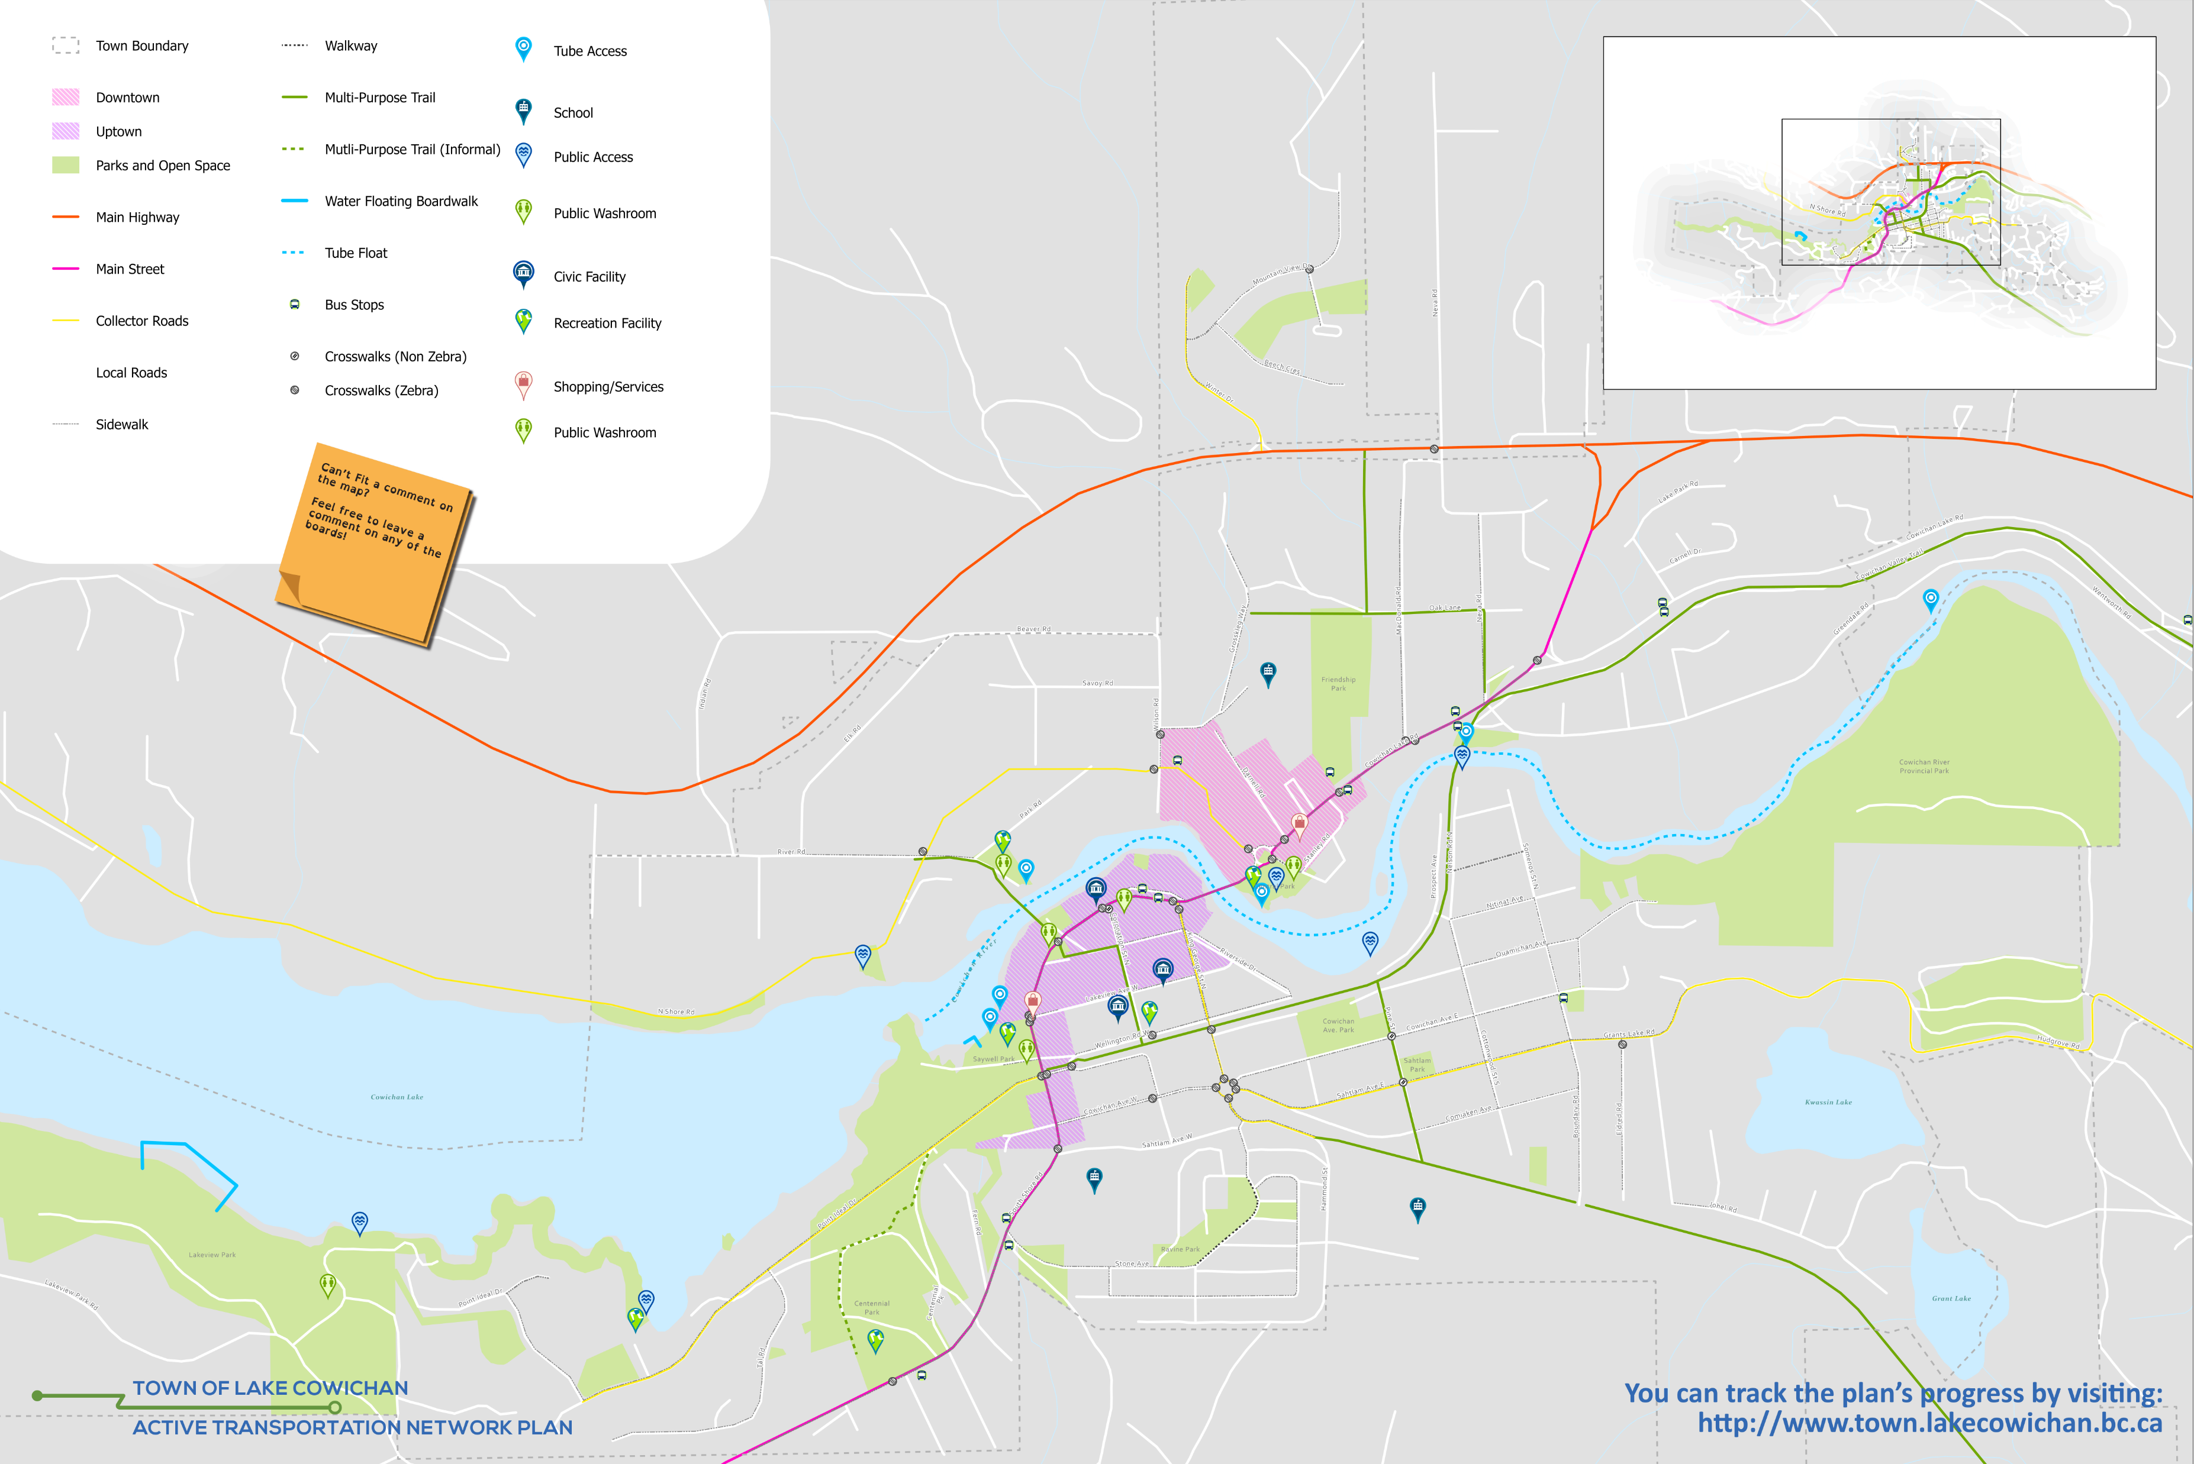
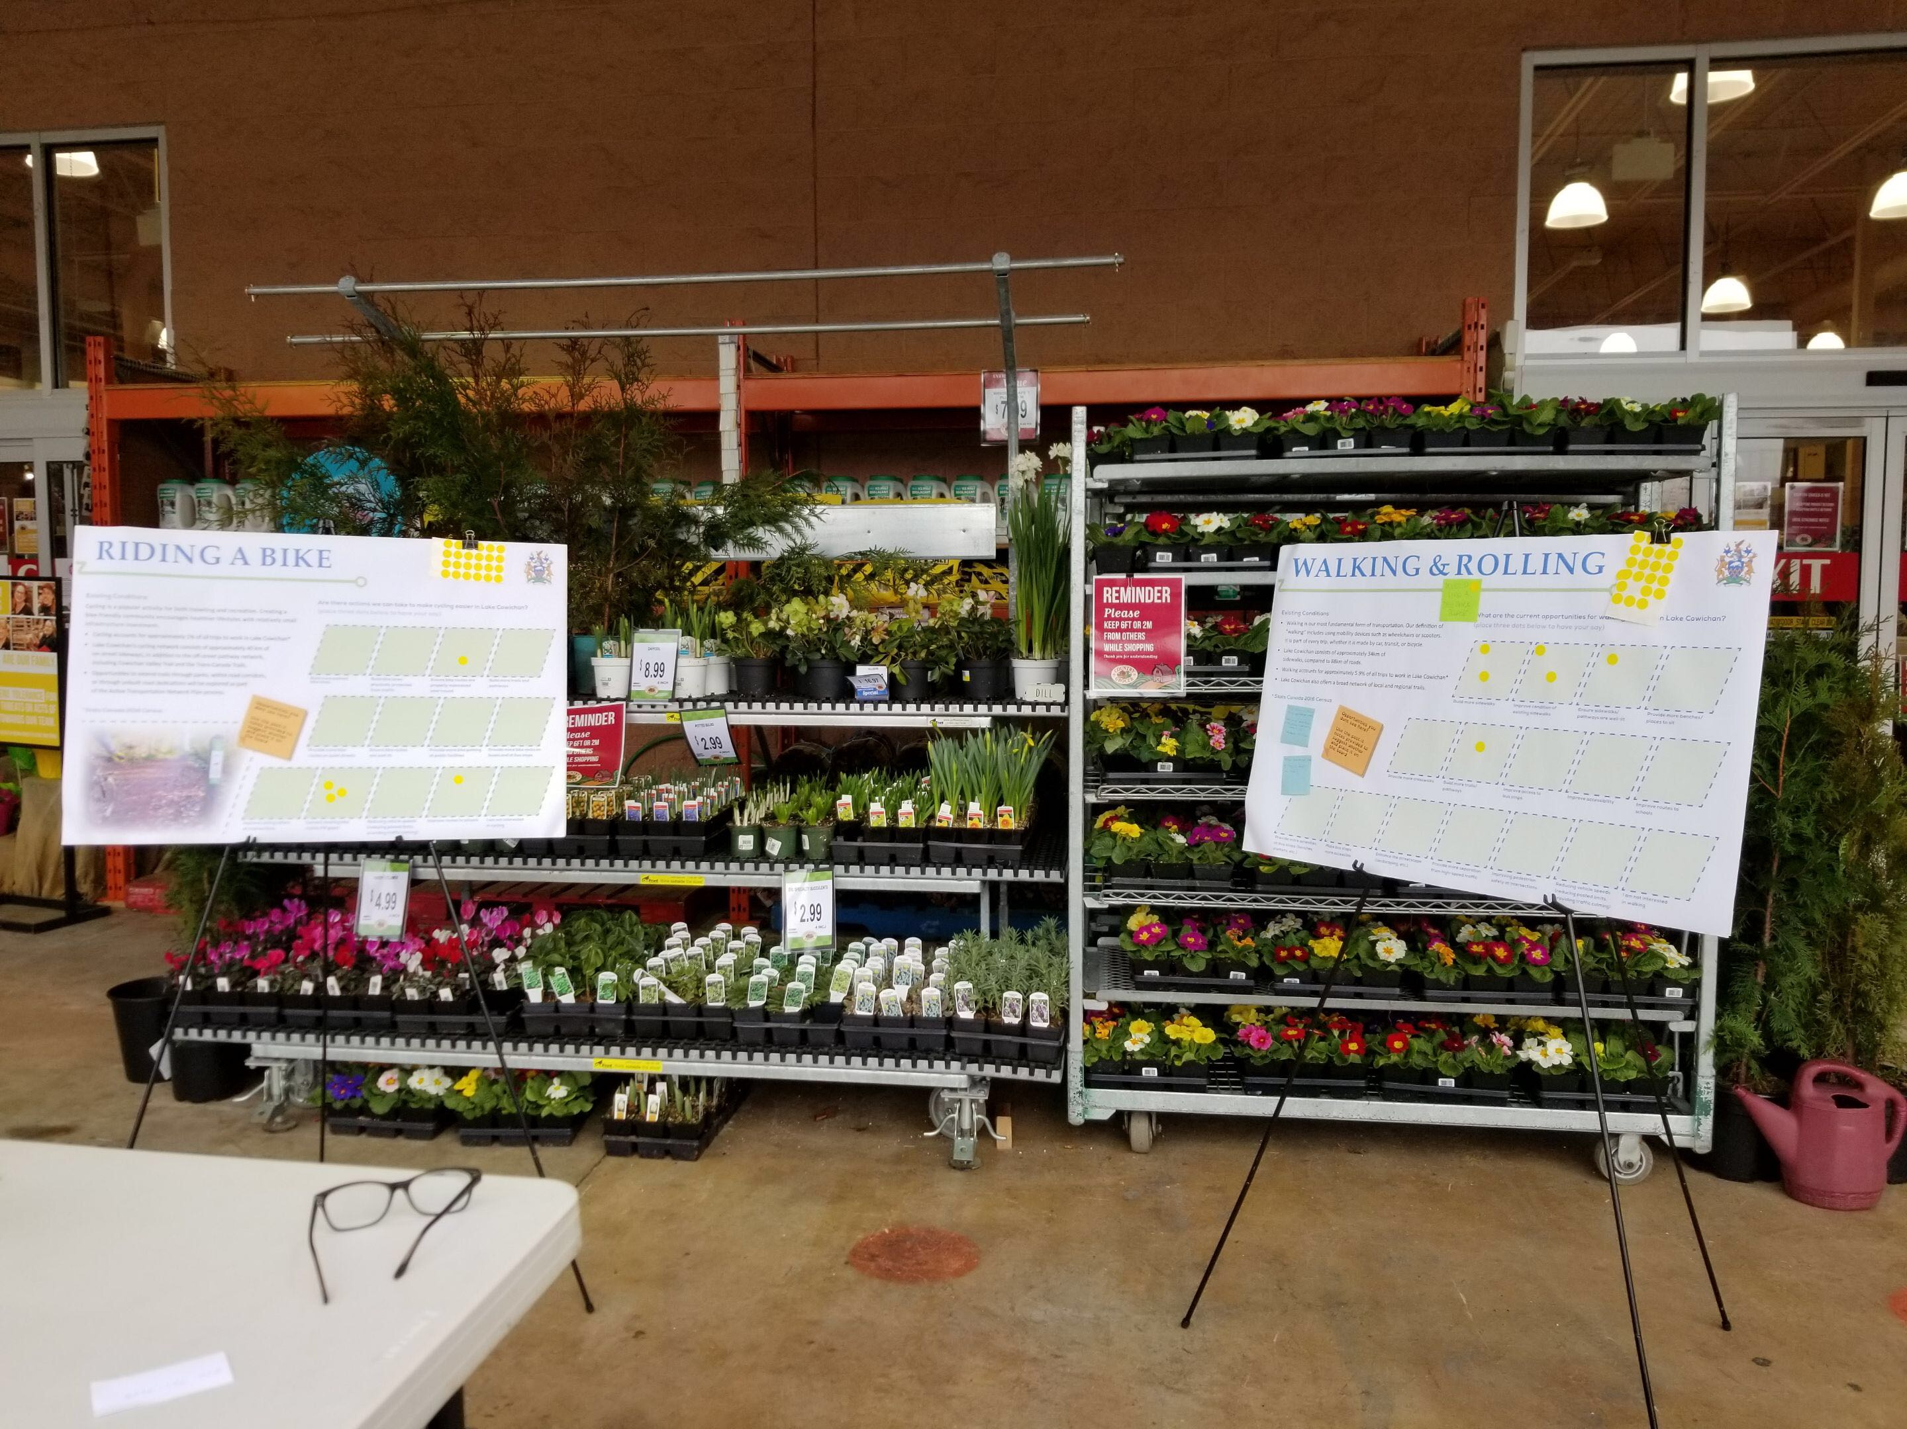
ENGAGEMENT Activites

Slide 10
Survey Results
Who We Have Heard From…

Slide 11
Survey Results
“Why Do You Walk?”

Slide 12
Survey Results
“What are the Barriers to Walking More Often?”

Slide 13
Survey Results
“Why Do You Bike?”

Slide 14
Survey Results
“I think Lake Cowichan could easily become a destination for cyclists. I believe we should be renting bikes to visitors, and generally making the town friendly to cyclists.” - Survey Respondent
“What Are the main Challenges for Cycling?”

Slide 15
Survey Results
“Our sidewalks need huge attention.” - Survey Respondent
“IF YOU WERE ABLE TO DIRECT INVESTMENTS INTO ACTIVE TRANSPORTATION What SPECIFIC ACTIONS WOULD YOU TARGET?”

Slide 16
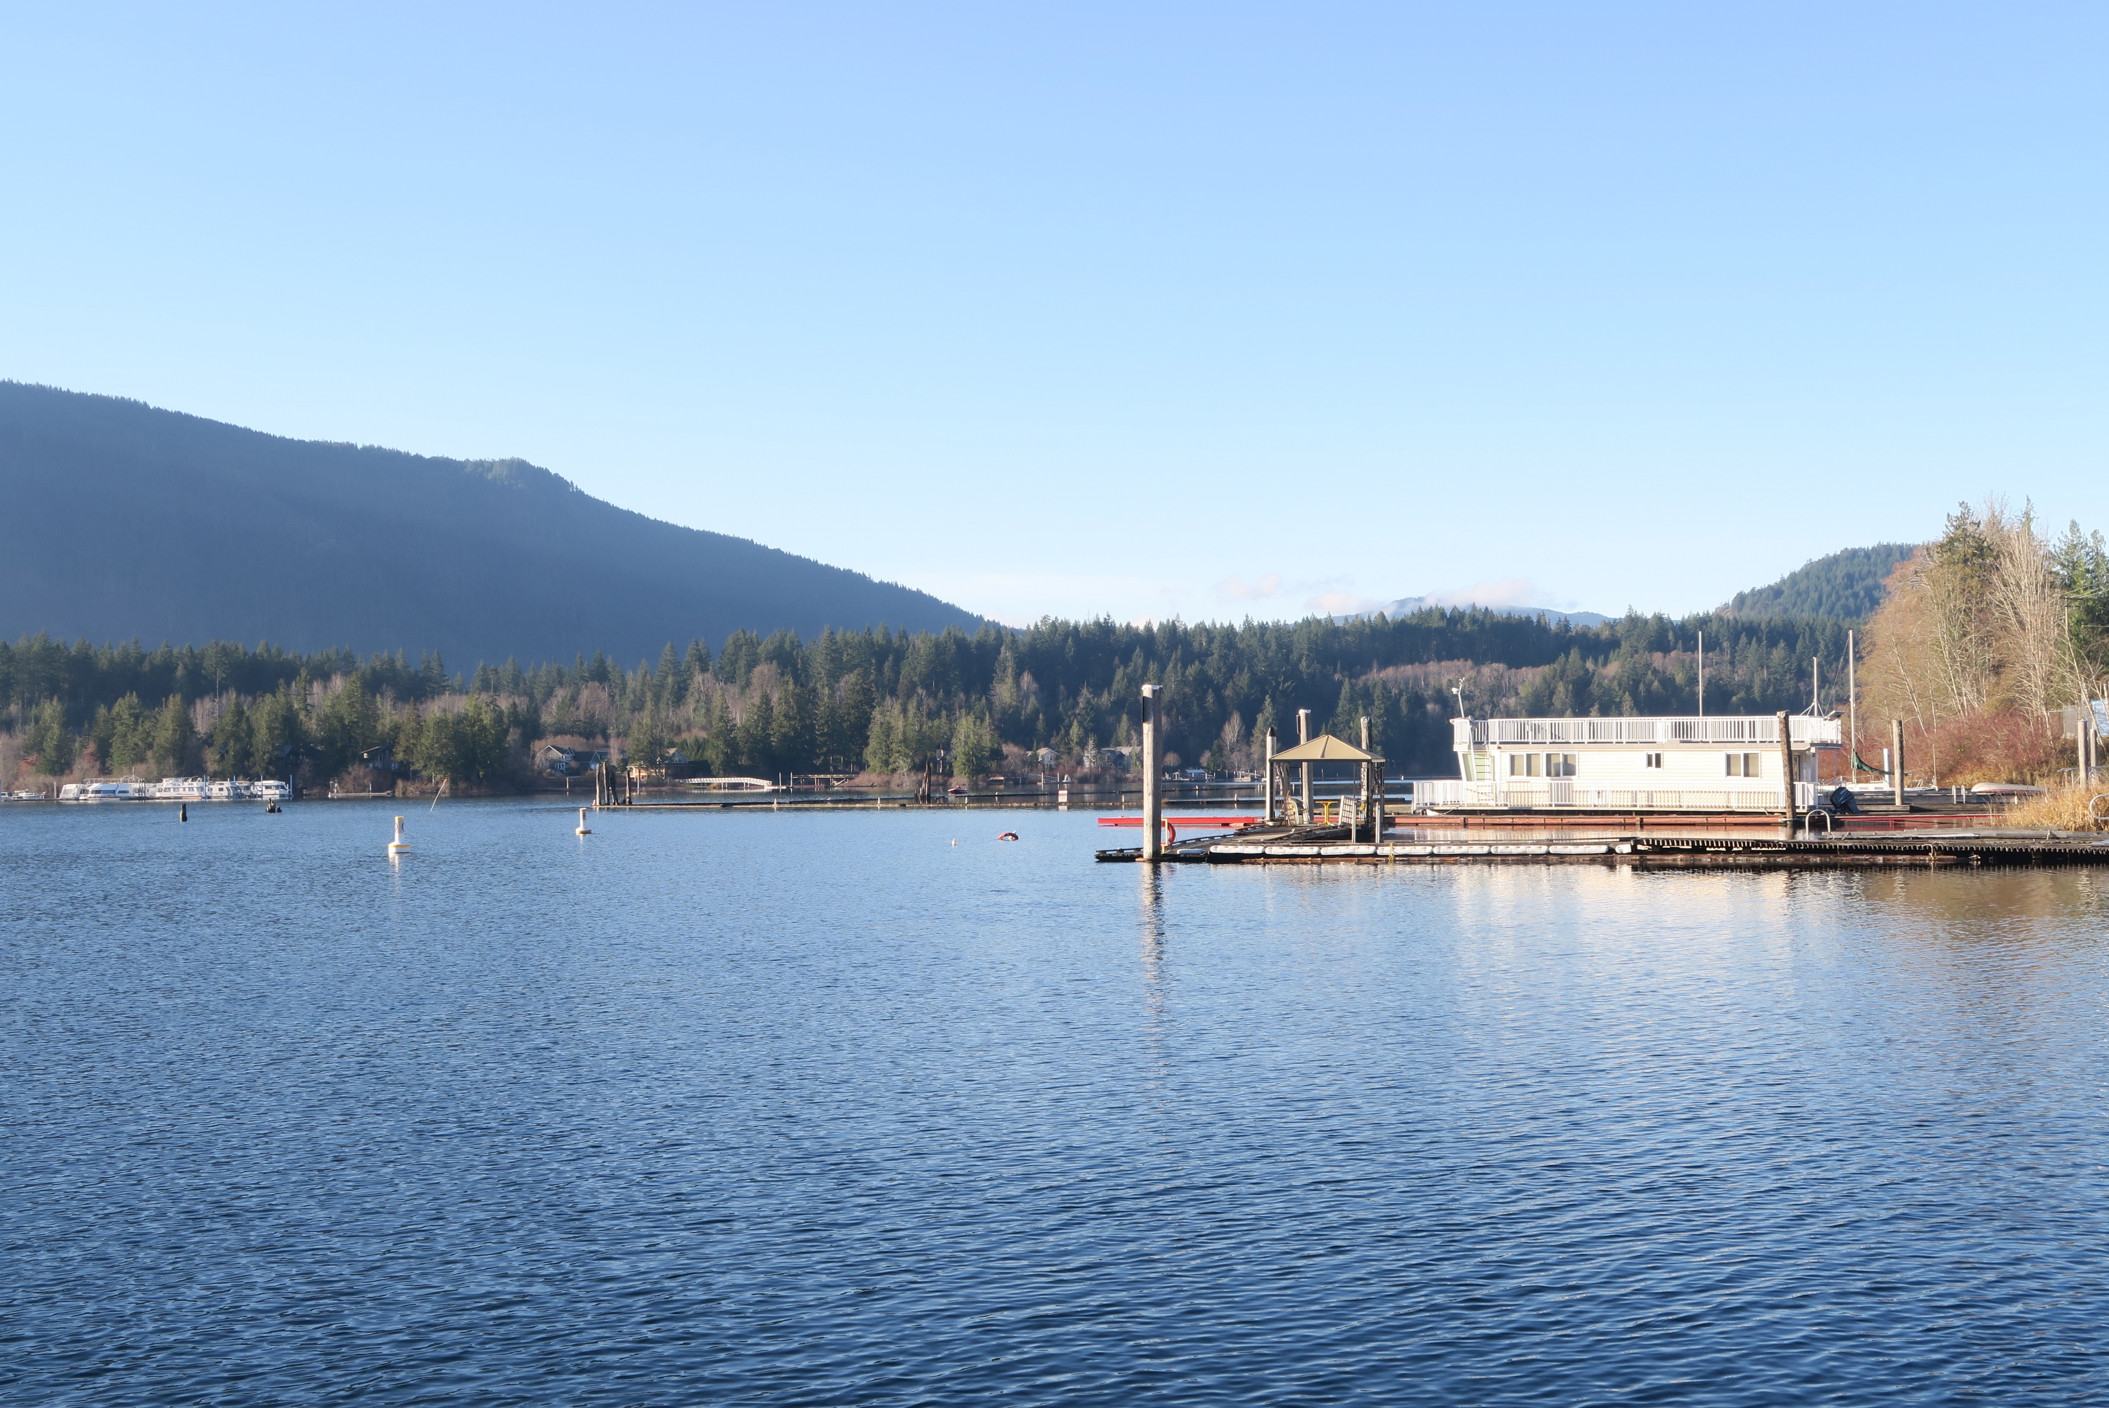
Vision statement (WORKING)
Lake Cowichan is home to a connected network of high-quality active transportation facilities that enable people of all ages and abilities to walk and bicycle safely and comfortably throughout the community.

Slide 17
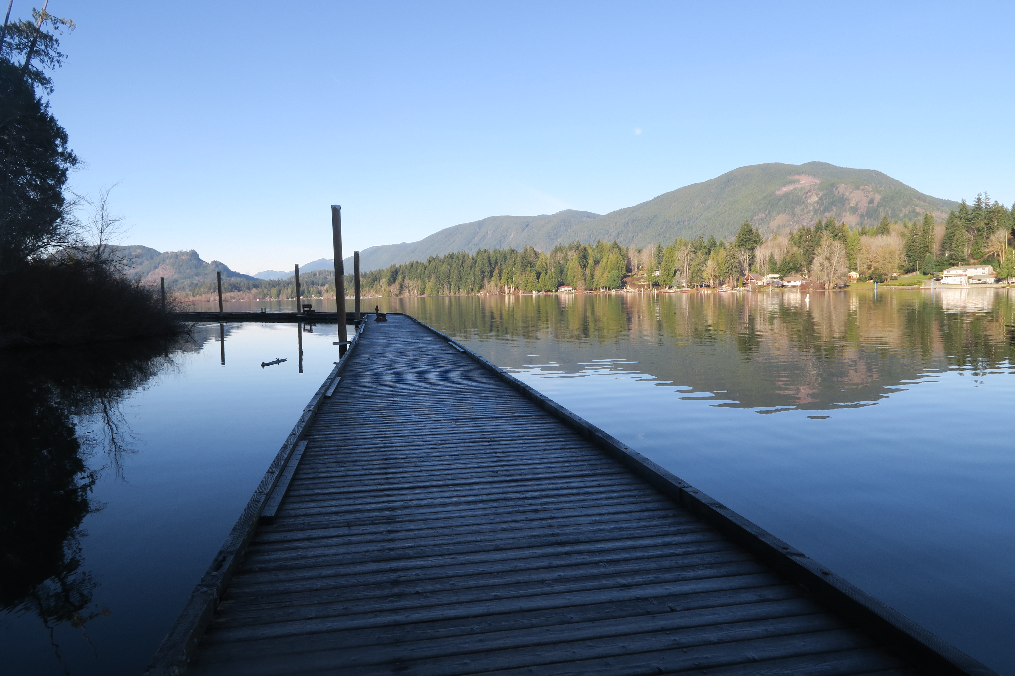
Principles
Principles to guide network planning + design
7 Principles of Universal Design:
1. Equitable Use
2. Flexibility in Use
3. Simple + Intuitive Use
4. Perceptible Information
5. Tolerance for Error
6. Low Physical Effort
7. Size and Space for Approach + Use
Comfortable + Enjoyable
Connected
All Ages + Abilities
Supports Local Economy
Safe

Slide 18
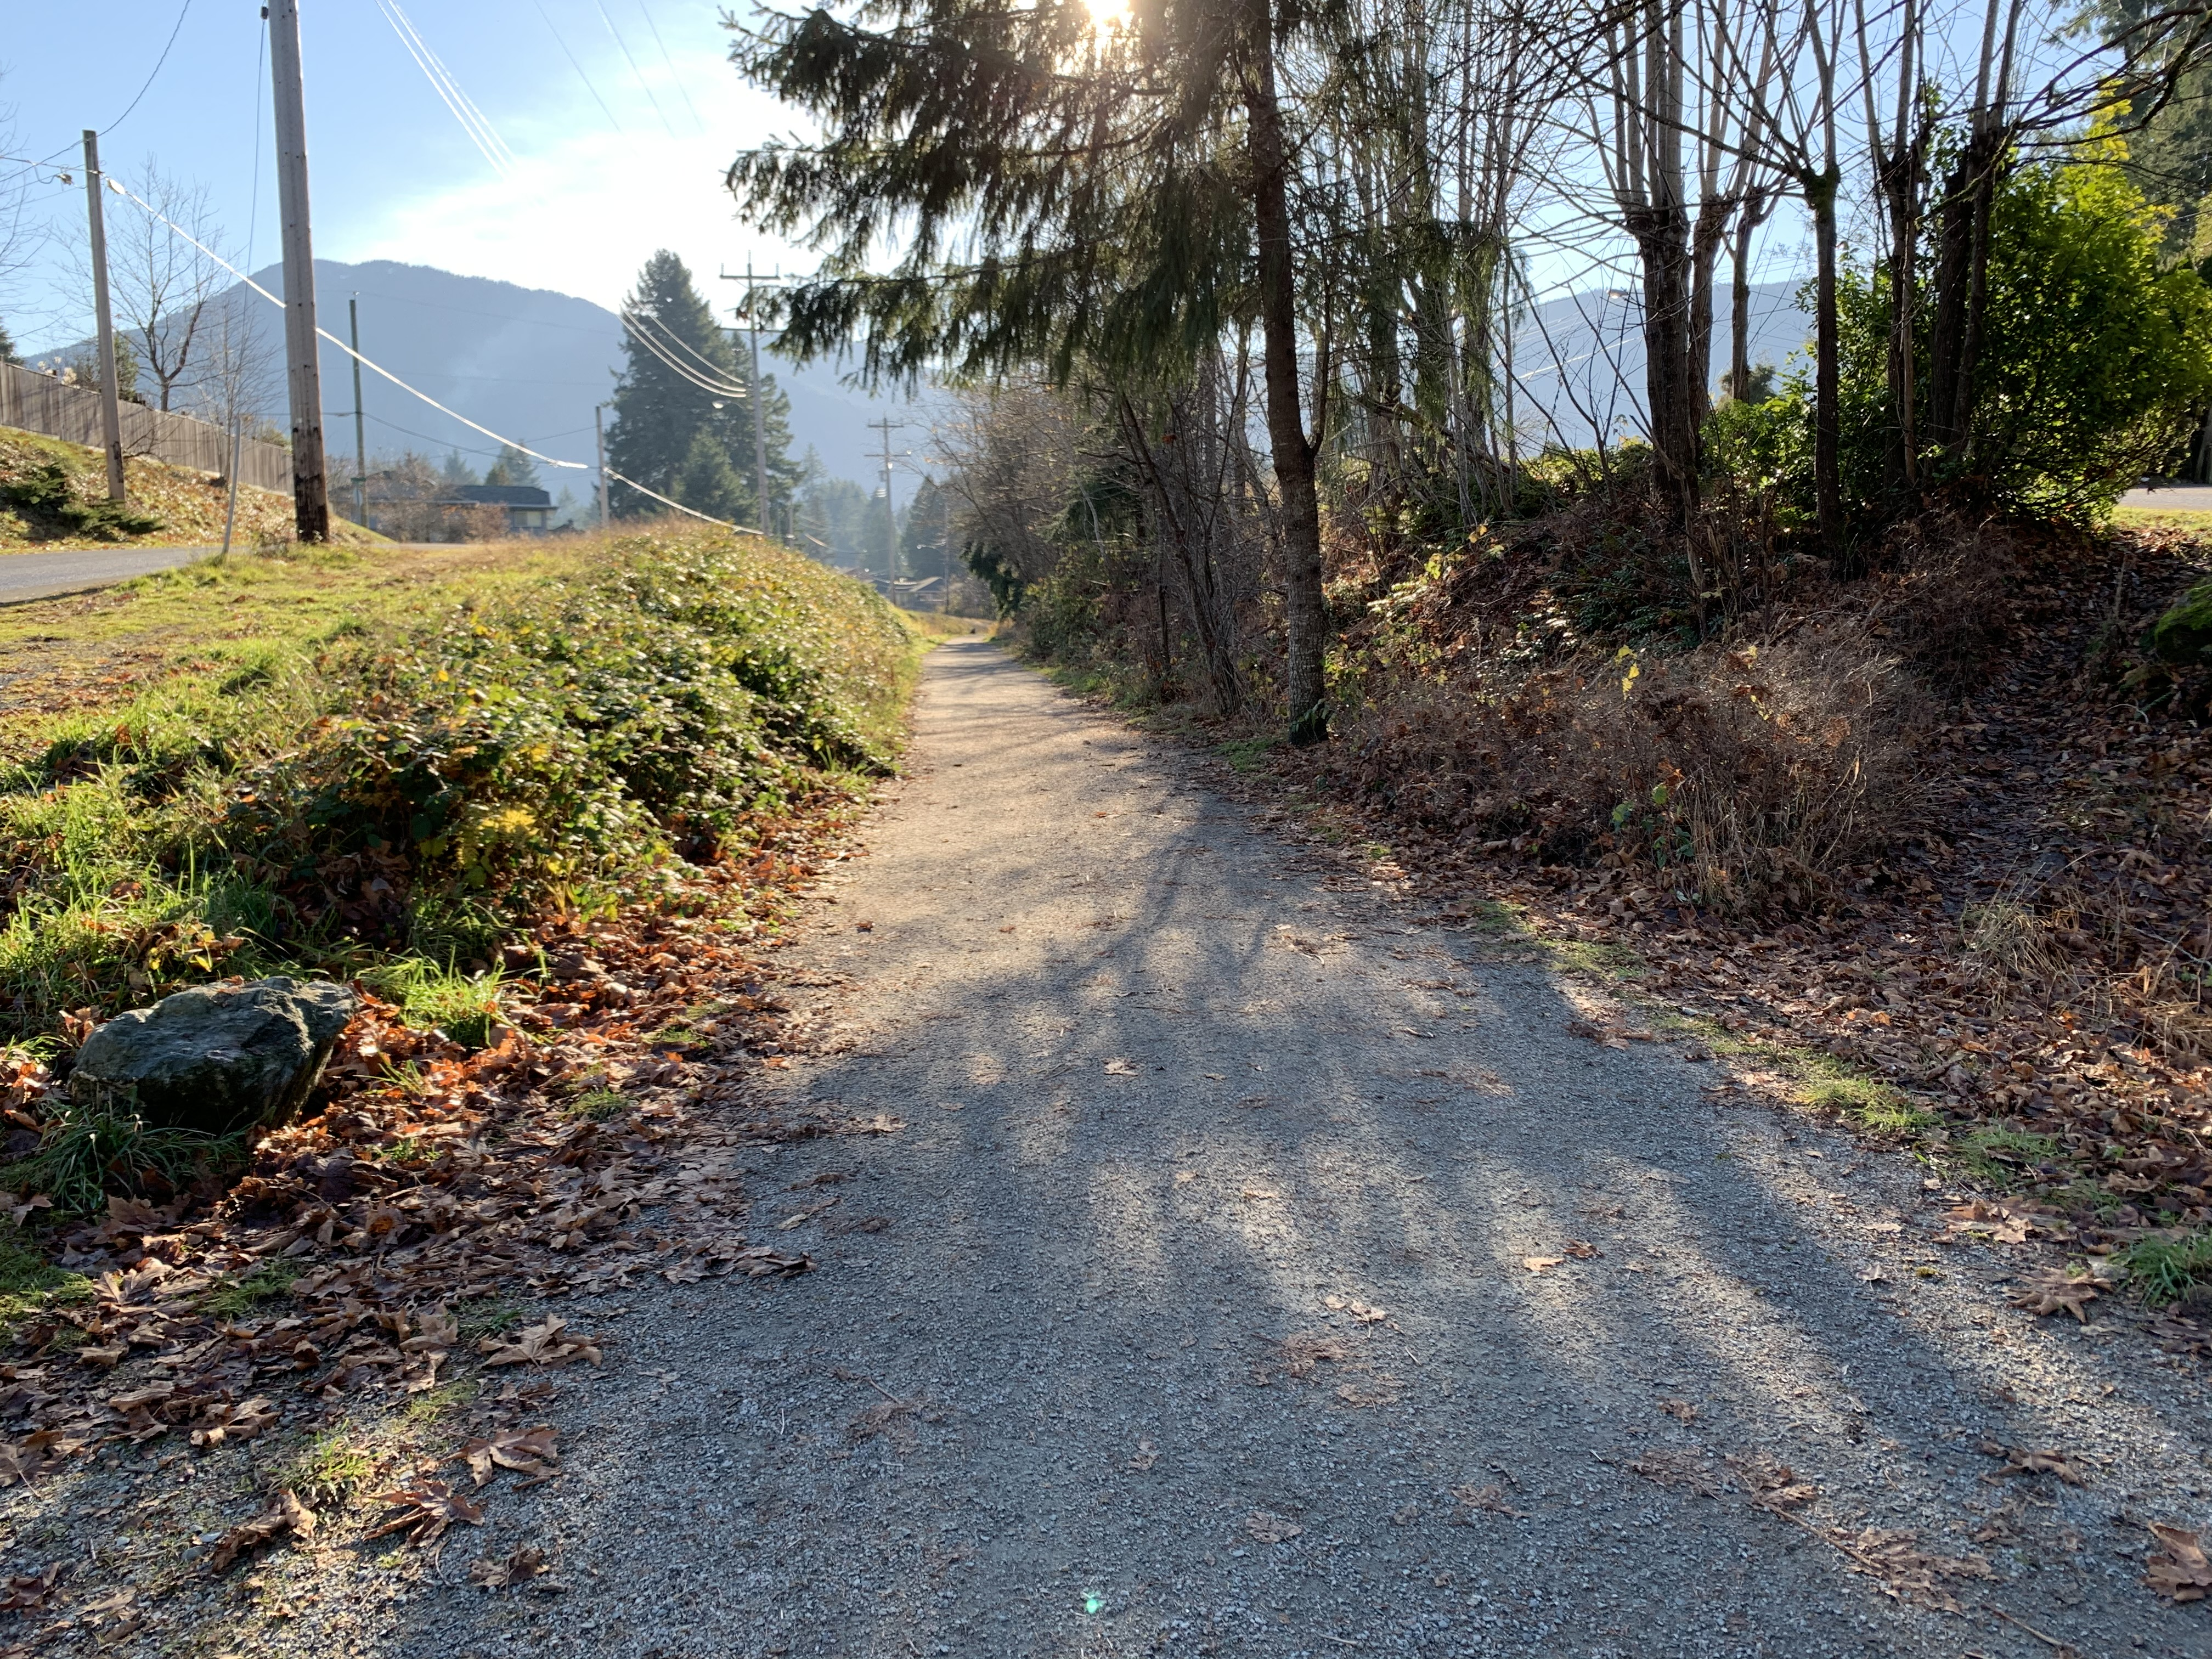
Goals
More Walking + Cycling Trips
More + Better Active Transportation Facilities
No Barriers to Personal Mobility
Everyone with Access to Recreation + Nature

Slide 19
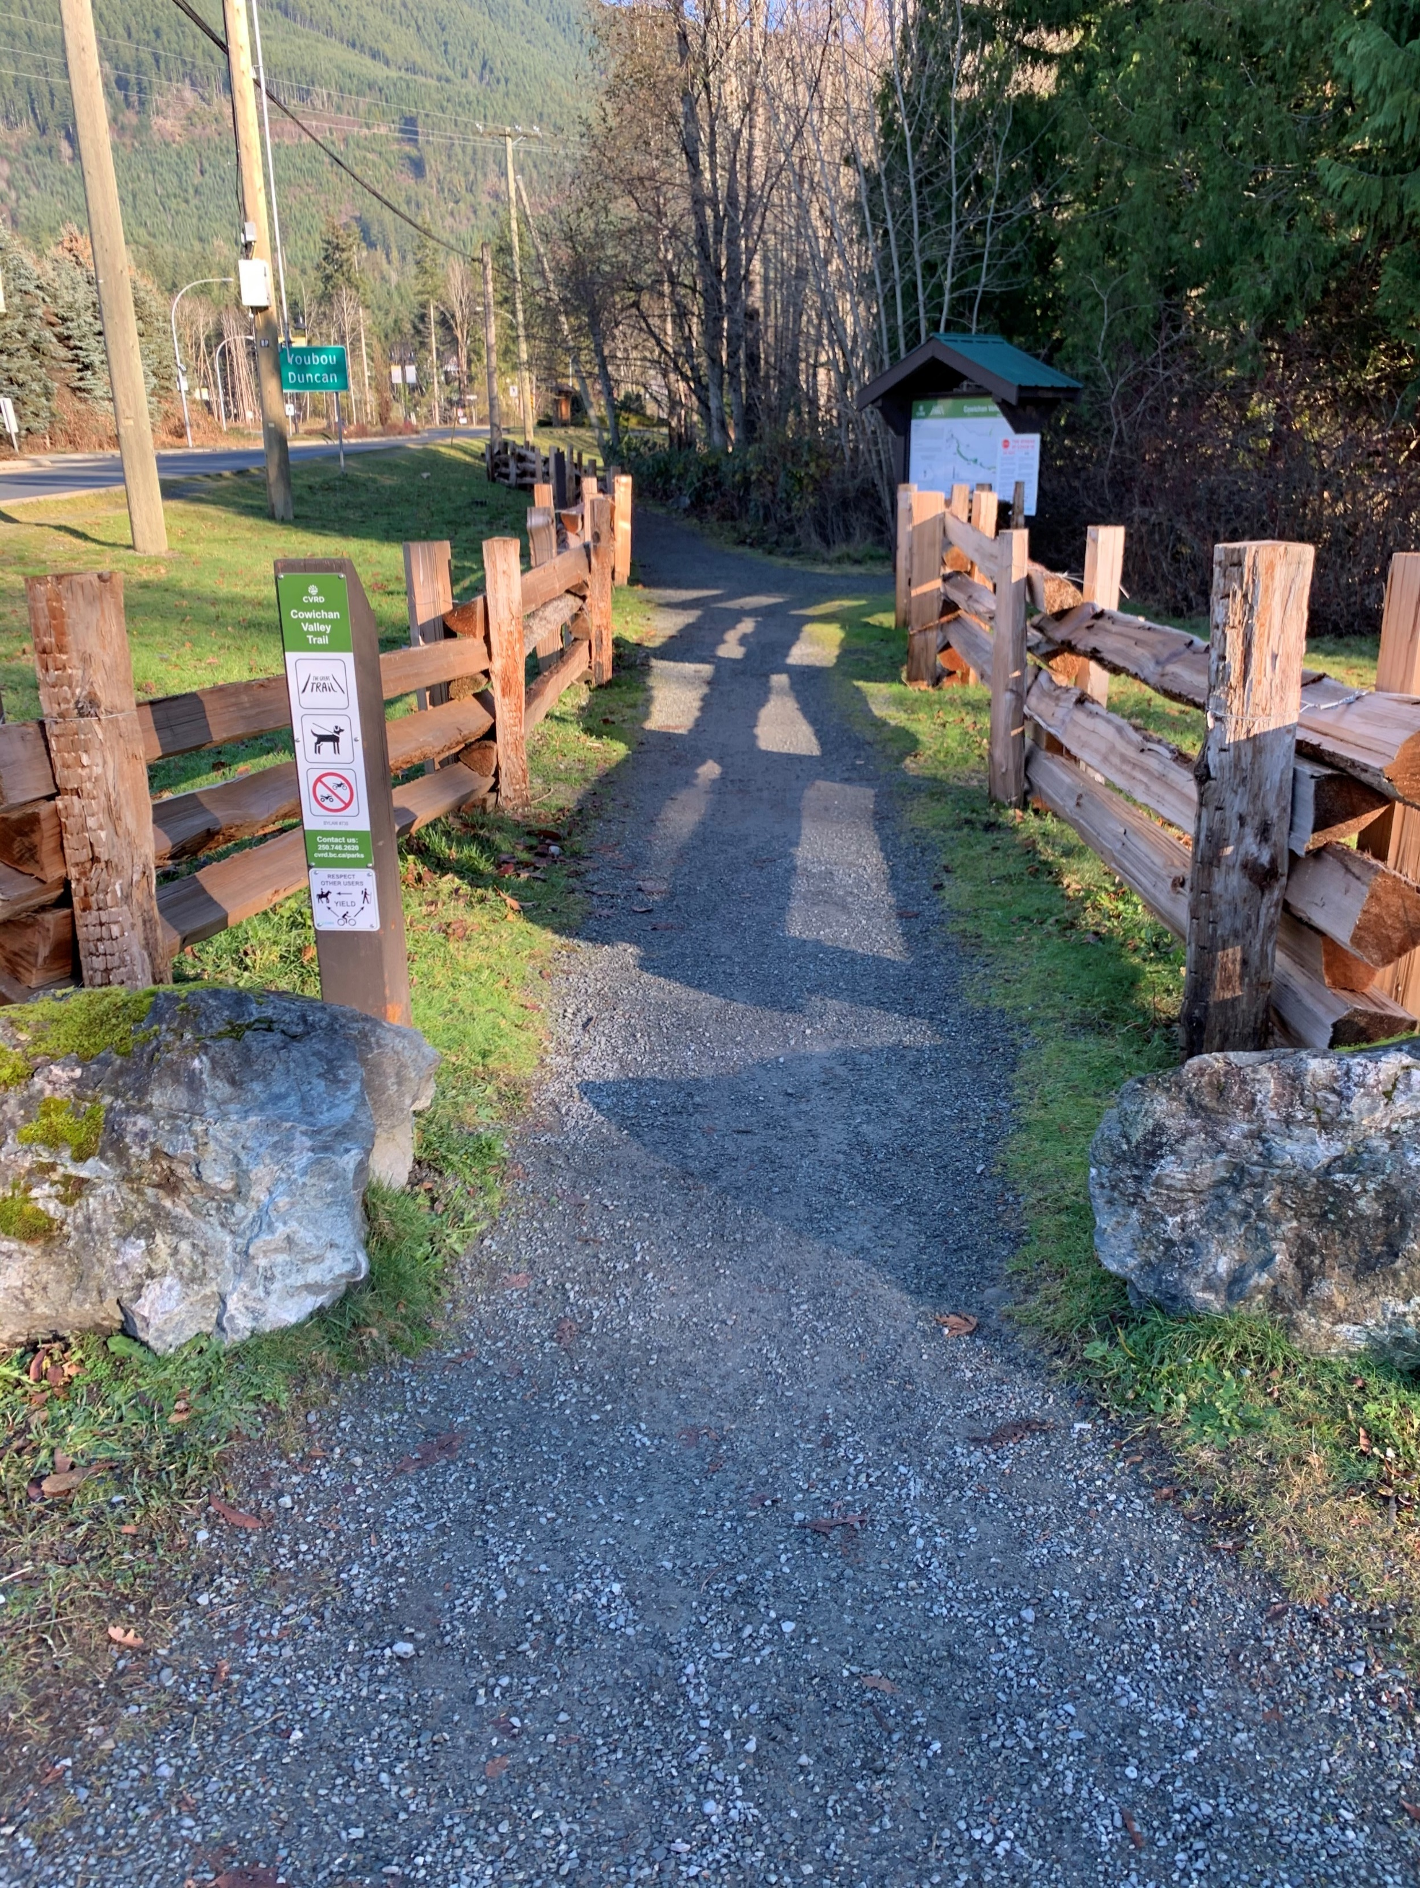
Final ATNP
Overview
Intro, How to Use This Plan?
Shaping Influences
History, Community Trends, Travel Behaviour
Plan Framework
Vison, Principles, Goals
Long-Term Network
Network Plans, Facility Design, Support Facilities
Actions + Implementation
Action Plan, Priority Projects, Partnerships + Funding

Slide 20
next steps

Slide 21
