Slide 1


Sanitary Sewer Capacity Assessment
Town of Lake Cowichan
May 2022
Project: 1525-091

Slide 2
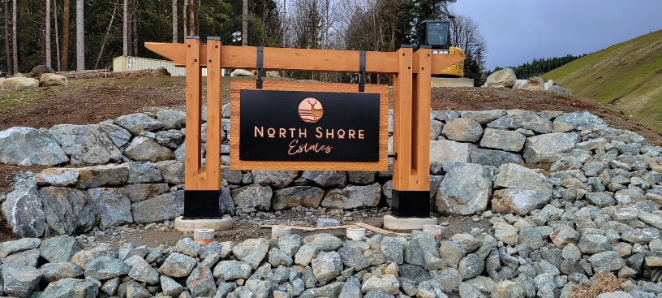
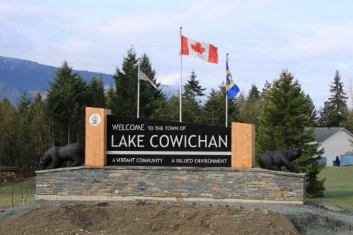
Introduction
Overview:
Ts’uubaa-asatx First Nation (in partnership with the Town of Lake Cowichan)
Retained TRUE Consulting to review the Town’s sanitary sewer conveyance and treatment system.
Goal:
Understand system deficiencies causing the Town to implement a moratorium on development permit application approvals.

Slide 3
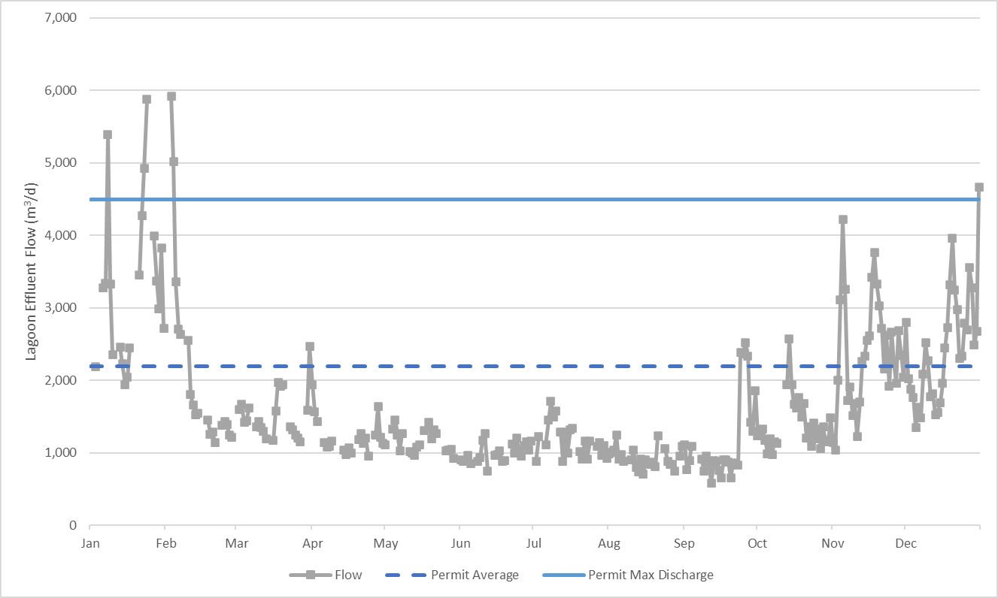
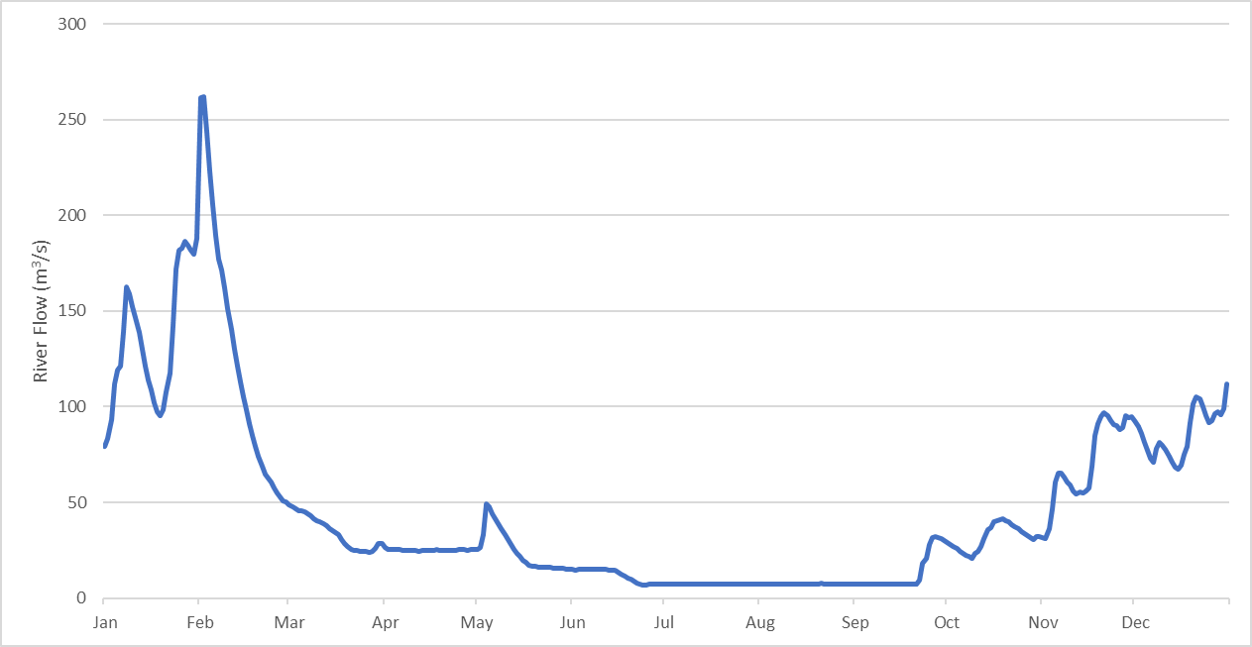
Sanitary Sewer System
Background Information
  The Town’s authorized Rate of discharge:
    Average: 2,200 m³/day
    Maximum: 4,500 m³/day
Average flows between April – September: 1,100 m³/day
Peak flows observed during wet months vs. summer when tourists and more residents are in Town.
Peak flow exceeded limit of 4,500 m³/day in 2020 during the winter.
Direct correlation between increased flows and rainfall.
Lagoon Effluent Flow (2020)
Cowichan River Flow (2020)

Slide 4
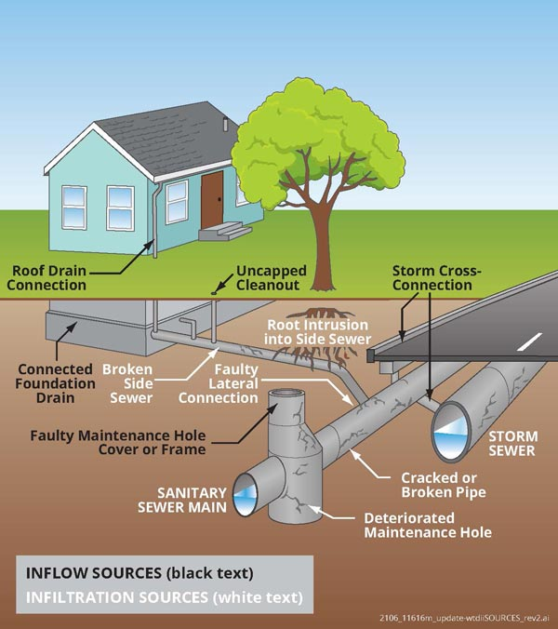
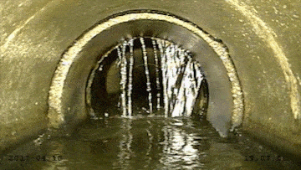
Sanitary Collection System
Inflow and Infiltration
Definition:
Inflow and Infiltration: Excess water that flow into the sewer pipes from groundwater and storm water.
  Infiltration :
  Groundwater seeps into sewer pipes through holes, cracks, joint failures and faulty connections.
  Inflow:
  Water flow into sewers via roof drain downspouts, foundation drains, storm drain cross-connections, and through holes in manhole covers.
Source: Kingcounty.gov.
Source: sehinc.com

Slide 5
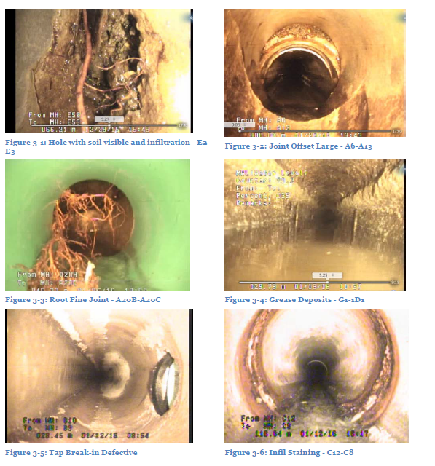
Sanitary Collection System
Inflow and Infiltration
Collection system constructed in the 1970’s.
Comprised of AC and PVC pipe.
Useful life AC pipe is 50 years.
CCTV condition assessment completed in 2016 showing key areas of deterioration.
Cracked and punctured pipes and leaking manholes are causing rainwater and groundwater to flow into the sanitary collection system.
Photo from Opus 20016 CCTV Report

Slide 6
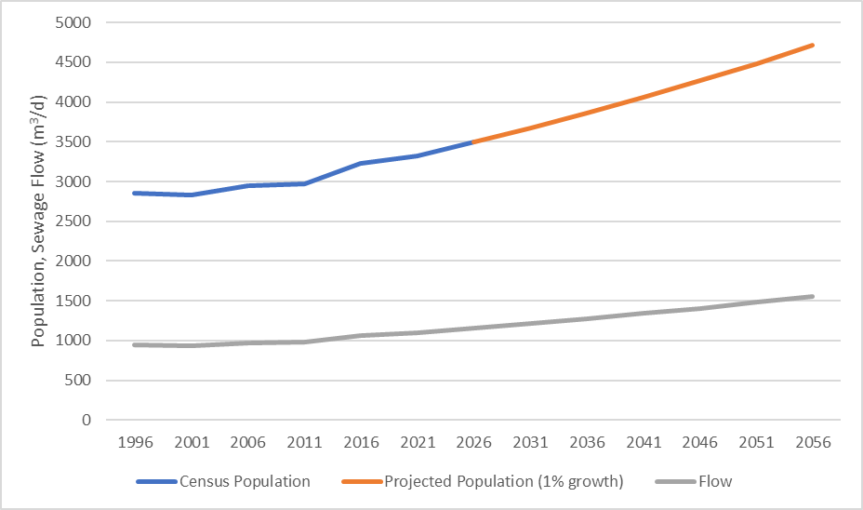
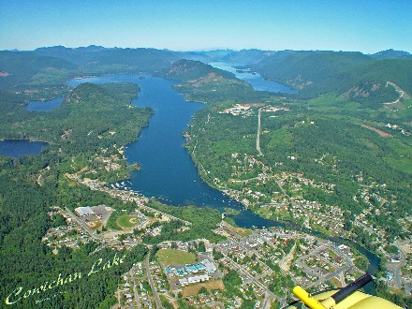
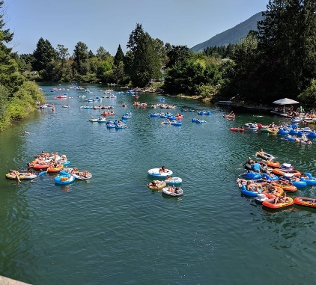
Sanitary Sewer System
Population Projection
Summer sewer flow: 1,100 m³/day
2021 per capita flow approx. 330 L/capita/day
1% population growth rate for 20 years would increase summer sewer flow to 1,500 m³/day.
Well within permit limits.
Projected Population
Census Population
Existing and Projected Flow (Less I&I)
Population Trend vs. Sewage Flows (Less I&I)

Slide 7
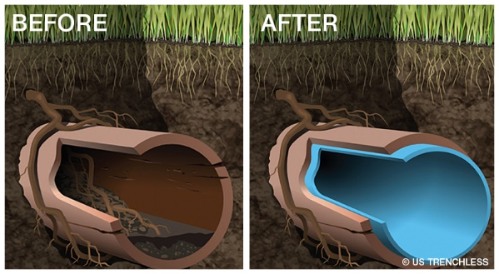
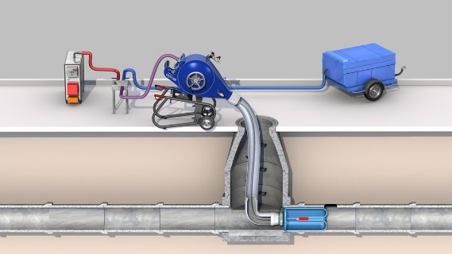
Sanitary Collection System
Condition Assessment
17% of pipes condition 3 or greater in 2016.
These segments require more intensive maintenance:
  Root cutting
  Grouting
  Trenchless point repairs
  External point repairs
  Pipe Lining
  Pipe Replacement
Source: Crafton Tull
Source: Trelleborg
Diameter (mm) | Total Length Inspected (m) | MH to MH Segments | Custom Pipe Rating
 |  |  | 5 | 4 | 3 | 2 | 1
150 | 228 | 5 | 0 | 0 | 0 | 0 | 5
200 | 14119 | 196 | 5 | 6 | 20 | 36 | 129
250 | 1512 | 19 | 0 | 0 | 6 | 5 | 8
Total | 15859 | 220 | 5 | 6 | 26 | 41 | 142
 |  |  | 2% | 3% | 12% | 19% | 64%
From Opus 20016 CCTV Report

Slide 8
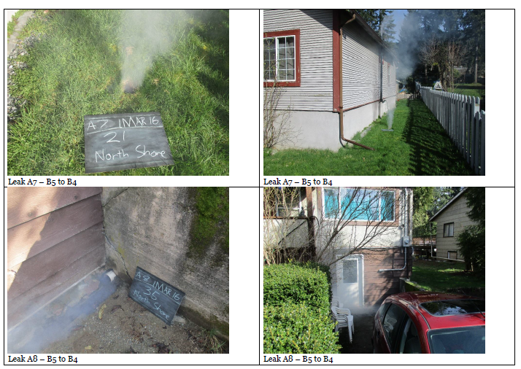
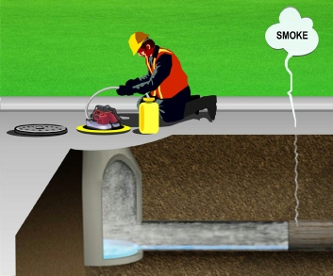
Sanitary Collection System
Prioritization for Pipe Repair and Replacement
Prioritization Catchments for I&I Repairs
Catchment | I&I (L/ha/d) | I&I Repair Length (m) | Unit Rate I&I (L/m/d) | Rank | # Sections of Repair | 2016 Cost | 2022 Cost
S24* | 140,000 | 527** | 265.7 | 1 | 0 | $ - | $ -
F1 | 46,500 | 183 | 254.1 | 2 | 2 | $ 13,200 | $ 26,400
B4 | 17,800 | 139.6 | 127.5 | 3 | 2 | $ 40,800 | $ 81,600
C7 | 16,500 | 137.2 | 120.3 | 4 | 1 | $ 4,200 | $ 8,400
2E1 | 78,000 | 828.4 | 94.2 | 5 | 10 | $ 67,900 | $ 135,800
2A1 | 11,700 | 136.5 | 85.7 | 6 | 2 | $ 12,000 | $ 24,000
E34 | 8,000 | 204.6 | 39.1 | 7 | 2 | $ 8,400 | $ 26,800
A20*** | 0 | 221.9 | 0 | - | 3 | $ 43,700 | $ 87,400
E49 | 159,000 | 0 | 0 | - | 0 | $ - | $ -
D12 | 46,000 | 0 | 0 | - | 0 | $ - | $ -
A6 | 3,000 | 0 | 0 | - | 0 | $ - | $ -
D4 | 46,000 | 0 | 0 | - | 0 | $ - | $ -
Totals |  |  |  |  |  | $ 190,200 | $ 380,400
Source: OpusDaytonKnight
Prioritized Structural and Operational Repairs
Rating | # Sections of Repair | Length of Sections to Repair | 2016 Cost | 2022 Cost
5 | 0 | 0 | $ - | $ -
4 | 1 | 44 | $ 13,500 | $ 27,000
3 | 9 | 738.6 | $ 84,200 | $ 168,400
2 | 5 | 321.4 | $ 3,700 | $ 7,400
1 | 0 | 0 | $ - | $ -
Totals |  |  | $ 101,400 | $ 202,800
Source: Global Sewer Technologies

Slide 9
Sanitary Collection System
2022 Lift Station Condition Assessment
Lift Station | Replacement/Upgrade Costs
LS#1: Central Park Central park on the edge of Cowichan River. Built in the 1970’s. Only lift station on the North side of Cowichan River, which is seeing a lot of new development. Upgrades within the last ten years include installation of a generator. Elevation raised, so flood water does not enter the chamber. | $1,500,000
LS#2: Johel Road Small system built in the mid-1990s. Good condition. Require installation of a generator system. | $300,000
LS#3: Nelson Road Located near the edge of Cowichan River. Small system built in the 1970s. Does not have a generator. No significant upgrades have occurred at this location and the system should be replaced soon. | $800,000
LS#4: Pine Street Main lift station in Lake Cowichan. All sanitary systems are pumped through this station to the sewer lagoons. Built in the 1970’s. Some pump upgrades at this station. Eelectrical all requires replacement in the near term and the whole lift station requires a major retrofit or replacement. | $2,500,000
 | $5,100,000

Slide 10
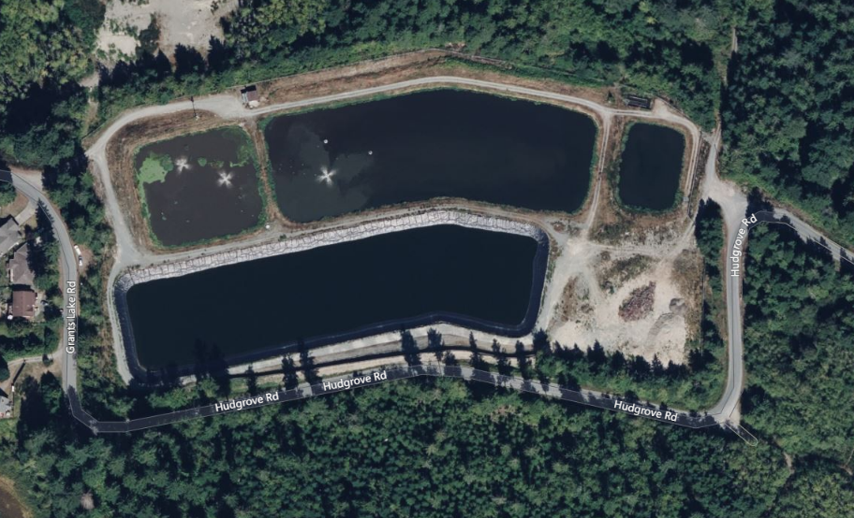
Sanitary Treatment System
Current Condition
Cell 1: partial mix aerated lagoon
  Surface aerators
  Newer technology available – submerged fine bubble aerators
    Energy efficiency
    Reduced odor
Cell 2: facultative/polishing lagoon
Cell 3: not connected
  Sludge from Cell 1 transferred to Cell 3.
  Desludging prior to use.
Hydraulic retention time for this type of system is 30 days.
  Summer: 26 days
  Winter: 1 day
Cell 2 – Facultative Lagoon
Cell 1 – Aerated Lagoon
Dechlorination
Cell 3 – Unused

Slide 11
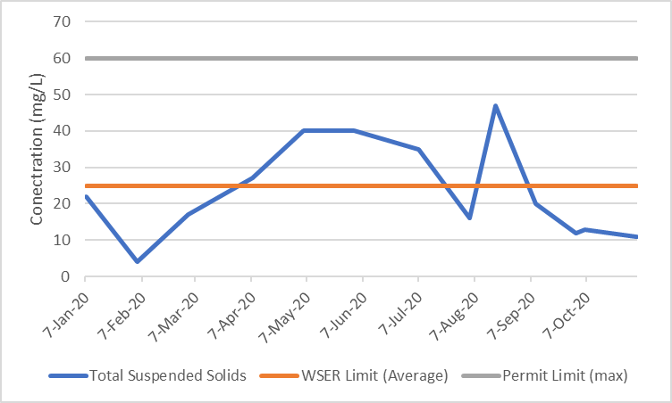
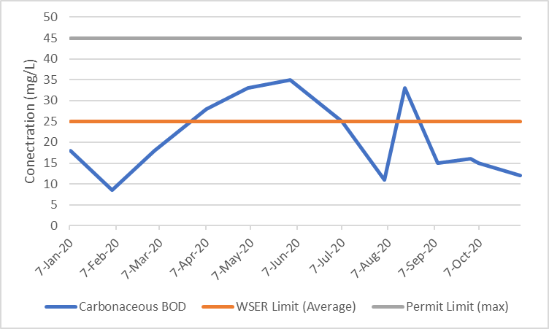
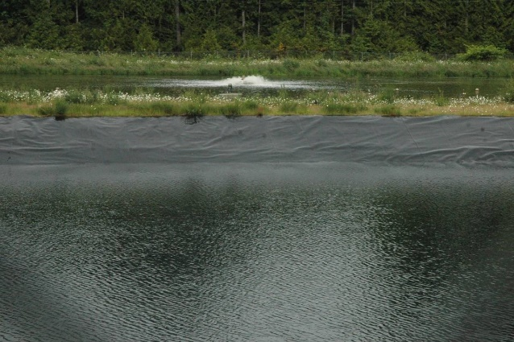
Sanitary Treatment System
Discharge Quality
Wastewater treatment process meeting target effluent quality for cBOD and TSS.
Total Chlorine limit compliance unknown.
Permit updates and increased treatment requirements will likely be updated with system upgrades.
Town can operate within permitted discharge flows if I&I is managed.
Effluent Total Suspended Solids
Permit Limit
Effluent cBOD
Permit Limit

Slide 12
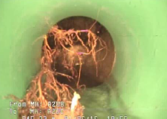
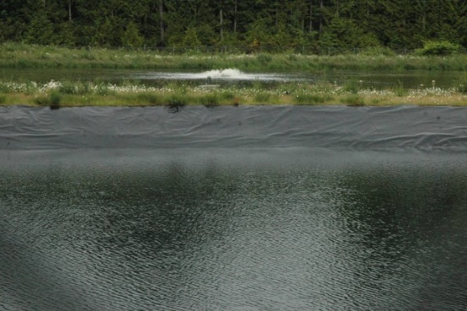
Summary
Town currently meeting Permit discharge requirements except for flow.
  (Note: De-chlorination concentration unknown)
Sewer flows peak during winter months.
Previous studies have prioritized repair and replacement work.
Proposed treatment facility upgrade capacity can be reduced within I&I reduction.
DCCs fund specific, identified, infrastructure projects that support development and are normally set to recover the true cost of a development to the municipality.
Much higher DCCs would be appropriate and would not be expected to have an impact on the choice to develop in the Town of Lake Cowichan.

Slide 13

Questions

